Slide 1
Water Quality Protection Measures for Agriculture
Authors:
Dee Carlson, Natural Resources Conservation Service
Sue Donaldson, University of Nevada
Ronda Hirnyck, University of Idaho
Jane Thomas, Washington State University
This slide set was funded by USDA NIFA through
the Western Integrated Pest Management Center
January, 2013
by mtsvancouver
Notes:
This module is designed to teach pesticide applicators about the ways in which pesticides can move into water after they are applied, about the soil and pesticide properties that influence the movement of pesticides, and how pesticide applicators can use best management practices to protect water resources. The slide set was funded by the USDA NIFA through the Western Integrated Pest Management Center. We would appreciate input from you on your use of these slides. Please send input to Carla Thomas, Associate Director, Western IPM Center, cthomas@ucdavis.edu or wripmc.org

Slide 2
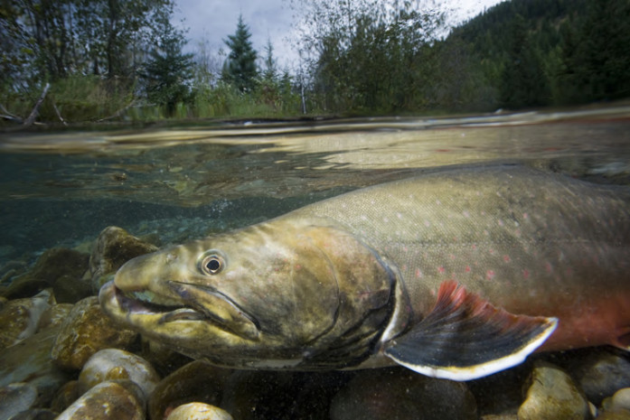

Water Quality Protection Measures for Agriculture
by mtsvancouver
Photo courtesy of Joel Sartore, National Geographic
Notes:
How Can Pesticide Users Protect Water?
This module is designed to teach pesticide applicators about the ways in which pesticides can move into water after they are applied, about the soil and pesticide properties that influence the movement of pesticides, and how pesticide applicators can use best management practices to protect water resources. The slide set was funded by the USDA NIFA through the Western Integrated Pest Management Center. We would appreciate input from you on your use of these slides. Please send input to Carla Thomas, Associate Director, Western IPM Centercthomas@ucdavis.edu or wripmc.org

Slide 3
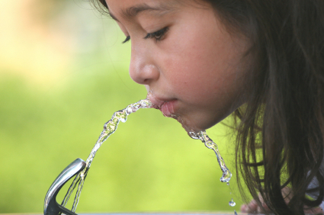
So what’s the big deal?
Notes:
The National Water Quality Assessment conducted in 2006 found that 97% of streams in agricultural watersheds had pesticide detections; 10% exceeded a human health benchmark, and 57% exceeded an aquatic life benchmark. Sixty-one percent of shallow ground water had detections – shallow ground water is the source of domestic water in many western areas. [PRESENTER NOTE: EACH PRESENTER MAY WANT TO ADD LOCAL WATER QUALITY INFORMATION HERE.]

Slide 4
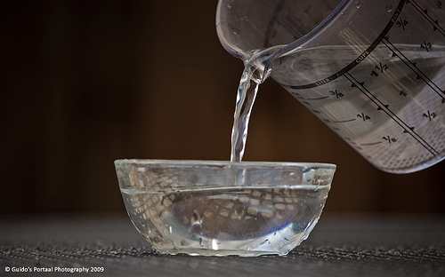

Agricultural pesticide use and good water quality can be compatible.
Notes:
The goal of this presentation is to provide you with a better understanding of how pesticides can end up contaminating urban waters -- but more importantly, what you can do to ensure pesticides have little or no impact on water quality and aquatic ecosystems.

Slide 5
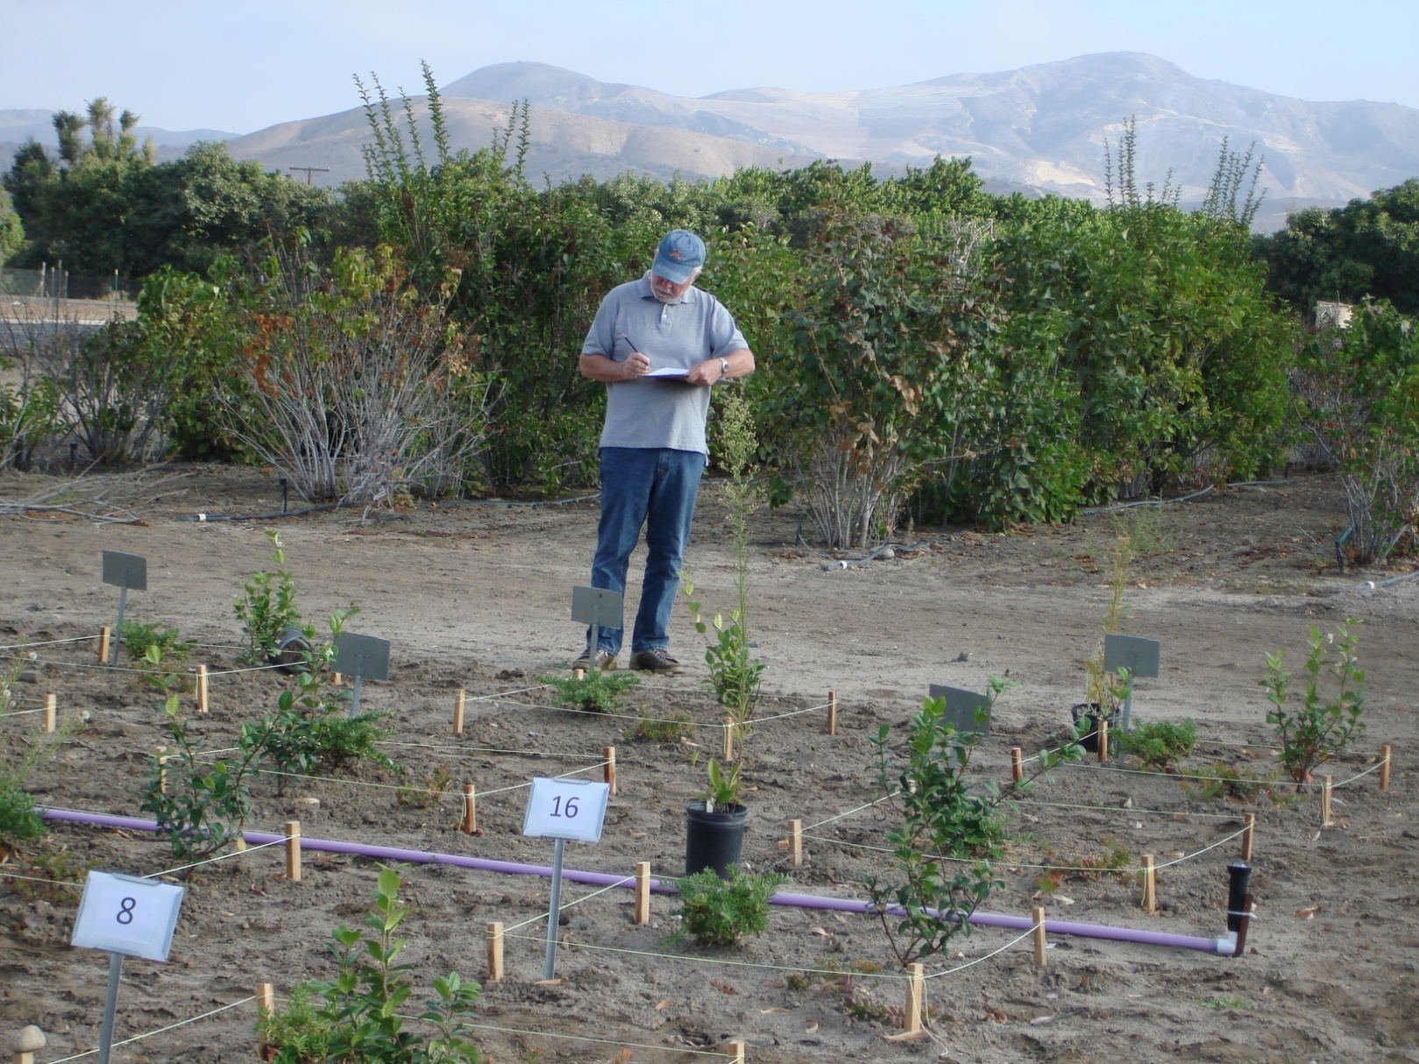
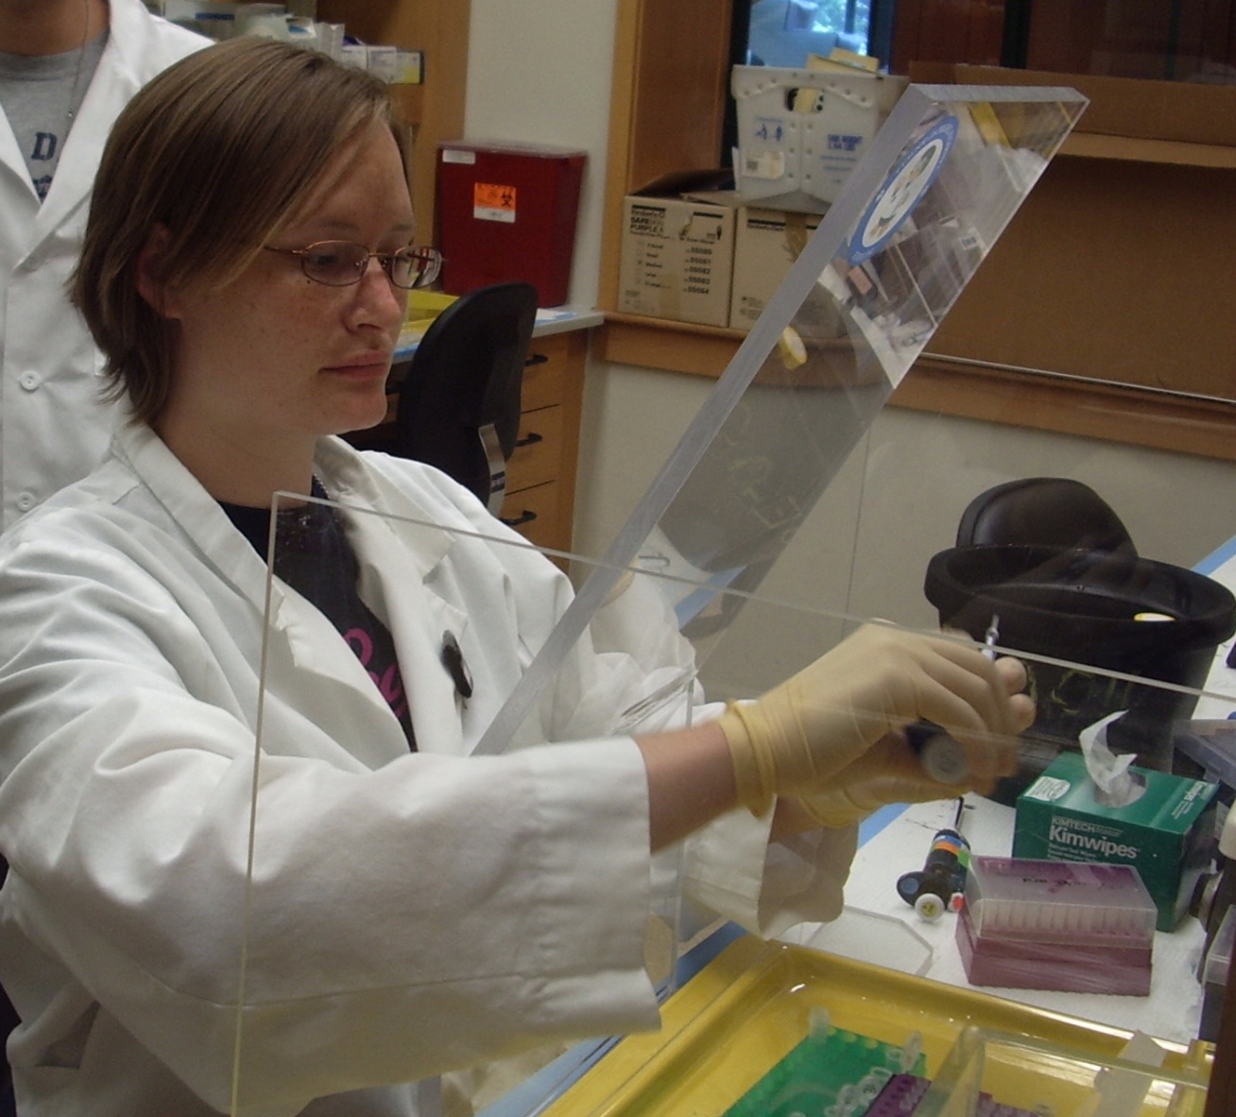
Use IPM and best management practices to protect water.
Notes:
There are several tools available to you to effectively manage pests while still protecting water quality. Integrated Pest Management (IPM), an example of a best management practice, helps you to effectively manage pests while still protecting water quality. This presentation includes 1) a basic explanation of the different ways pesticides can easily enter waterways, 2) information on how soil and pesticides properties and weather impact pesticide movement, and 3) the simple management practices you can implement to lessen the likelihood that the use of a pesticide will impact water quality.

Slide 6

How can pesticides get into water?
Photo courtesy of gmeador

Slide 7
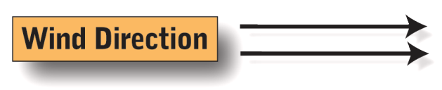
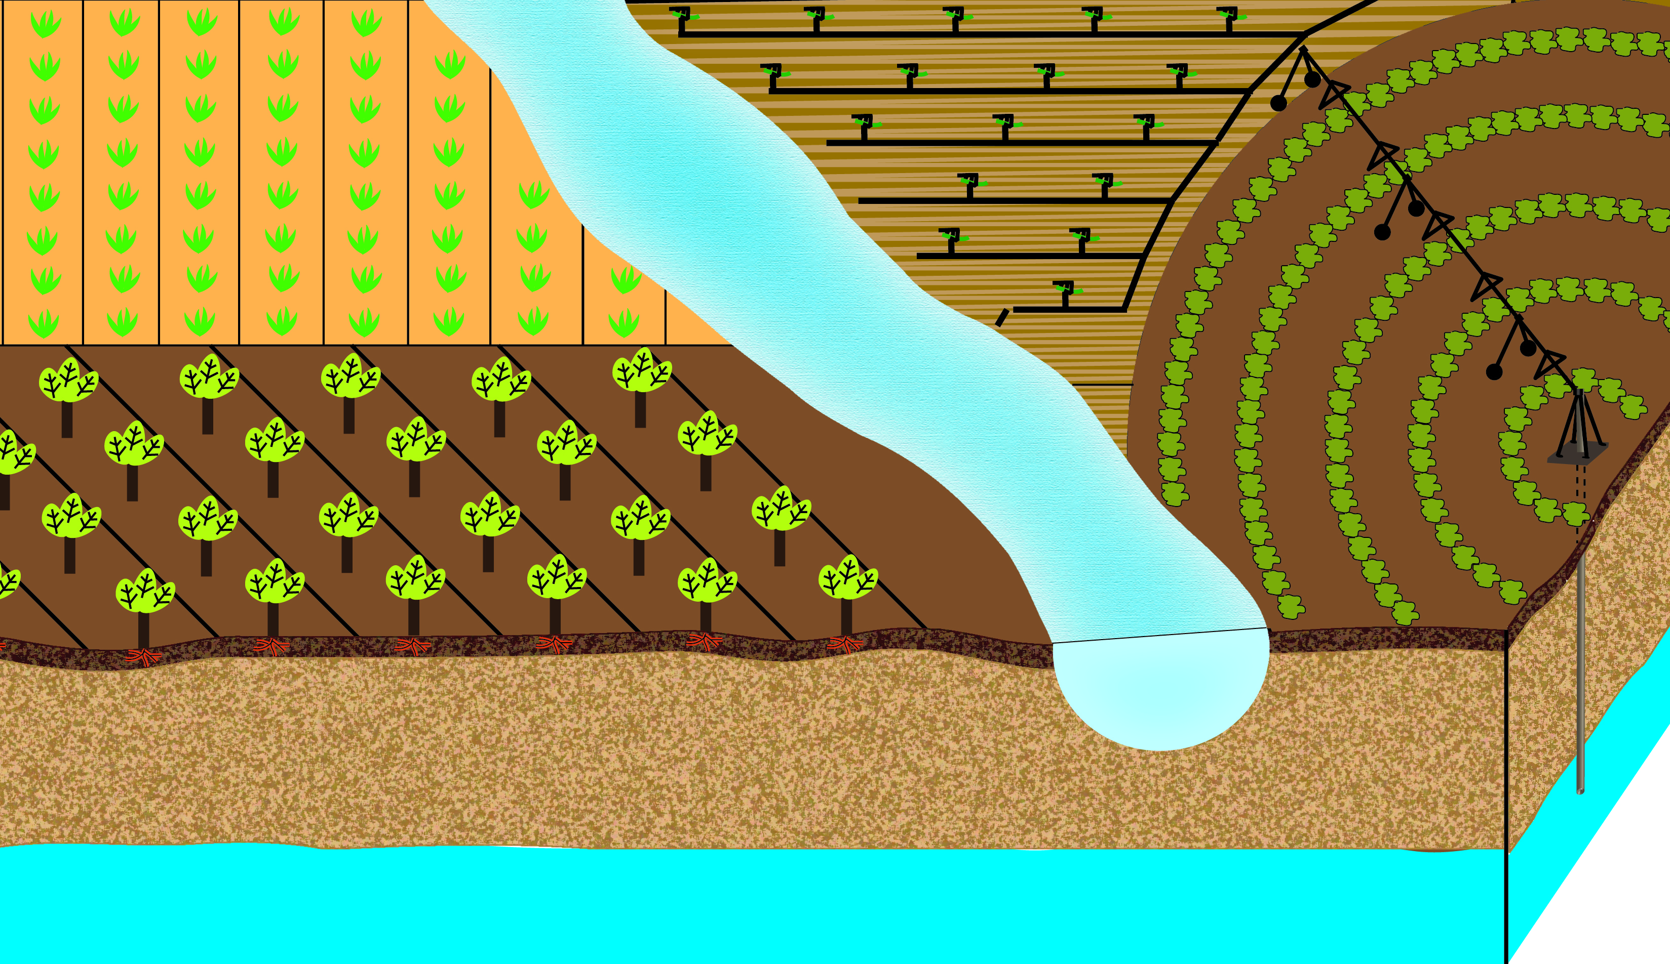
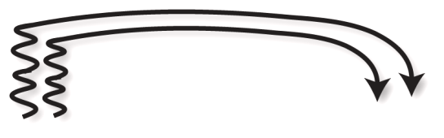
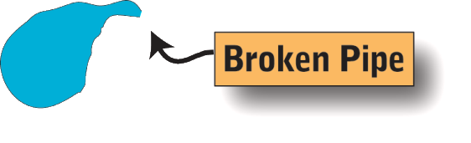
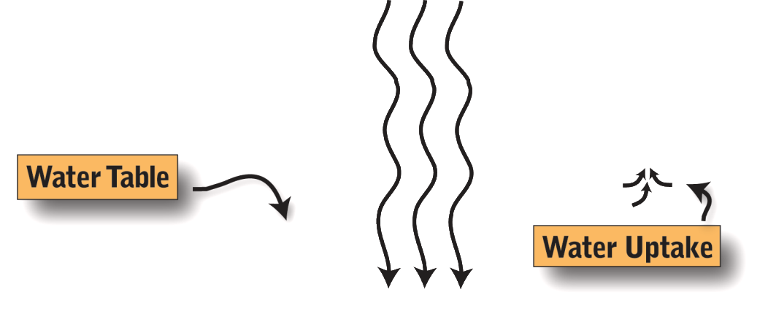
There are several ways that pesticides get into water.
Drifting Dust
Volatilization
Aquatic Applications
Chemigation
Pesticide Drift
Runoff
Leaching
Notes:
Pesticides can enter water in several ways:
Click 1) Pesticides applied to crops can volatilize in certain weather conditions and move off site into nearby surface water. (click 2)
Click 3) Pesticides adsorbed to soil particles can be blown off site into water. (tractor depicted working soil and worked soil being blown off site) (click 4)
Click 5) Pesticide sprays can move off site with wind and be deposited in nearby water. (click 6)
Click 7) Pesticides adsorbed to soil particles can also enter surface water via runoff. Runoff can occur for several reasons: excessive rainfall, snowmelt, or through irrigation problems, as shown here. (click 8)
Click 9) Pesticides can enter groundwater (water table) by moving below the rooting zone. The movement of the pesticide depends on both the properties of the soil and the chemical properties of the pesticide. (Click 10)
(Click 11) Pesticides can also enter water directly. One way is via the wellhead and can happen if back-siphoning occurs during chemigation. Pesticides can also directly enter ground- or surface water when accidents such as spills or leaks occur near wellheads or surface water. (Click 12) Pesticides are also intentionally applied to water resources in order to control invasive species, unwanted aquatic vegetation, or unwanted fish in a managed fishery. Crop fields underlain with tile drains can carry pesticides to surface water, and interflow can contribute pesticides to both surface water and groundwater. [Drain tile may or may not be pertinent to your area.]
Click 13) As you can see from this slide, there are many mechanisms for pesticides to enter ground- and surface water. We are going to discuss each mechanism and then talk about Best Management Practices (BMPs) designed to prevent this type of pesticide movement. This is very important, since there are so many ways that pesticides can enter water.
Pesticides can contaminate water as either point or nonpoint source pollution. A point source is where a pollutant can be traced back to a discrete conveyance. In this schematic the point source examples are: a chemigation backflow contaminating a well, a broken pipe leaking treated water into the river during a chemigation, and the aquatic application. Nonpoint sources are diffuse pollution that does not originate from a specific site. In this schematic the runoff and leaching from treated fields, both drift examples (pesticide and drifting dust), and volatilization are all examples of nonpoint source pollution.

Slide 8
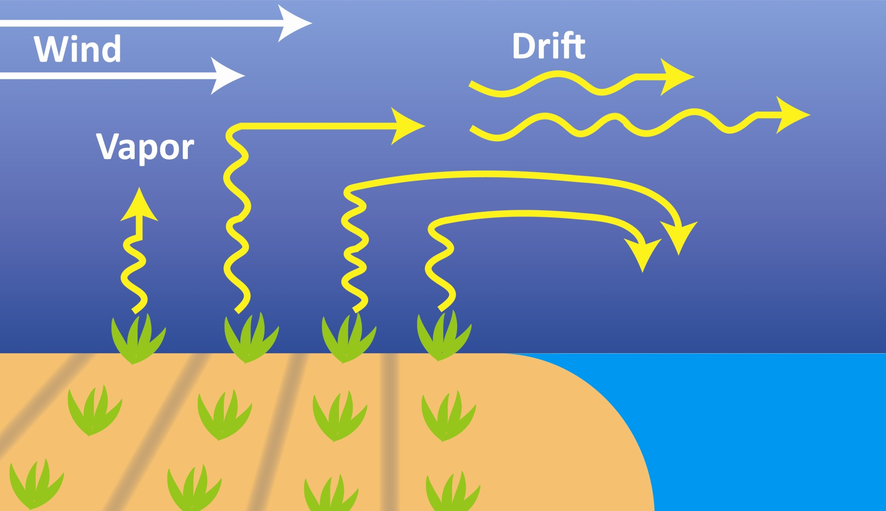
Pesticides can move to water through volatilization or vapor drift.
Wind
Drift
Temperature
Wind
Humidity
Vapor
Higher
Volatility
=
Notes:
One way pesticides can enter water is through volatilization or vapor drift, and this can move pesticides off site even after application. Here, a pesticide that has been applied to plants or soil (either a solid or a liquid) enters the air as a vapor and can be carried off site and deposited into nearby water (volitilization). (click) Increases in temperature and wind increase the potential for volatility. Also, lower humidity levels increase the potential for off-site movement.

Slide 9
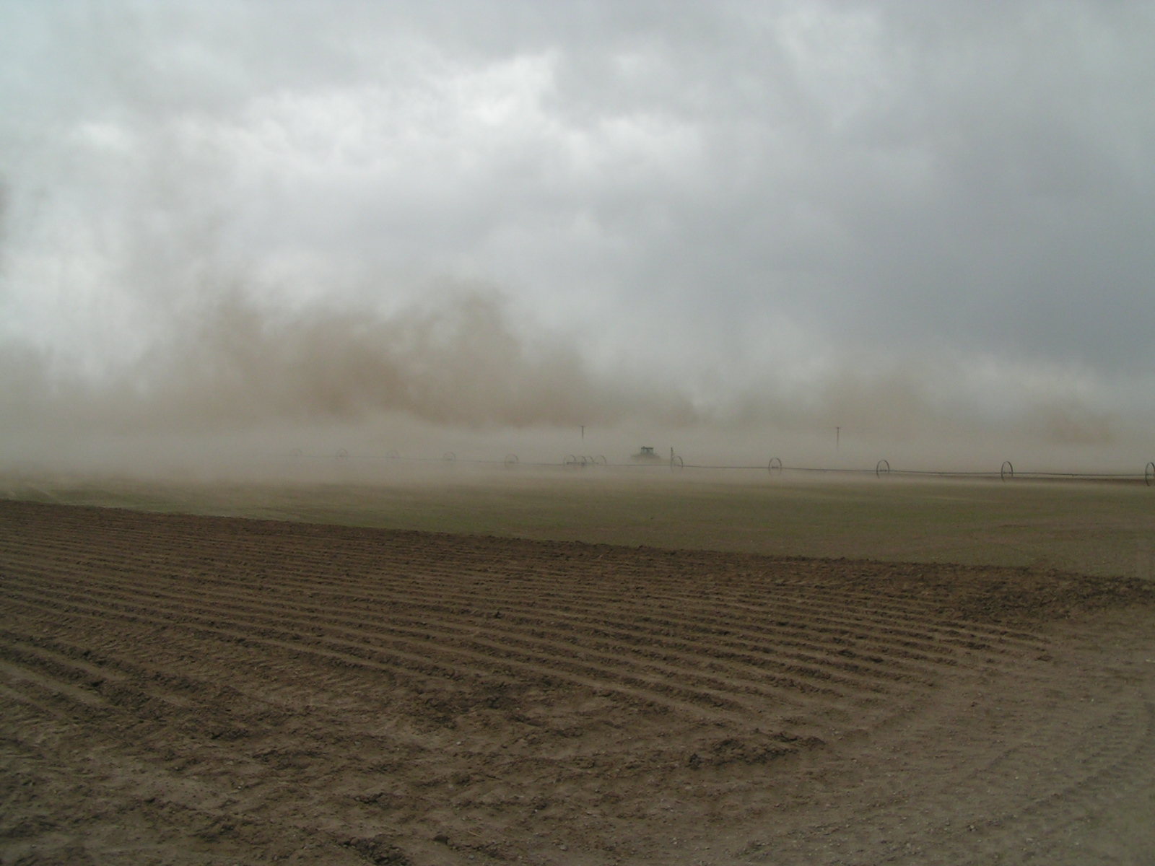
In windy conditions, pesticides can be carried off site attached to soil particles.
Photo courtesy of Idaho NRCS
Notes:
In windy conditions, pesticides can be carried off site attached to soil particles. This drifting dust can lead to pesticides being deposited in water. Wind erosion is a major problem in many areas in the West.

Slide 10
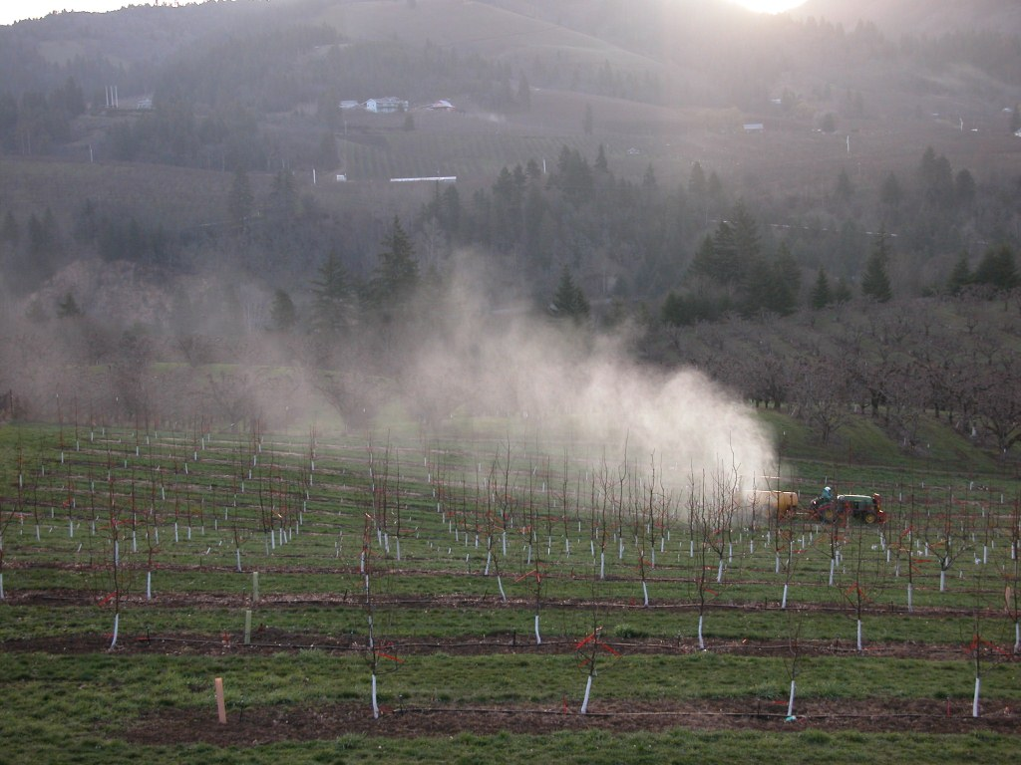
During pesticide applications, sprays can be carried into water.
Photo courtesy of Steve Castagnoli, OSU
Notes:
In windy conditions, pesticide sprays can be carried off site. Small spray droplets can travel with wind and be deposited in nearby water bodies, causing contamination.

Slide 11
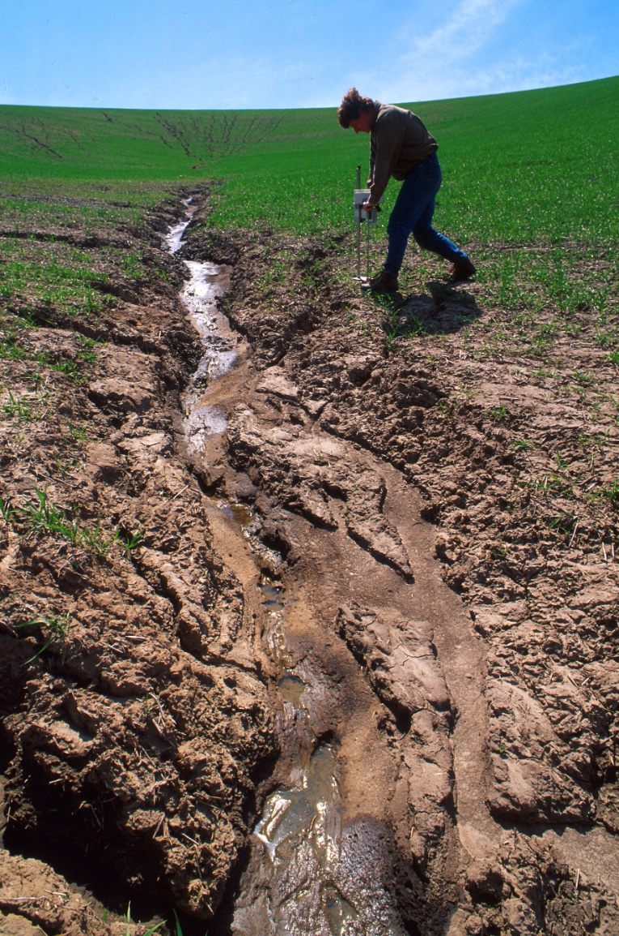
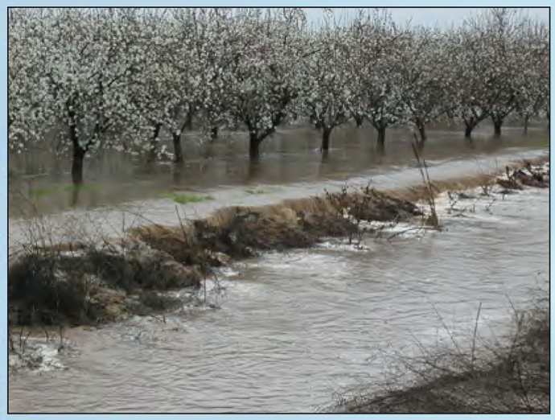
Runoff and erosion can move pesticides off site.
Photo courtesy of USGS
Photo courtesy of USDA-NRCS
Notes:
Runoff is excess water that moves off the field. The factors that contribute to a runoff event include the grade or slope of the area, soil texture, and the amount of vegetation. Soil that is saturated can’t take in the water, so it runs off. The amount and timing of irrigation or rainfall are critical. The pesticide characteristics, especially water solubility, also play a role. Runoff carries soluble pesticides into water.
Erosion is the process whereby soil is removed from a field via runoff. This can happen because of problems with irrigation equipment (such as line breaks), errors with irrigation management (over-irrigation), or weather (excessive rainfall or snow melt). The quantity and velocity of runoff determine the extent of erosion. When erosion occurs, pesticides adsorbed to soil particles travel off site with the eroded soil.

Slide 12
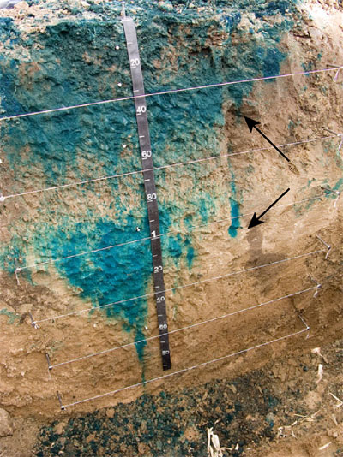
Pesticides can leach into the water table.
Photo courtesy of
Kansas Geological Society
Notes:
This photo shows how dissolved substances move through the soil profile through leaching. A dye applied to the soil surface was carried down into the soil with water. In this same way, pesticides can migrate into the water table as water moves through the soil, either from rain, snow melt, or irrigation. Some soil types, such as coarse-textured soils, increase the likelihood of leaching, and soluble pesticides are more likely to leach. Pesticides in groundwater are a problem because groundwater may be a source of drinking water, irrigation water, or it may feed into streams, lakes, or other surface water. Groundwater contaminated by pesticide leaching is nearly impossible to completely clean up (remediate), and it is extremely costly. It is much better to prevent groundwater contamination in the first place by using preventive practices.

Slide 13
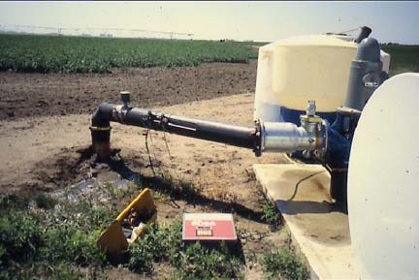
Improper pesticide handling can contaminate water.
Notes:
When handling pesticides near a wellhead, such as in this chemigation photo, proper handling and clean-up is important to prevent pesticides from entering the wellhead directly (point source) or leaching through the soil near the wellhead (nonpoint source). During chemigation, back-siphoning of pesticides from the storage tank into the wellhead will contaminate groundwater (point source).

Slide 14
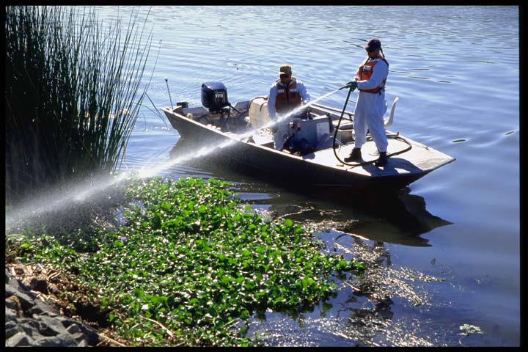
Pesticides sometimes get in water through intentional, direct application.
Photo courtesy of UCIPM
Notes:
Some pesticides are registered for use in aquatic systems, e.g., to control aquatic weeds or unwanted fish populations.
The National Pollutant Discharge Elimination System (NPDES) allows permittees to apply pollutants (pesticides) to water bodies for certain uses (e.g., mosquito and other flying insect pest control, weed and algae control, animal pest control, and forest canopy pest control). The permit requires that pesticide discharges be minimized through the use of pest management measures, and that permittees monitor for and report any adverse incidents. Be aware that some states have additional aquatic use requirements.
Aquatic use MUST be listed on the label as an allowable application site.

Slide 15

Weather conditions impact pesticide movement.
Notes:
The weather can have a significant effect on the movement of pesticides away from where they are applied. It is important to understand how weather affects pesticide movement and avoid conditions that could lead to off-target movement and water contamination.

Slide 16
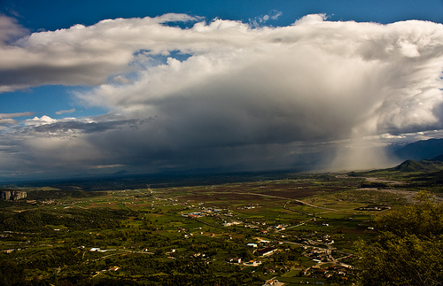
Excessive or untimely rainfall can affect pesticide movement.
Notes:
High rainfall events or unexpected rainfall immediately after a pesticide application can cause soil-applied pesticides to run off into surface waters or leach into groundwater. Do not apply pesticides when heavy rain is expected within 48 hours.

Slide 17
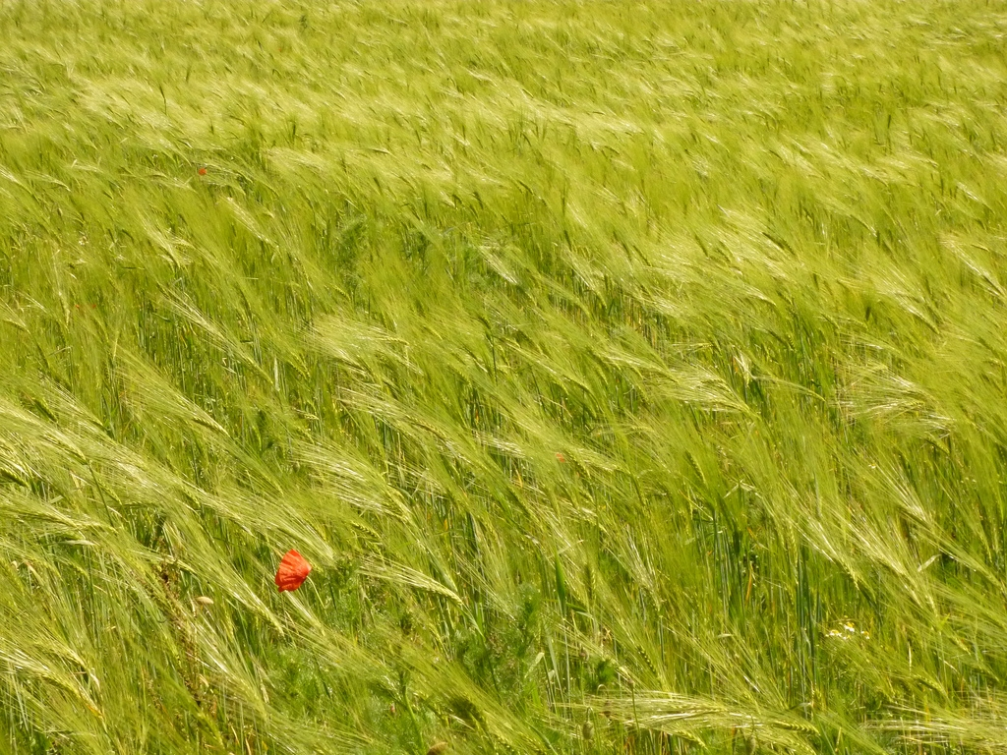
Wind direction and speed can cause off-site pesticide movement.
Photo by tinle Yla, Flickr
Notes:
Windy and/or gusty conditions can cause pesticide sprays to move off site, potentially reaching surface waters. Also, windborne soil particles with adsorbed pesticides can be blown off site and into waters.

Slide 18
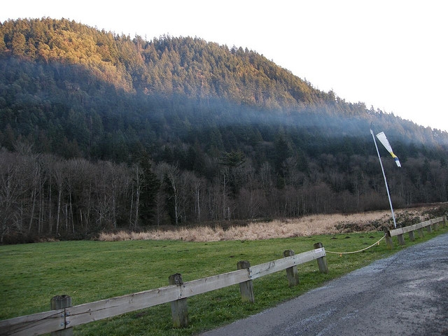
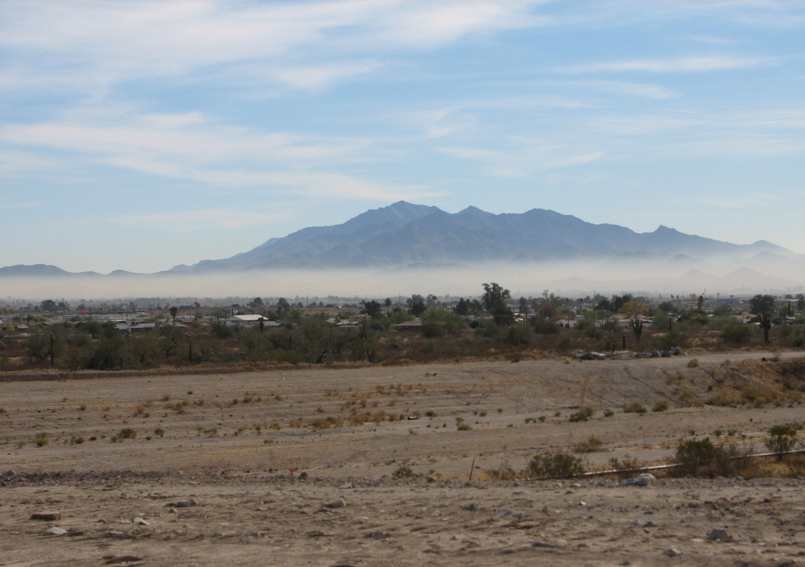
Temperature inversions can cause pesticides to move off site.
Photo courtesy of nordique, Peter Stevens
Photo courtesy of Maricopa Air Quality Department
Notes:
Inversions occur when warm air traps cooler air near the ground. In an inversion, normal air mixing does not occur. If a pesticide application is made during an inversion, trapped pesticide particles or vapors have the potential to move off site and contaminate surface water. (Click) An inversion is present if you look at smoke coming out of a chimney and see the smoke laying out horizontally, as in this photo.

Slide 19
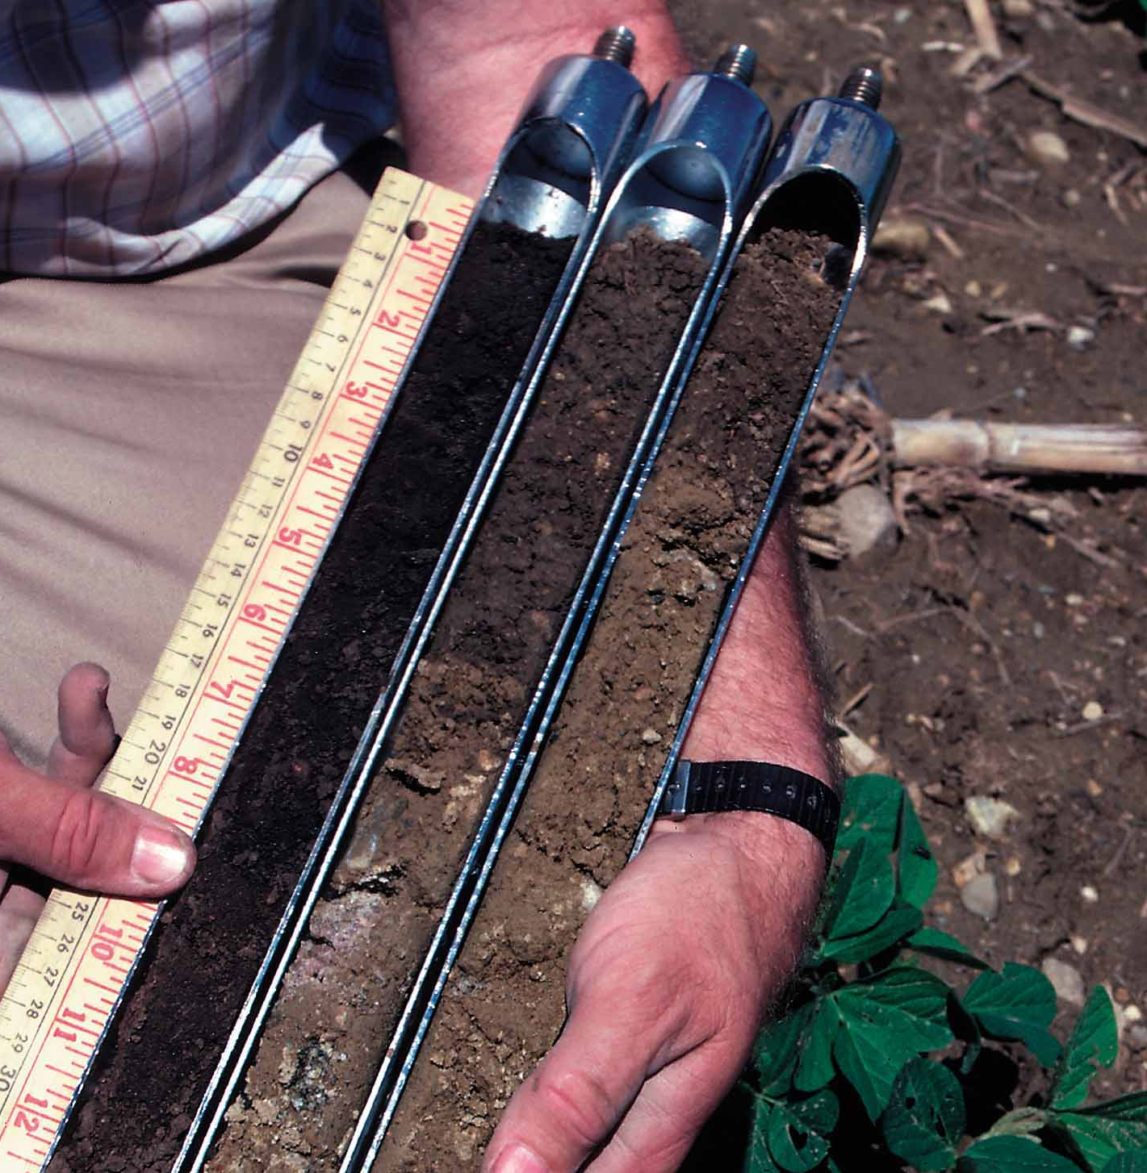
Soil characteristics and pesticide properties influence off-site movement of pesticides.
Photo courtesy of USDA-NRCS
Notes:
We have looked at the ways that pesticides can move away from the place where they were applied and end up in water. Soil and pesticide properties also influence the potential for pesticide movement.

Slide 20
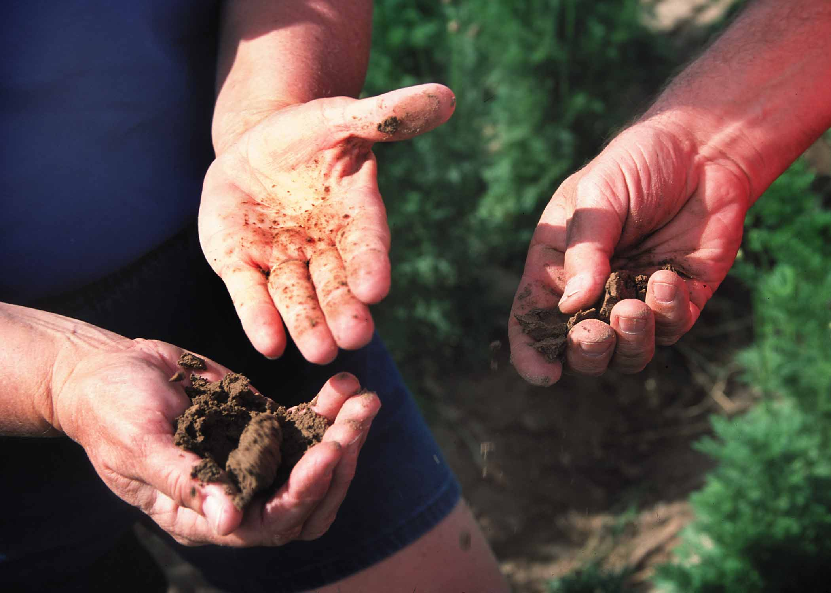

Soil Characteristics: Soil texture and structure impact how pesticides move in soil.
Photo courtesy of USDA-NRCS
Notes:
Soil texture and soil structure are important physical properties that determine the arrangement of soil particles and amount and type of soil pore space (spaces occupied by air and water). Soil texture is the amount of sand, silt, and clay in a soil. Structure is the grouping of soil particles into larger aggregates or clods. Soil texture and structure determine a soil’s water-holding capacity and the extent and speed with which water enters the soil (infiltrates) and moves through the soil (percolates).
Coarse-textured soils, with high sand content, have large pore spaces and low water-holding capacity, increasing water movement. Fine-textured soils, like clay, have very small pore spaces and bind water tightly to clay particles, reducing the potential for leaching. Silty soils are intermediate to sand and clay, with medium-sized pore spaces. Coarse soils tend to have a higher potential for deep percolation and leaching of pesticides.

Slide 21
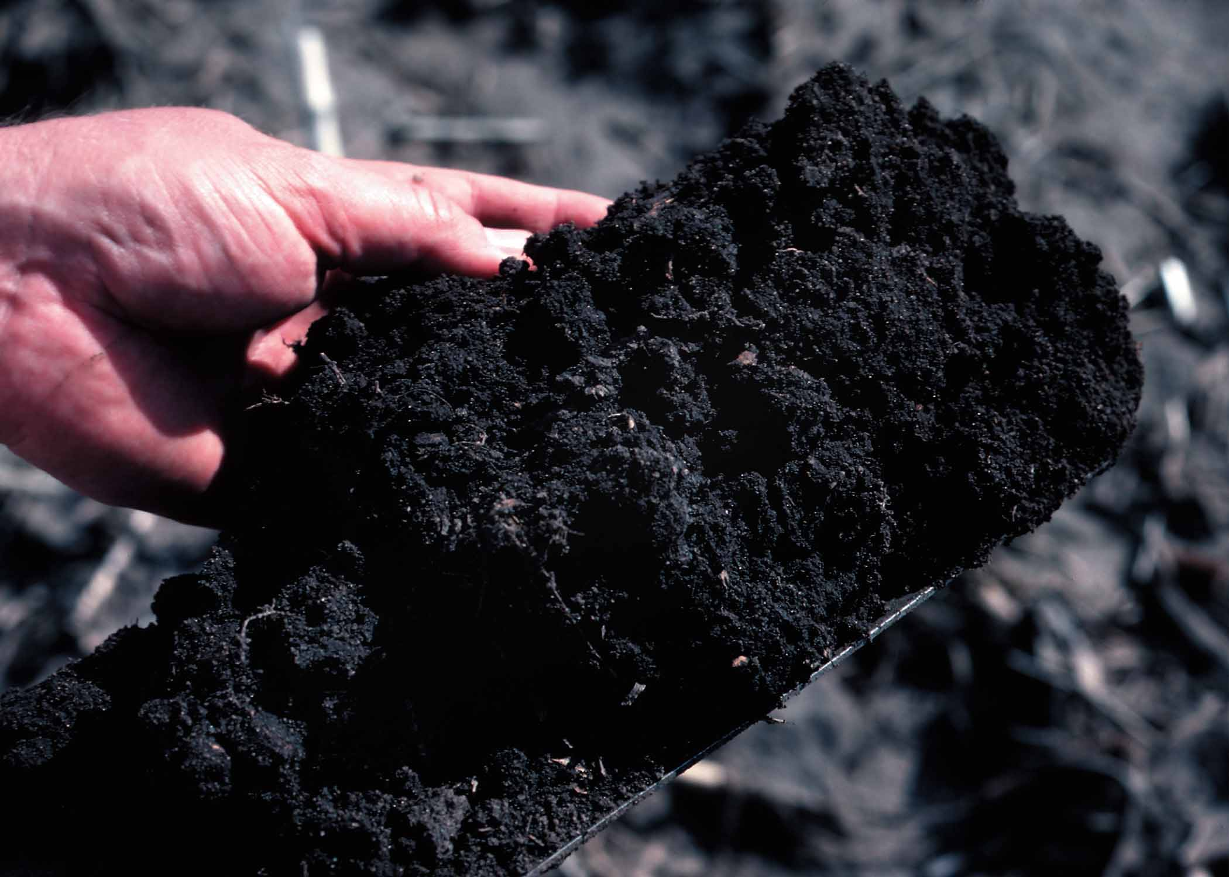
Soil organic matter and pH affect how tightly pesticides bind to soil.
Photo courtesy of USDA-NRCS
Notes:
Adsorption is important to the fate of pesticides. Adsorption, that is A-D-sorption, is the physical binding of the chemical to the outside of soil particles and organic matter. “Ad” means to “add onto.” Pesticides that are oil-soluble or oil-loving tend to adsorb or bind to soil particles. Soil type is a key factor affecting how much chemical is held by the soil particles. Clay and organic soils have many, many binding sites and adsorb a lot of pesticide. When pesticide is adsorbed or bound to the soil, it doesn’t move freely with the soil water. Thus pesticides in the soil solution are greatly reduced.
Soil organic matter influences soil structure and water-holding capacity, provides a source of energy for microorganisms, and can retain nutrients and adsorb other chemical constituents. All of these characteristics impact pesticide movement and persistence.
Soil pH typically ranges from 5 to 9. Most pesticides are labeled for specific soil conditions. If soils have a pH outside the label’s allowed range, pesticides may become ineffective, may be changed to an undesirable form, or may not degrade as expected. Soil pH also influences microbial activity, which can also impact pesticides.

Slide 22
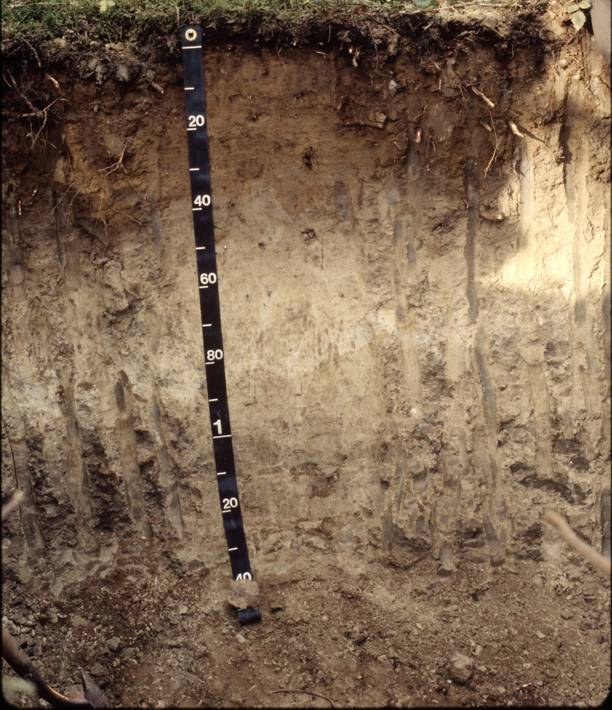
Deeper soil lessens the potential for pesticide leaching.
Photo courtesy of USDA-NRCS
Notes:
A soil is made up of individual layers with different soil properties, called soil horizons. The upper soil horizon generally contains considerable amounts of organic matter. As mentioned in the previous slide, organic matter increases pesticide adsorption and thus helps reduce leaching. Some soils contain restrictive soil horizons (e.g., thick clay layers) which can significantly reduce leaching and groundwater contamination. Soil depth, or the amount of soil overlaying bedrock, can also determine the potential for leaching.
Soil temperature and soil moisture vary by depth, and these properties also influence the efficacy and persistence of pesticides. The deeper the water table, the less chance there is that it will be contaminated with pesticides that move through the soil. Remember, the water table can change seasonally.

Slide 23

Pesticide Properties can influence off-site movement.
Notes:
Pesticide active ingredients and formulations also have properties that you need to consider. When you purchase a pesticide, the active ingredient in the pesticide is the chemical that kills the pest. The formulation is the mixture of ingredients that comes in the container. It may contain water, stabilizers, and other ingredients to aid in application or safety.

Slide 24
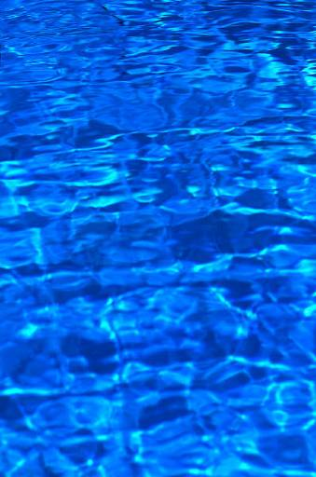
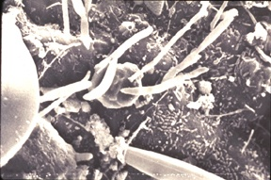
Pesticide Properties: Pesticides are degraded in the environment by microorganisms, sunlight, and chemical processes.
Hydrolysis
occurs
at
high pH.
Notes:
Understanding how readily a pesticide degrades and the mechanism of how it degrades is important. Generally, after a pesticide degrades it becomes inactive in the environment, having no impact on water quality. However, there are some degradation products of pesticides (e.g., atrazine) that may still be active and contaminate water resources. Microbial degradation is the process in which soil microorganisms feed on pesticides and break them down. Soil conditions that favor microorganism reproduction increase the degradation process. These soil conditions include warm soil temperatures, aeration, adequate soil moisture, fertility, favorable pH, and adsorption. Simple chemical reactions that occur in the soil can also lead to pesticide degradation. Pesticides break down in water (hydrolysis). In natural field settings, hydrolysis occurs most often in soils with higher pH (alkaline soils). The mixing of water and the pesticide can result in hydrolysis, which causes pesticides to break down. Sunlight can cause another type of pesticide breakdown called photodegradation.

Slide 25
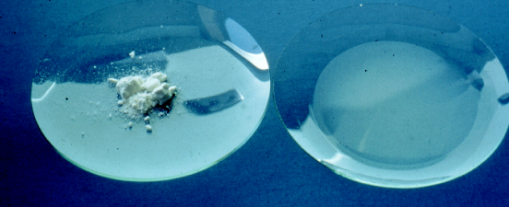
Water-soluble pesticides are more likely to move with water.
Notes:
Solubility is a pesticide’s ability to dissolve in water or some other liquid. Water-soluble pesticides are more likely to move with water in the form of runoff, or in the case of leaching, to move with water through the soil and into the groundwater. Once in the water, soluble pesticides move and spread out quickly.

Slide 26
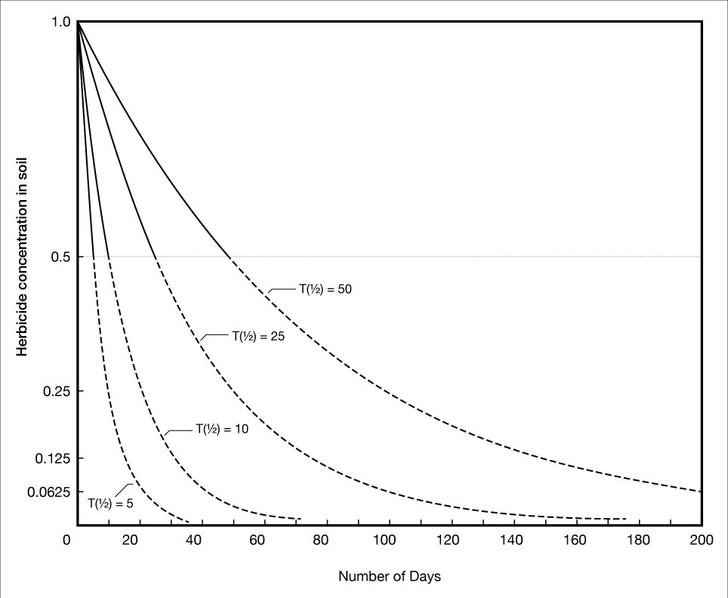
Persistence is the measure of how long a pesticide remains active before it degrades.
Notes:
Persistence is another important pesticide characteristic to consider when assessing impacts on the environment. Persistence is the measure of how long a pesticide remains active before it breaks down, or degrades. Persistent pesticides don’t break down for some time, which makes them more prone to move off site through dust, runoff, or leaching. Persistent pesticides have a greater potential to harm sensitive plants or animals. Factors that affect persistence of a pesticide include its volatility, solubility, and formulation, as well as soil moisture, soil and air temperature, and air movement.
Because persistent pesticides don’t degrade for longer periods of time -- often months to years -- they are more prone to move off site through blowing soil and/or runoff and leaching. This graph shows the number of days it takes for different compounds to break down. T(1/2) refers to the half-life of a compound, in other words, how long it take the compound to break down to half its original amount. The curves on this graph show half lives of 5, 10, 25, and 50 days. In Oklahoma soils, 2,4-D has a half-life of 5 days and dicamba is much more persistent with a half-life of 25 days.

Slide 27
Volatile pesticides can move long distances off site.
Notes:
Volatilization occurs when a pesticide changes from a solid or liquid to a gas or vapor. Once airborne, volatile pesticides can move long distances off site and into surface water. As stated earlier, air temperature, humidity, and wind all influence volatility. Once a pesticide has become a vapor, it can move off site with the air flow. A rise in temperature, an increase in wind speed, or a reduction in humidity all increase the potential for volatility.

Slide 28
Best Management Practices (BMPs) to Protect Water Quality
Photo courtesy of USDA-NRCS
Notes:
There are many things that you can do to prevent pesticides from entering water. Recommended Best Management Practices (BMPs) have been developed to protect ground- and surface water from pesticide contamination. Many of the steps used to protect water quality are common sense practices and as such have been covered before in other pesticide training sessions. However, because these practices are so important we are going to address them again here.
Best Management Practices (BMPs) to protect water quality include:
Integrated Pest Management (IPM) Strategies
Irrigation Water Management
Proper Pesticide Application Methods
Pesticide Application Equipment Calibration/Maintenance
Drift Prevention
Proper Pesticide Mixing/Loading/Storage/Disposal
Runoff and Erosion Control
Weather Monitoring
Education

Slide 29
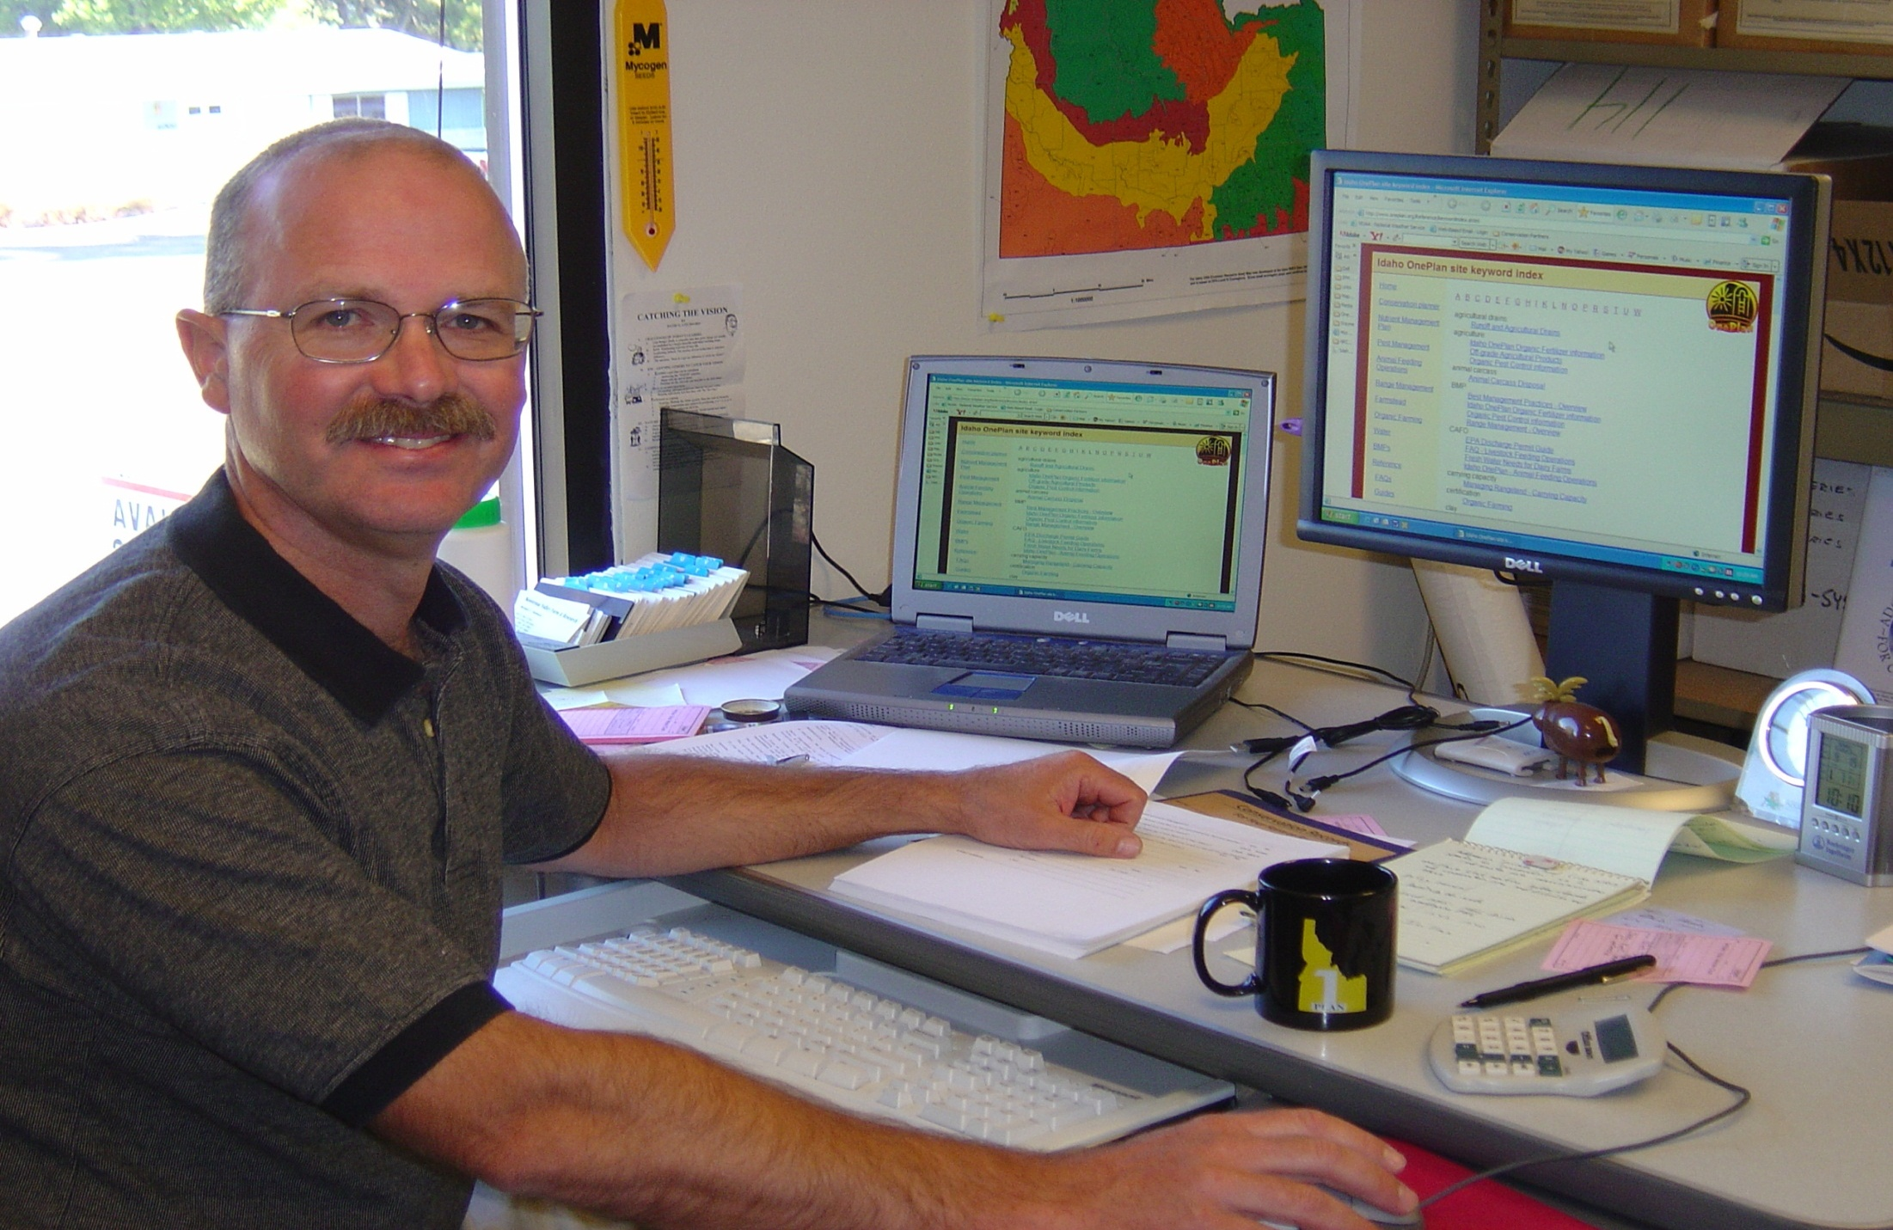
Integrated Pest Management (IPM) is one of the best ways to protect water.
Notes:
Integrated pest management (IPM) is the use of a variety of practices, such as mechanical, cultural, biological, and chemical, to control pests. The use of IPM to manage pests will help you reduce the pesticide load in soils and water resources. IPM also preserves beneficial organisms present in the field and can save the applicator money by avoiding unnecessary pesticide applications.
Pest management planning is a cornerstone of IPM. Before the growing season begins, producers can research and plan a variety of pest management options and make site-specific decisions. Advance planning also allows producers more time to review pesticide options and select less environmentally hazardous pesticides for use. Always maintain records of all pest avoidance, prevention, suppression, and monitoring activities. Then, during the off season, assess the previous years’ practices and make changes for future pest management. Always maintain the pesticide application records required by your state. Records help you keep track of what pesticides you have recently applied, along with their mode of action, which helps with resistance management.

Slide 30
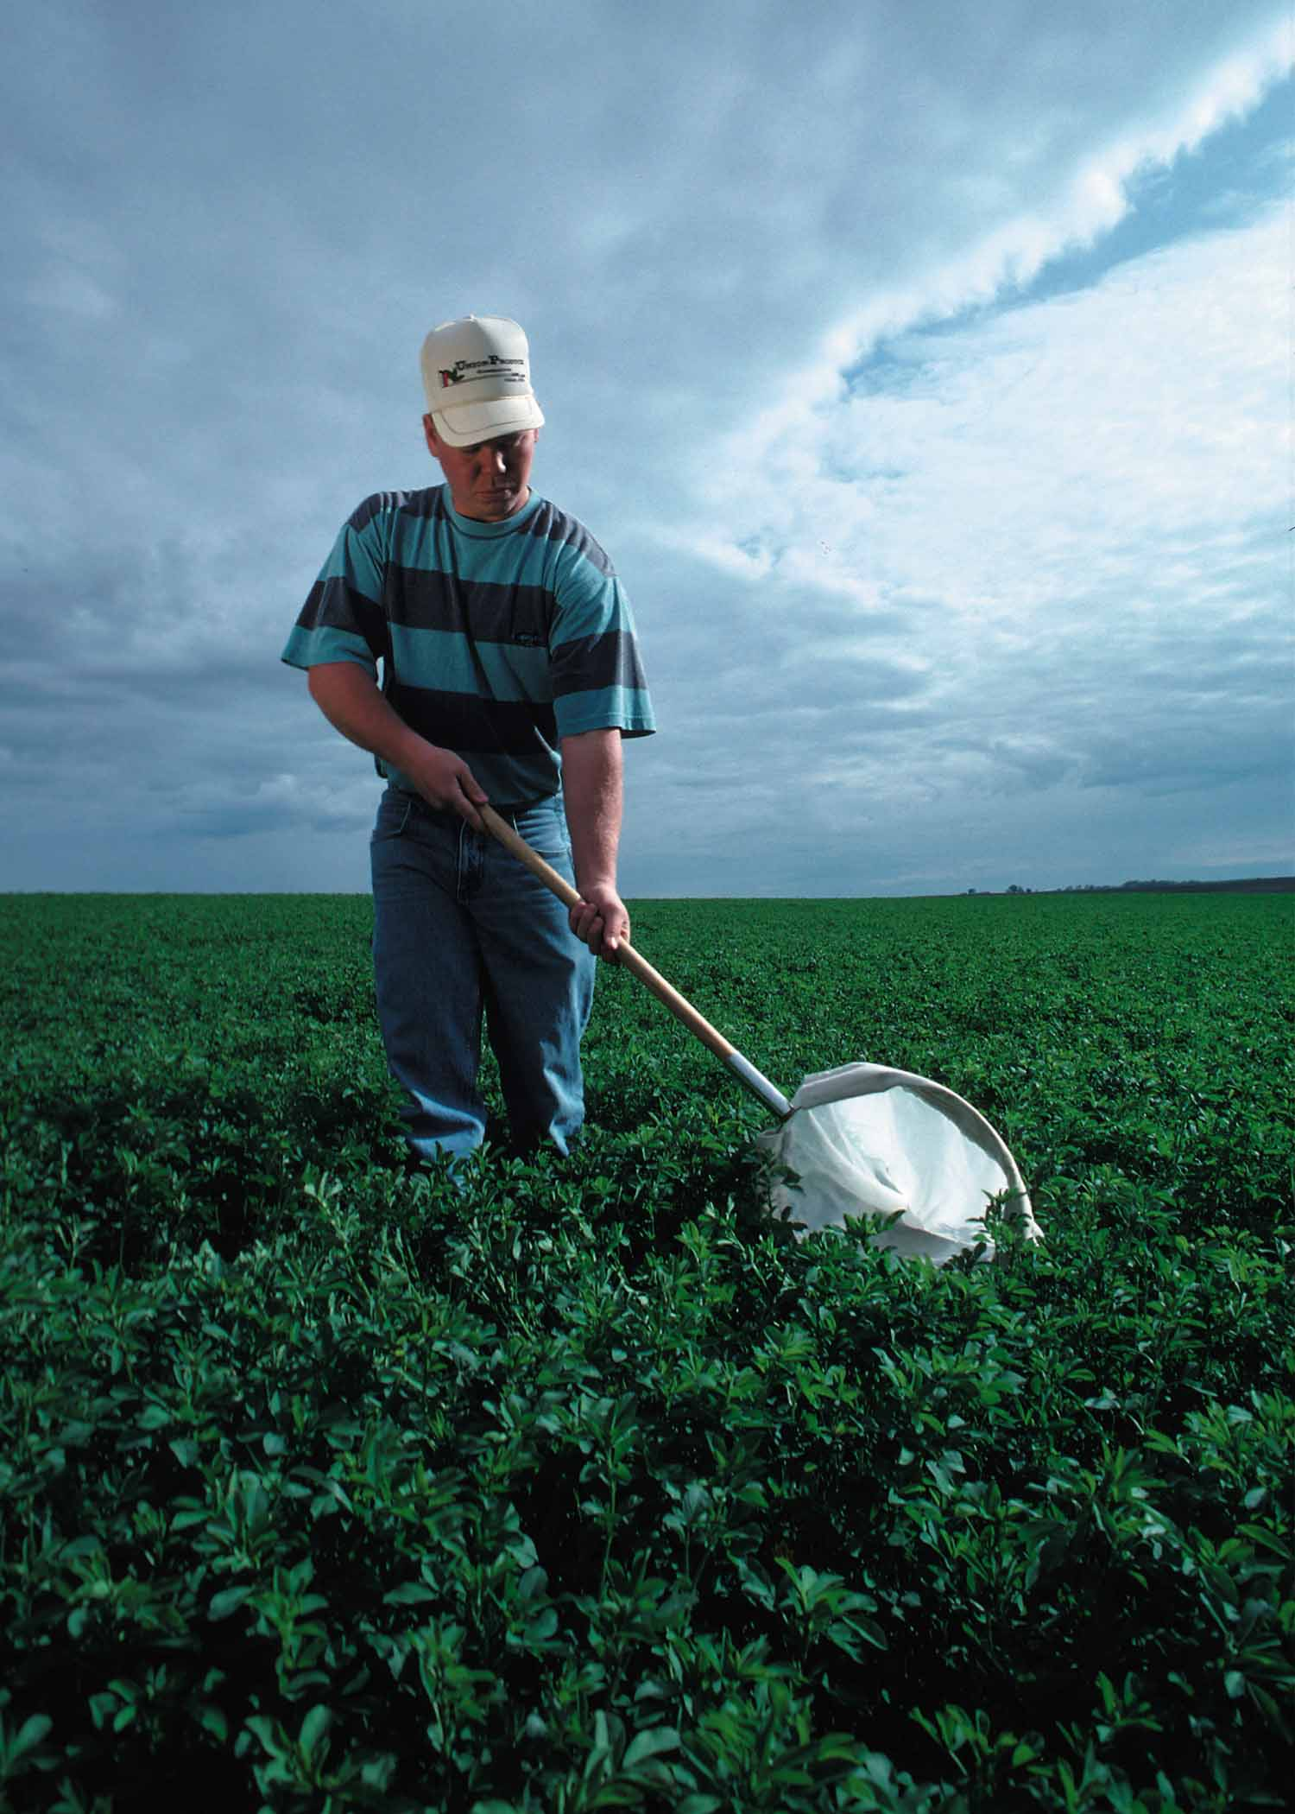
Scout to determine pest pressure and the presence of beneficial insects.
Photo courtesy of USDA-NRCS
Notes:
Prior to treating fields, properly identify pests and ascertain their population levels. Only treat when populations exceed economic threshold levels. Scout fields weekly to properly identify pests and determine their numbers. Pesticides should only be applied when pest numbers are high enough to justify the cost of the pesticide application. Monitoring pest levels will help you apply pesticides in the most timely and effective manner. Beneficial insects should also be monitored. You may be able to rely on them to help control pest populations.

Slide 31
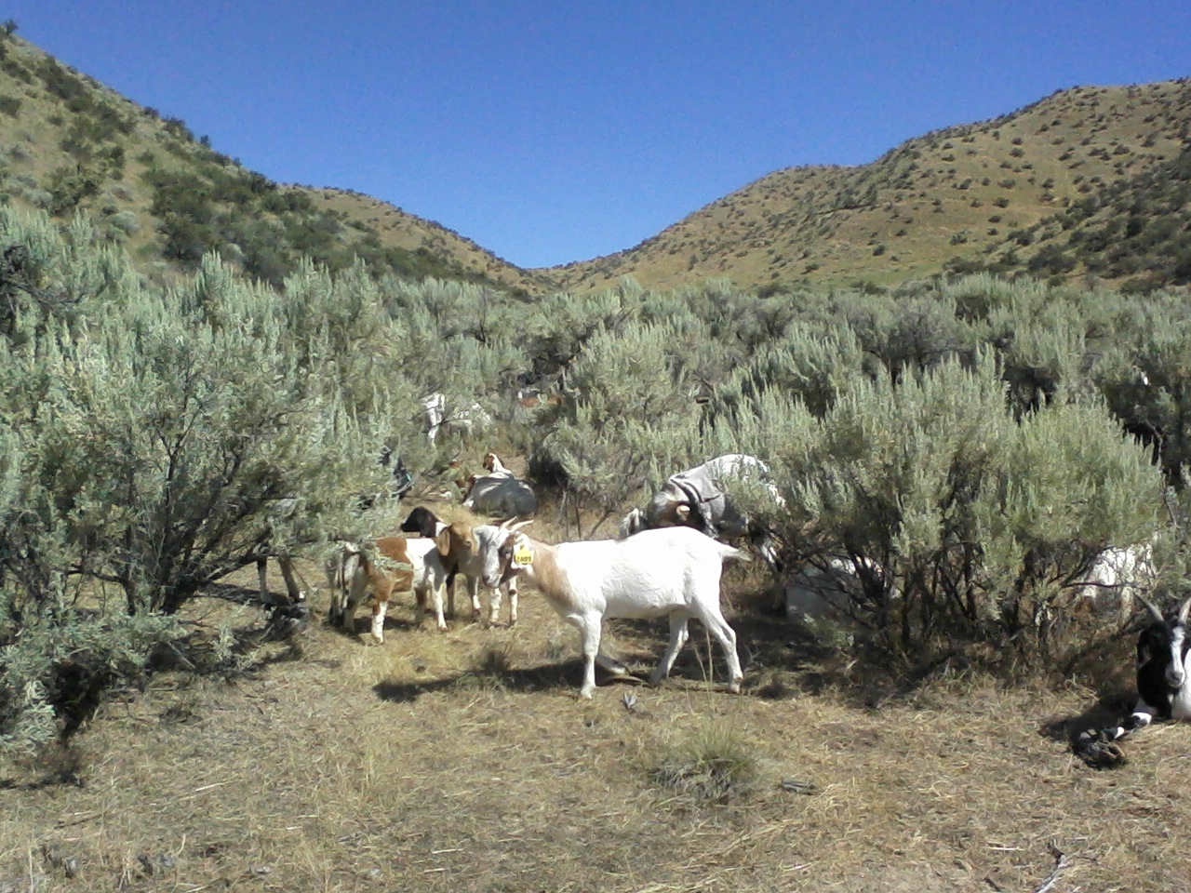
Use IPM (i.e., biological, cultural, and mechanical practices) to manage pests.
Notes:
IPM includes the use of biological, cultural, and mechanical practices to manage pests. Biological pest management is the use of biological agents to control pests. Cultural pest management is the use of cultural practices (i.e., planting certified seed, changing planting dates to avoid pests, rotating crops, using cover crops) to reduce pest pressure. Mechanical control includes practices such as mowing weeds, cultivating weeds, and flaming fields to burn off weeds, insects, and disease pathogens. Utilizing these suppression practices may help to reduce the use of and reliance on pesticides. In this photo, the goats are providing biological weed control.

Slide 32
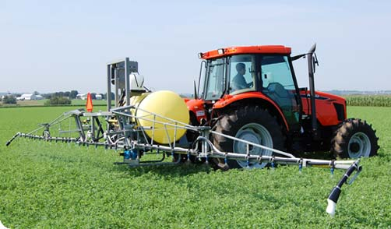
Carefully select pesticides to protect water.
Notes:
Only use pesticides when necessary. To reduce the overall pesticide load, consider using banding or spot treatments in place of broadcast applications or using reduced risk pesticides.
Some pesticides are categorized as “reduced risk” due to their low environmental risk -- but not always. Be sure you understand the pesticide properties and restrictions for your use. Pesticides categorized as reduced risk must meet certain criteria determined by EPA. Low environmental risk (e.g., low impact to water quality) may be one criterion to determine reduced risk status. Other criteria may be low human/mammalian toxicity, low toxicity to honey bees, low toxicity to beneficial insects and fish, etc. Use of risk assessment models/tools is also useful in considering a pesticide’s environmental risk. Research and understand a pesticide’s risk BEFORE selecting it for a job.

Slide 33
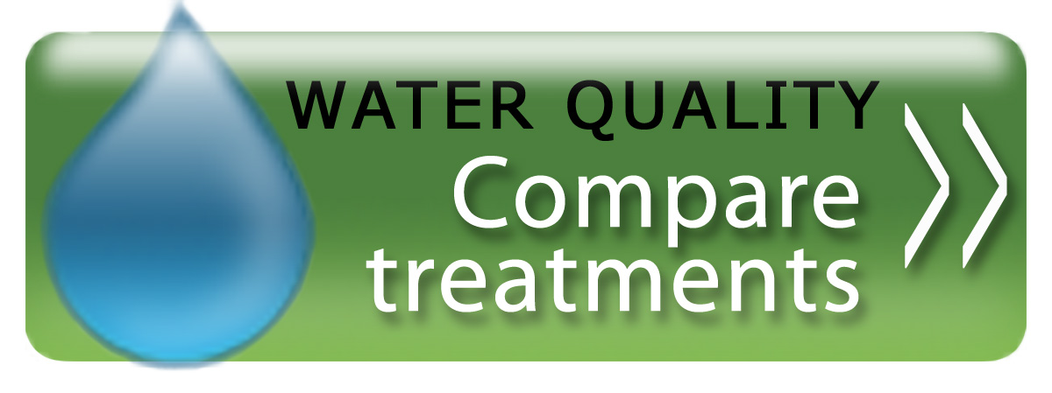
Before selecting a pesticide, use pesticide risk assessment tools.
From UCIPM Website
Notes:
The most common risk assessment tool is Windows Pesticide Screening Tool, known as Win-PST (http://go.usa.gov/Kok). Win-PST is a basic screening tool that uses both soil and pesticide properties to evaluate the potential for off-site transport when pesticides are applied according to label requirements. Win-PST determines the likely mode(s) of off-site transport (e.g., via leaching, as soluble product in runoff, or adhered to soil particles with erosion) under different management scenarios. Win-PST uses the potential for off-site transport in conjunction with pesticide toxicity to provide hazard ratings for humans and aquatics.
Using risk assessment tools such as the Win-PST helps you evaluate the risk that pesticides will move with water and eroded soil or organic matter and affect non-target organisms. The tool helps pesticide users consider the long-term hazard to humans and fish from leaching and runoff when they make pest management decisions that involve pesticides.

Slide 34
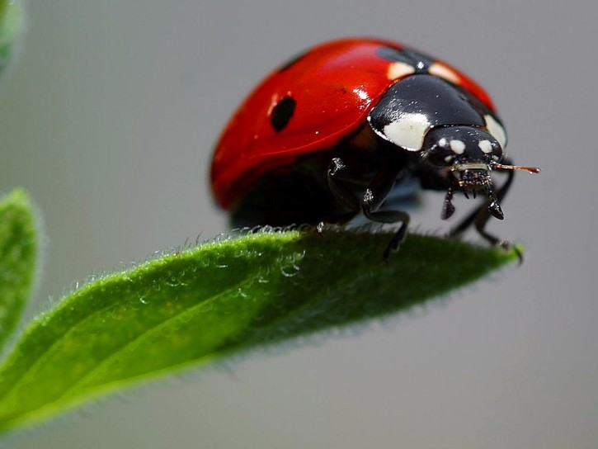
Protect beneficial organisms with proper timing of pesticide applications.
Notes:
Proper timing and selection of appropriate pesticides can reduce impacts to non-target organisms like beneficial insects, such as this lady beetle. To avoid impact to beneficial insects, time the pesticide application when they aren’t present. For example, to avoid bee kills, spray in the early morning or evening. You want to avoid killing the beneficials because, if you do, you will inherit their work.

Slide 35
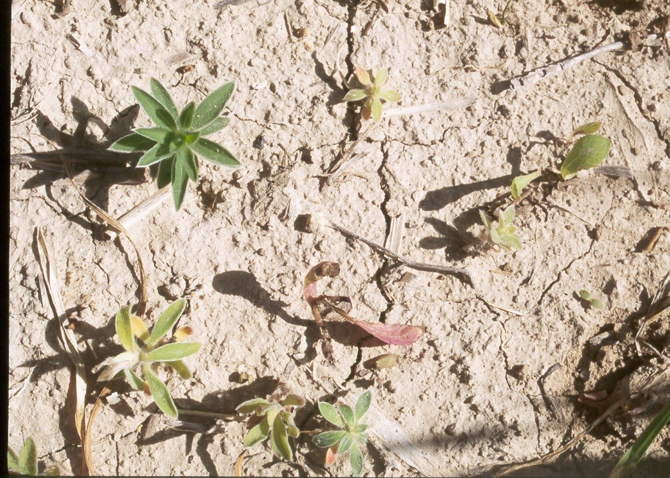
Rotate pesticides to avoid pesticide resistance.
Notes:
Rotating pesticides from different chemical classes and modes of action is crucial to avoid pesticide resistance. Pesticide resistance results in the need to keep applying higher and higher rates to get good pest suppression. This picture shows kochia after an acetolactate synthase (ALS) herbicide application. (click) This tolerant plant survives the treatment and will reproduce, resulting in more individuals that will survive the next ALS herbicide application. If you continue to apply herbicides in the ALS class, you will quickly produce a population of resistant kochia. When pests become resistant to pesticides, more pesticide is needed for the same level of control. Avoid resistance development in order to reduce pesticide use.

Slide 36
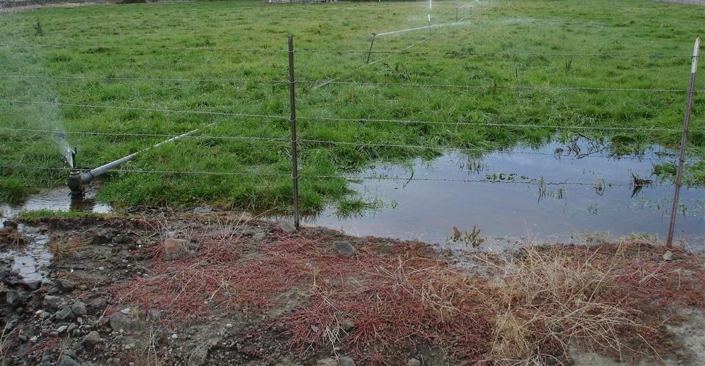
Use irrigation water management to reduce pesticides in water.
Photo courtesy of Troy Peters, WSU
Notes:
Irrigation water management involves determining and controlling the volume, frequency, and application rate of irrigation water in a planned, efficient manner. Properly scheduling irrigation (timing and amount), controlling runoff, minimizing deep percolation, and applying water uniformly are important components of irrigation water management. Irrigation should be scheduled based on crop need and adjusted throughout the growing season. Avoid over-irrigation, especially early and late in the season. Promptly fix broken irrigation equipment and maintain pumps, nozzles, etc. to reduce potential for over-irrigation or improper distribution of water. Allow for a delay between pesticide application and irrigation. This delay will allow the pesticide to become active in the soil and/or in crops or weeds before water is applied. This helps prevent irrigation water from carrying pesticides off site.

Slide 37
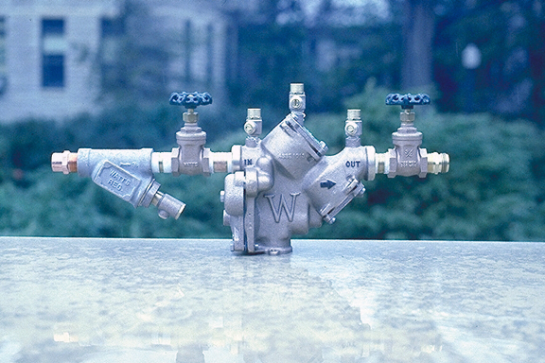
Use anti-siphon devices to prevent pesticide contamination in wells.
Photo courtesy of M.J. Weaver, pesticidepics.org (Virginia Tech)
Notes:
Ensure that a backflow prevention device is installed when chemigating. Backflow or anti-siphon devices prevent pesticides from being drawn down into the well and contaminating the well and aquifer when pesticides are being applied with irrigation water. Most states have laws regulating the use of backflow prevention devices, and some states require special application licenses for chemigation.

Slide 38
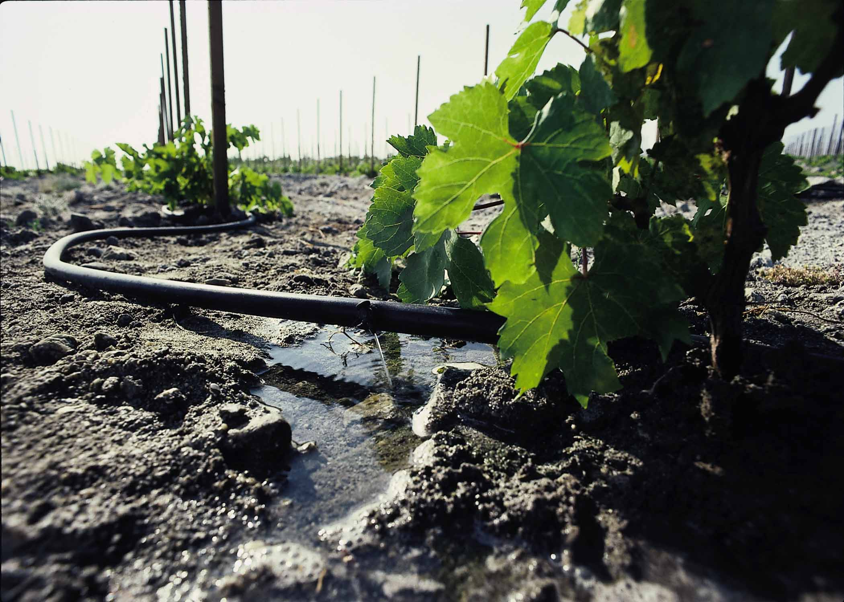
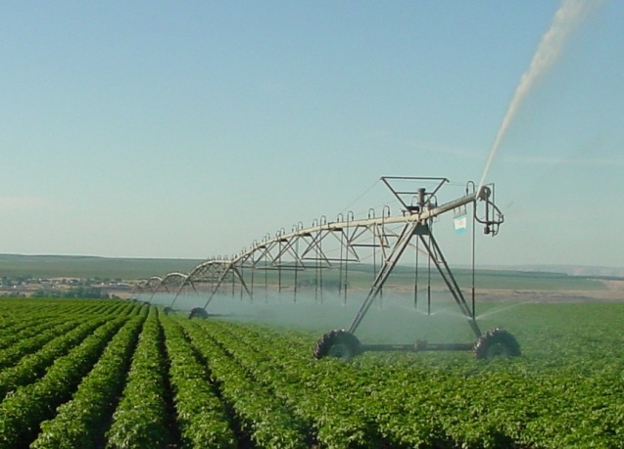
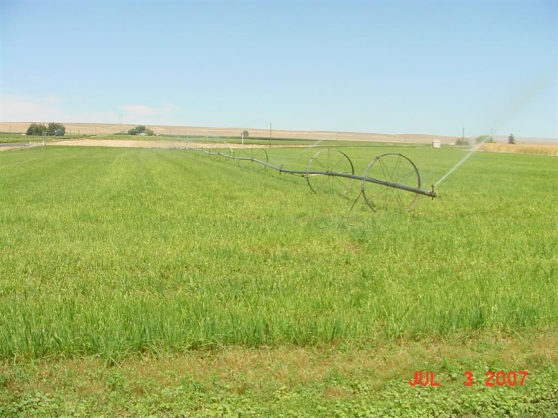
Select the appropriate type of irrigation for your situation.
Photo courtesy of USDA-NRCS
Photos courtesy of Troy Peters, WSU
Notes:
The irrigation method you use should be based on a site evaluation that considers soil, topography, water supply, energy supply, crops to be grown, and labor requirements. The irrigation method should efficiently and uniformly apply irrigation water to the crop or soil without causing erosion, excessive water loss, or reduction in water quality. The picture on the left shows drip irrigation in grapes, an efficient method to avoid excessive water application and possible leaching. Also shown are center pivot and wheel line applications, which may be preferable to gravity/furrow irrigation, because they may reduce excess water in the field, especially in the headlands. By selecting the best method of irrigation you can also help reduce pest problems, for example, disease.

Slide 39
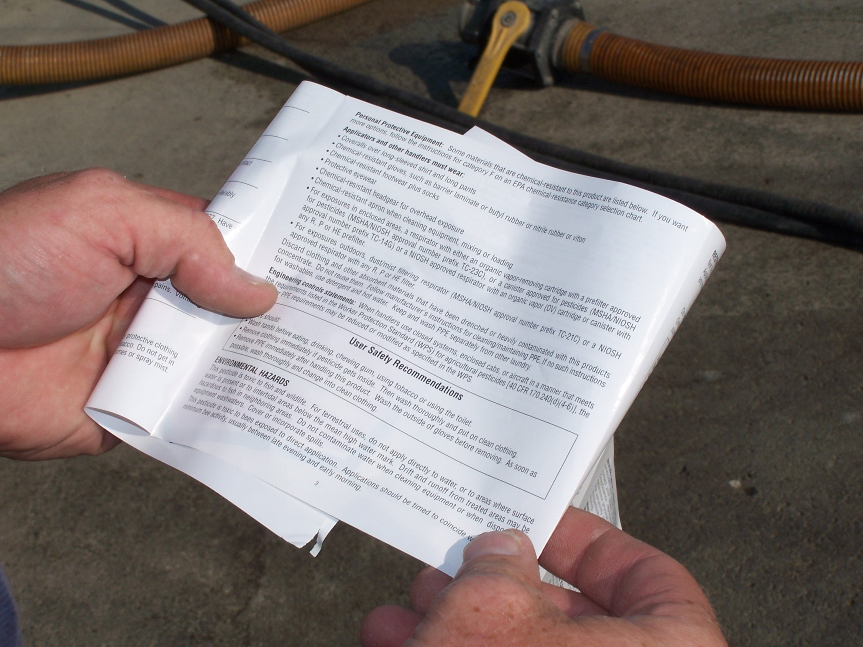
Use proper application methods to reduce off-site movement of pesticides.
Photo courtesy of Gail Amos, WSDA
Notes:
Apply pesticides properly by always reading, understanding, and following label directions. Always apply pesticides according to the label, paying careful attention to the listed application rate. The label is the law! All pesticide labels have an Environmental Hazards section. The label includes information on special measures you should take to prevent off-site movement of pesticides and to protect water resources. Other label information that aids in preventing off-site movement includes: correct rates for the application site, method of application, amount of carrier to use, and special instructions for nozzles. Remember: the label is the law.

Slide 40
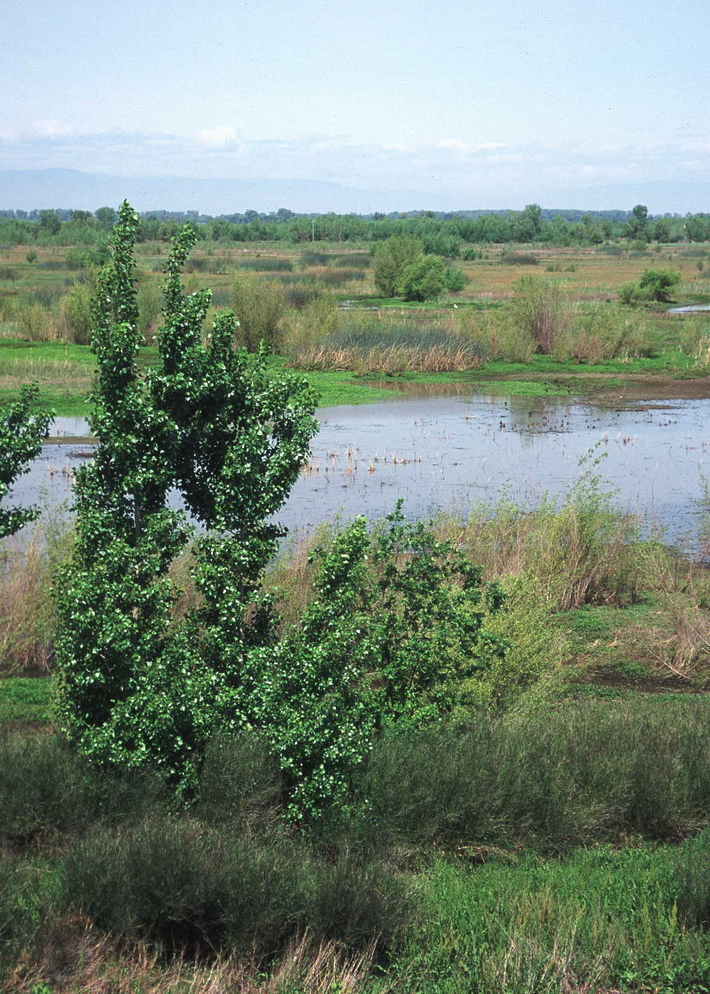
Do not apply pesticides near sensitive areas.
Photo courtesy of USDA-NRCS
Notes:
Identify sensitive areas near your application site. Avoid spraying near them in order to prevent water contamination and protect wildlife habitat. Examples of sensitive sites are riparian buffers, areas near wetlands, and areas that may harbor beneficial insects, wildlife, and/or endangered species. Certain places in your community, such as schools and hospitals, are also considered sensitive sites.

Slide 41
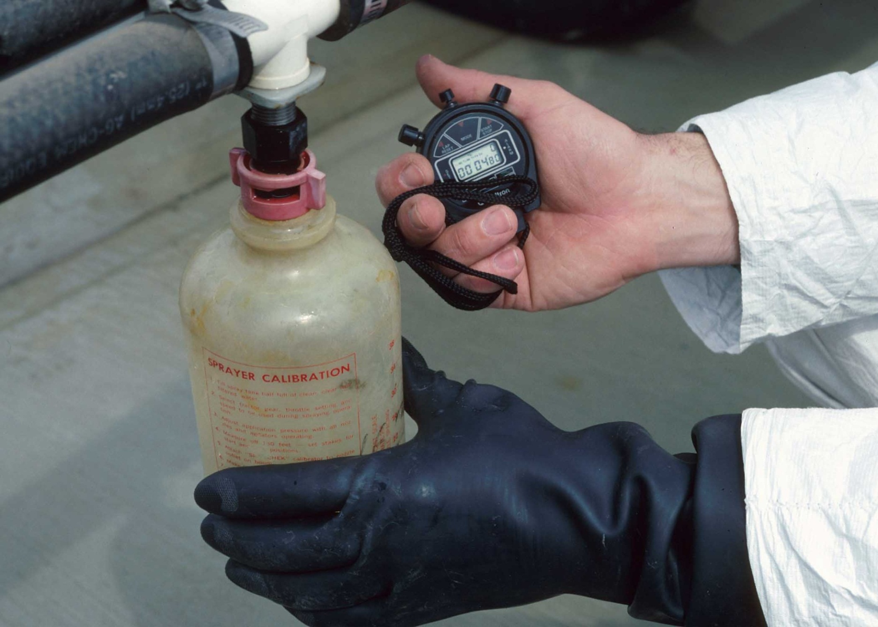
Always calibrate and maintain pesticide application equipment.
Photo courtesy of USDA-NRCS
Notes:
Calibrate application equipment before each season of use and with each major chemical change. It is important to apply pesticides at the proper rates in order to avoid excessive applications that may cause leaching into groundwater. This also saves the applicator money.

Slide 42
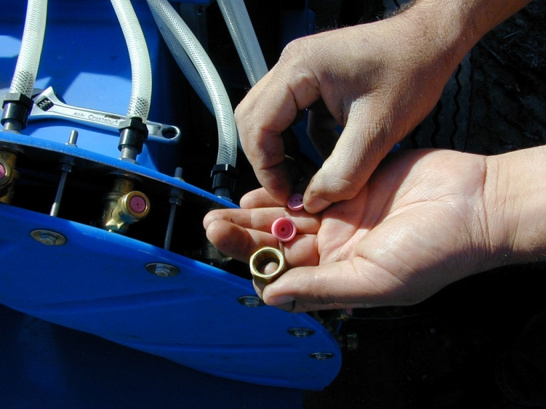
Regularly inspect pesticide equipment, and keep it in good repair.
Photo courtesy of PNASH
Photo courtesy of USDA-NRCS
Notes:
Frequently inspect equipment and perform regular maintenance. Replace worn nozzles and leaking tubing. This helps ensure that pesticides are applied at the correct rate. Keeping application equipment in good repair eliminates over-application and nozzle drips, which concentrate too much pesticide in the soil and increase the potential for pesticides leaching into groundwater.

Slide 43
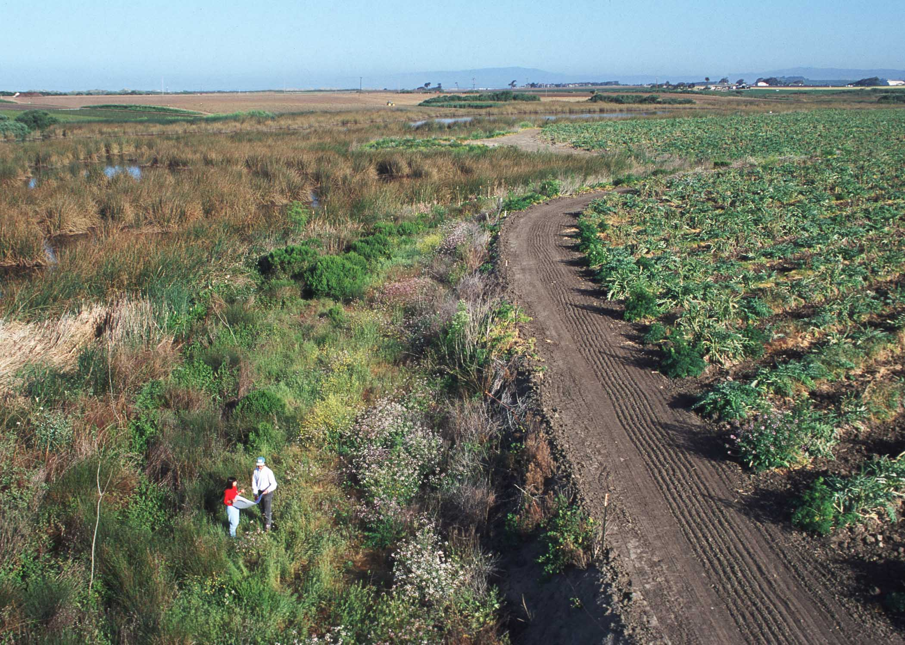
Reduce the potential for pesticide movement to sensitive areas by preventing drift.
Photo courtesy of USDA-NRCS
Notes:
Identify sensitive sites near your work area. Establish no-spray buffers to protect these sensitive sites from pesticide drift and avoid accidental pesticide contamination to water. This photo shows a no-spray buffer established between a waterway and an artichoke field in California. Read pesticide labels carefully, as some now carry buffer zone requirements.

Slide 44
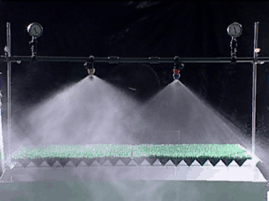
Select appropriate nozzle size to reduce the potential for drift.
The larger the spray droplet size
The less distance the droplet drifts
Photo courtesy of Bob Wolf of Wolf Consulting
Notes:
Nozzle size determines how coarse or fine spray droplets are. In this photo, the nozzle on the left has a smaller orifice and produces smaller droplets. Smaller droplets (fines) weigh less and are more likely to drift when there is an inversion or wind. Several pesticide labels do provide information on appropriate nozzle size/type for optimum application effectiveness and for reducing off-site movement. The nozzle on the right has a larger opening, producing larger droplets that are heavier and less likely to drift. Nozzle manufacturers and some pesticide labels now provide information to assist you in selecting the proper nozzle size and type for optimum application effectiveness and reduction of offsite movement. (Click) Remember: the larger the droplet size, the less potential for drift.

Slide 45
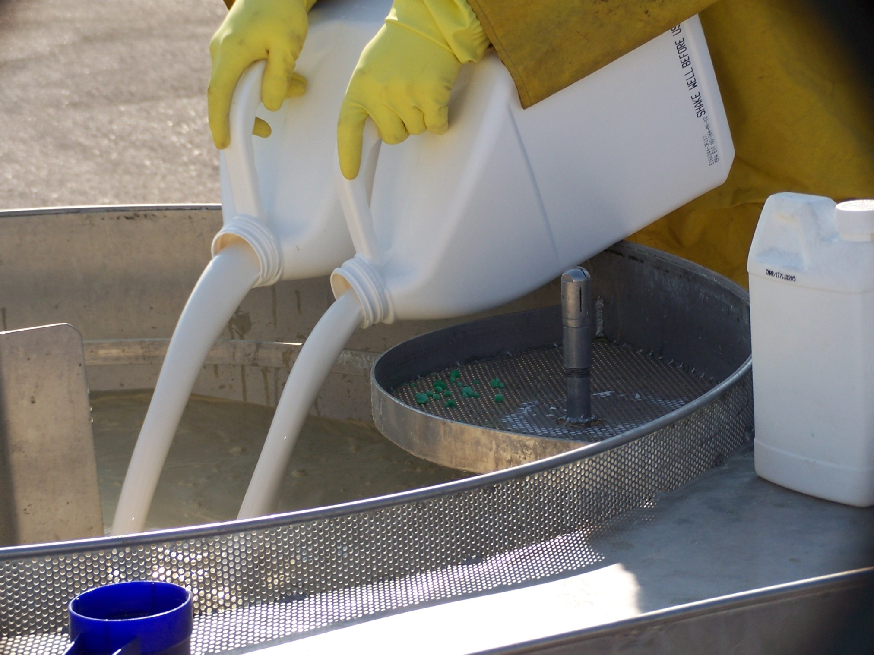
Practice proper pesticide mixing, loading, storage, and disposal to protect water resources.
Photo courtesy of Gail Amos, WSDA
Notes:
When using pesticides, mix only the amount of product needed for the job. This prevents having unused product that requires proper disposal.
Always check product compatibility to avoid application problems.
Never leave pesticides in a spray rig overnight, because products may separate or settle. This also reduces the potential for spills and leaks.
Triple rinse or pressure rinse containers and pour rinsate back into the tank. Triple- or pressure-rinsed and punctured containers are accepted by pesticide container recycling programs. This helps avoid excessive plastic in landfills, and it minimizes illegal pesticide and pesticide container disposal.

Slide 46
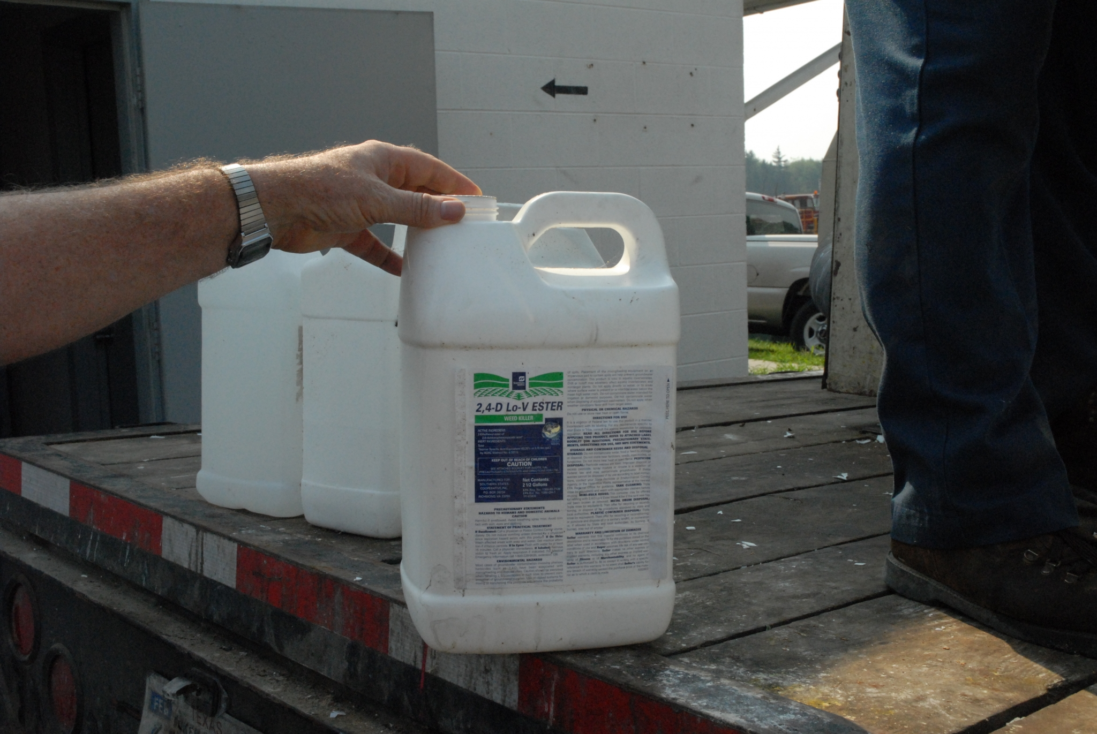
Always dispose of unwanted pesticides and empty containers properly.
Photo M. J. Weaver, Virginia Tech
Notes:
Always dispose of unused pesticides and empty containers in accordance with state and local regulations. Proper disposal of unwanted pesticides and containers helps prevent contamination of soil or sites, which also prevents related leaching into groundwater or contamination of surface water with runoff. Here, empty pesticide containers are being collected for recycling.

Slide 47

Do not fill spray tanks near a wellhead.
Photo courtesy of M.J. Weaver, pesticidepics.org (Virginia Tech)
Notes:
To avoid water contamination to your well, never mix pesticides near a water body or wellhead. Do not leave a sprayer unattended while filling. Most states require that when filling a tank or handling pesticides, you are 100 feet from the wellhead. [Presenter Note: Check the requirement for your own state.]

Slide 48

Mix and load pesticides on impermeable sites.
Photo courtesy of Gail Amos, WSDA
Notes:
Construct impermeable mixing/loading pads at permanent mixing/loading sites. Do not mix on hard-packed roads, since this could allow pesticides to drain or run off into nearby waterways. The mixing and loading area shown here is sloped to a central sump. In areas where there is a lot of mixing/loading, an impermeable surface prevents pesticides from accumulating in the soils. Chemicals that accumulate in the sump are pumped back into a spray tank for use in the field application.

Slide 49


Always store pesticides in secure locations to avoid pesticide spills and contamination.
Photos courtesy of Wayne Buhler, NC State
Notes:
Store all agricultural chemicals in a locked, well-marked building with impermeable floors. Always store pesticides in their original containers with their labels intact, visible, and legible. Periodically inspect storage facilities to be sure containers are not leaking and have not been knocked off of shelving.

Slide 50

Use practices to reduce runoff and erosion.
Photo courtesy of USDA-NRCS
Notes:
Terracing, conservation tillage, grass buffers, and cover crops are all mechanisms used to protect water quality. Terracing, as shown in this photo of a California vineyard, prevents runoff from contaminating down-slope water. Conservation tillage and residue management are used to reduce runoff and erosion, especially during critical erosion periods. Crop residue left on the soil surface increases water absorption and reduces the volume of surface runoff. Grass buffers are also sometimes used between fields and wetlands to protect water quality. Planting cover between rows in orchards and vineyards is another way to reduce runoff.

Slide 51

Use constructed wetlands to collect contaminated sediment.
Photo courtesy of USDA-NRCS
Notes:
A constructed wetland improves water quality by reducing sediment, nutrients, and pesticides in runoff. Tailwater can also be recovered in ditches at the ends of fields to prevent the water that runs off fields from directly entering surface water. Field runoff is generally heavy with sediment that can contain pesticides. These ditches and constructed wetlands allow the sediment to settle. Your local NRCS office can provide assistance with constructed wetland design or other best management practices.

Slide 52

Use products such as PAM to avoid runoff-generated erosion.
Furrow irrigation water without PAM
Furrow irrigation water with PAM
Photo courtesy of NWISRL, ARS, Idaho
Notes:
Polyacrylamide (PAM) is a white, granular substance used in agricultural settings to bind soil particles and allow them to settle out in water rather than to be carried off site. PAM is used in surface irrigation to reduce erosion. It is typically applied during the first irrigation, treating the first 5 feet of the furrow. Subsequent applications in irrigation water may be needed when there is soil disturbance (e.g., cultivation) or when soil movement is observed. The use of PAM in the furrow irrigation water pictured on the right removed sediment.

Slide 53

Always check the weather before making a pesticide application.
Weather Monitoring
Notes:
Select an appropriate historical and real-time source for weather information. Weather monitoring is an important BMP not only to predict the best times for a pesticide application but also to help you monitor pest outbreaks and degree days. Reliable weather data, such as that on the National Weather Service site (http://www.weather.gov/), can help you avoid making applications when conditions are not optimal. Always monitor and record weather conditions prior to, during, and after an application. Delay applications when significant rainfall events are forecast. High rainfall events can cause soil-applied pesticides to run off into surface waters or leach into groundwater. Do not apply pesticides when an inversion is forecast. Take note of temperature and humidity predictions, and avoid using highly volatile pesticides when temperatures will be high and humidity low.
[Presenter Note: You may want to add information on volatile pesticides used in your area.]

Slide 54

Pursue continuing education opportunities.
Notes:
Maintain your pesticide license with continuing education, and keep up to date with new products, techniques, and regulatory changes, especially regarding pesticide applications and protection of water quality and endangered species.

Slide 55
Using science-based best management practices will help protect our water resources.
Photo courtesy of Joel Sartore, National Geographic

Slide 56
The Western IPM Center would like to thank the following people for their assistance reviewing this training module:
Troy Bauder, Colorado State University
Wayne Buhler, North Carolina State University
Steve Castagnoli, Oregon State University
Laurie Gordon, Oregon Department of Agriculture
Jeff Jenkins, Oregon State University
Kelly McLain, Washington State Department of Agriculture
Jennifer Miller, Northwest Center for Alternatives to Pesticides
Jennifer Ryder Fox, California State University
Sherman Takatori, Idaho State Department of Agriculture

