Slide 1
Water Quality Protection
Measures for Homeowners
Authors:
Sue Donaldson, University of Nevada
Carrie Foss, Washington State University
Darren Haver, University of California
This slide set was funded by USDA NIFA through
the Western Integrated Pest Management Center
January, 2013
Notes:
This module is designed for use by educators to teach homeowners about the ways in which pesticides can move into water after they are applied, about the soil and pesticide properties that influence the movement of pesticides, and about how you can use best management practices to protect water resources. The slide set was funded by the USDA NIFA through the Western Integrated Pest Management Center. We would appreciate input from you on your use of these slides. Please send input to Carla Thomas, Associate Director, Western IPM Center, cthomas@ucdavis.edu or wripmc.org

Slide 2
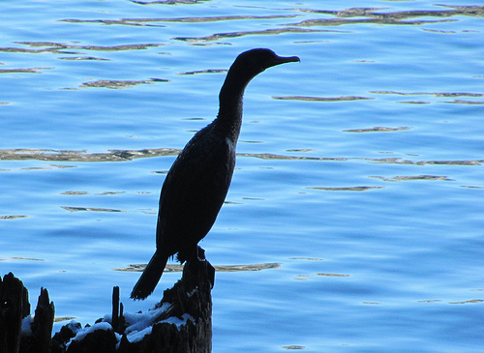
How can you protect water when using pesticides?
Photo courtesy of mtsvancouver
Notes:
How can you protect water when using pesticides?
This module is designed for use by educators to teach homeowners about the ways in which pesticides can move into water after they are applied, about the soil and pesticide properties that influence the movement of pesticides, and about how you can use best management practices to protect water resources. The slide set was funded by the USDA NIFA through the Western Integrated Pest Management Center. We would appreciate input from you on your use of these slides. Please send input to Carla Thomas, Associate Director, Western IPM Center, cthomas@ucdavis.edu or wripmc.org

Slide 3
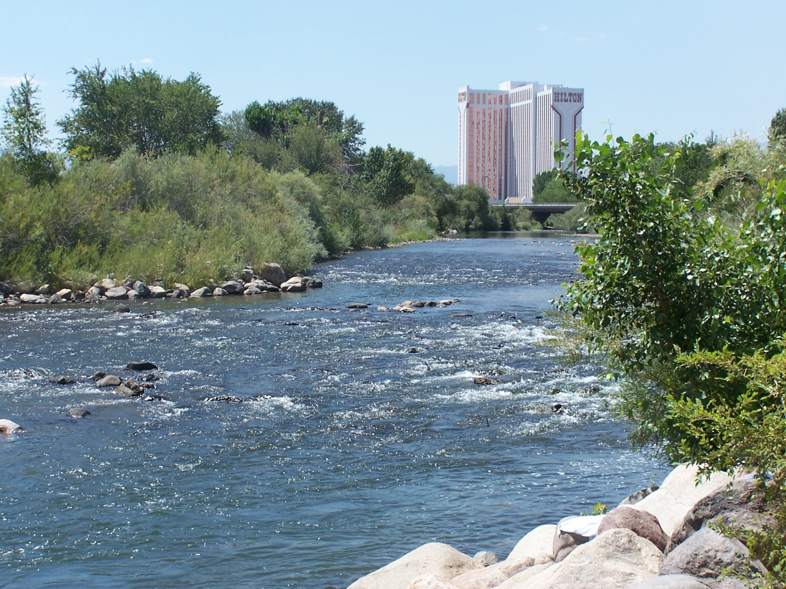
Pesticides have been found in water in many places.
Notes:
Water quality monitoring programs conducted in many western states, as well as in other parts of the country, have identified pesticides as the main or a contributing factor affecting water quality. Contamination of urban waters by pesticides may result when people have little understanding about what happens to pesticides once they are applied in an urban environment.

Slide 4
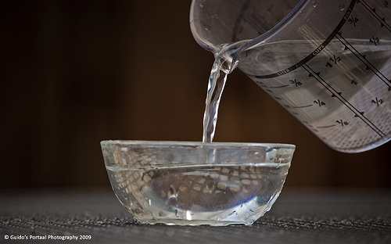
It is possible to use pesticides and protect water quality.
Notes:
The goal of this presentation is to provide you with a better understanding of how pesticides can end up contaminating urban waters -- but more importantly, what you can do to help ensure that pesticides applied by you have little or no impact on water quality and the organisms that live in water.

Slide 5
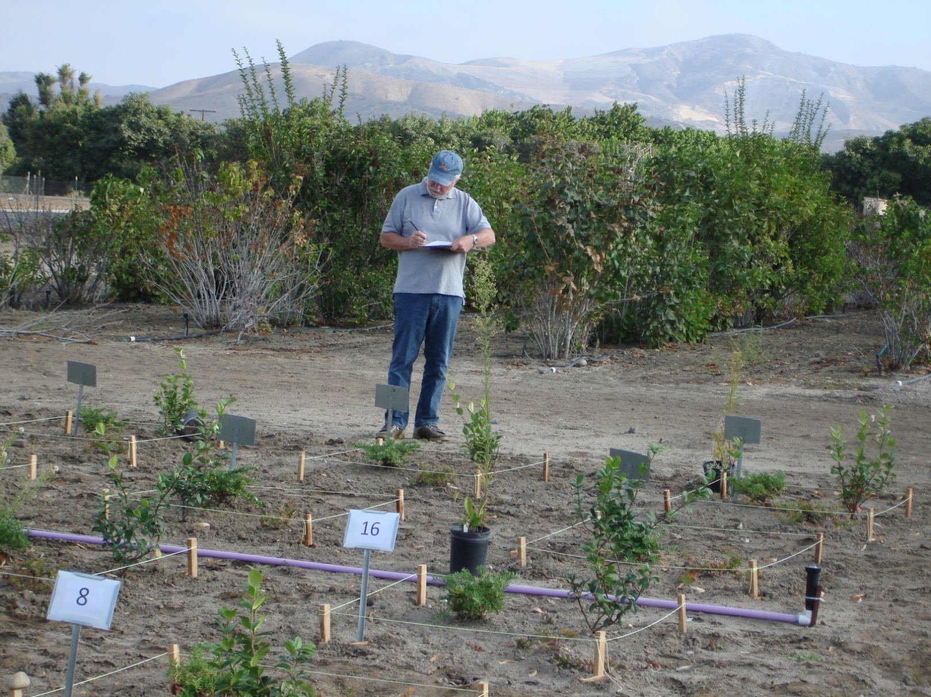
Use science-based best management practices to protect water.
Notes:
There are several tools available to you to effectively manage pests while still protecting water quality. This presentation includes 1) a basic explanation of the different ways pesticides can easily enter waterways, 2) information on how soil and pesticide properties and weather impact pesticide movement, and 3) the simple management practices you can implement to lessen the likelihood that the use of a pesticide will impact water quality.

Slide 6
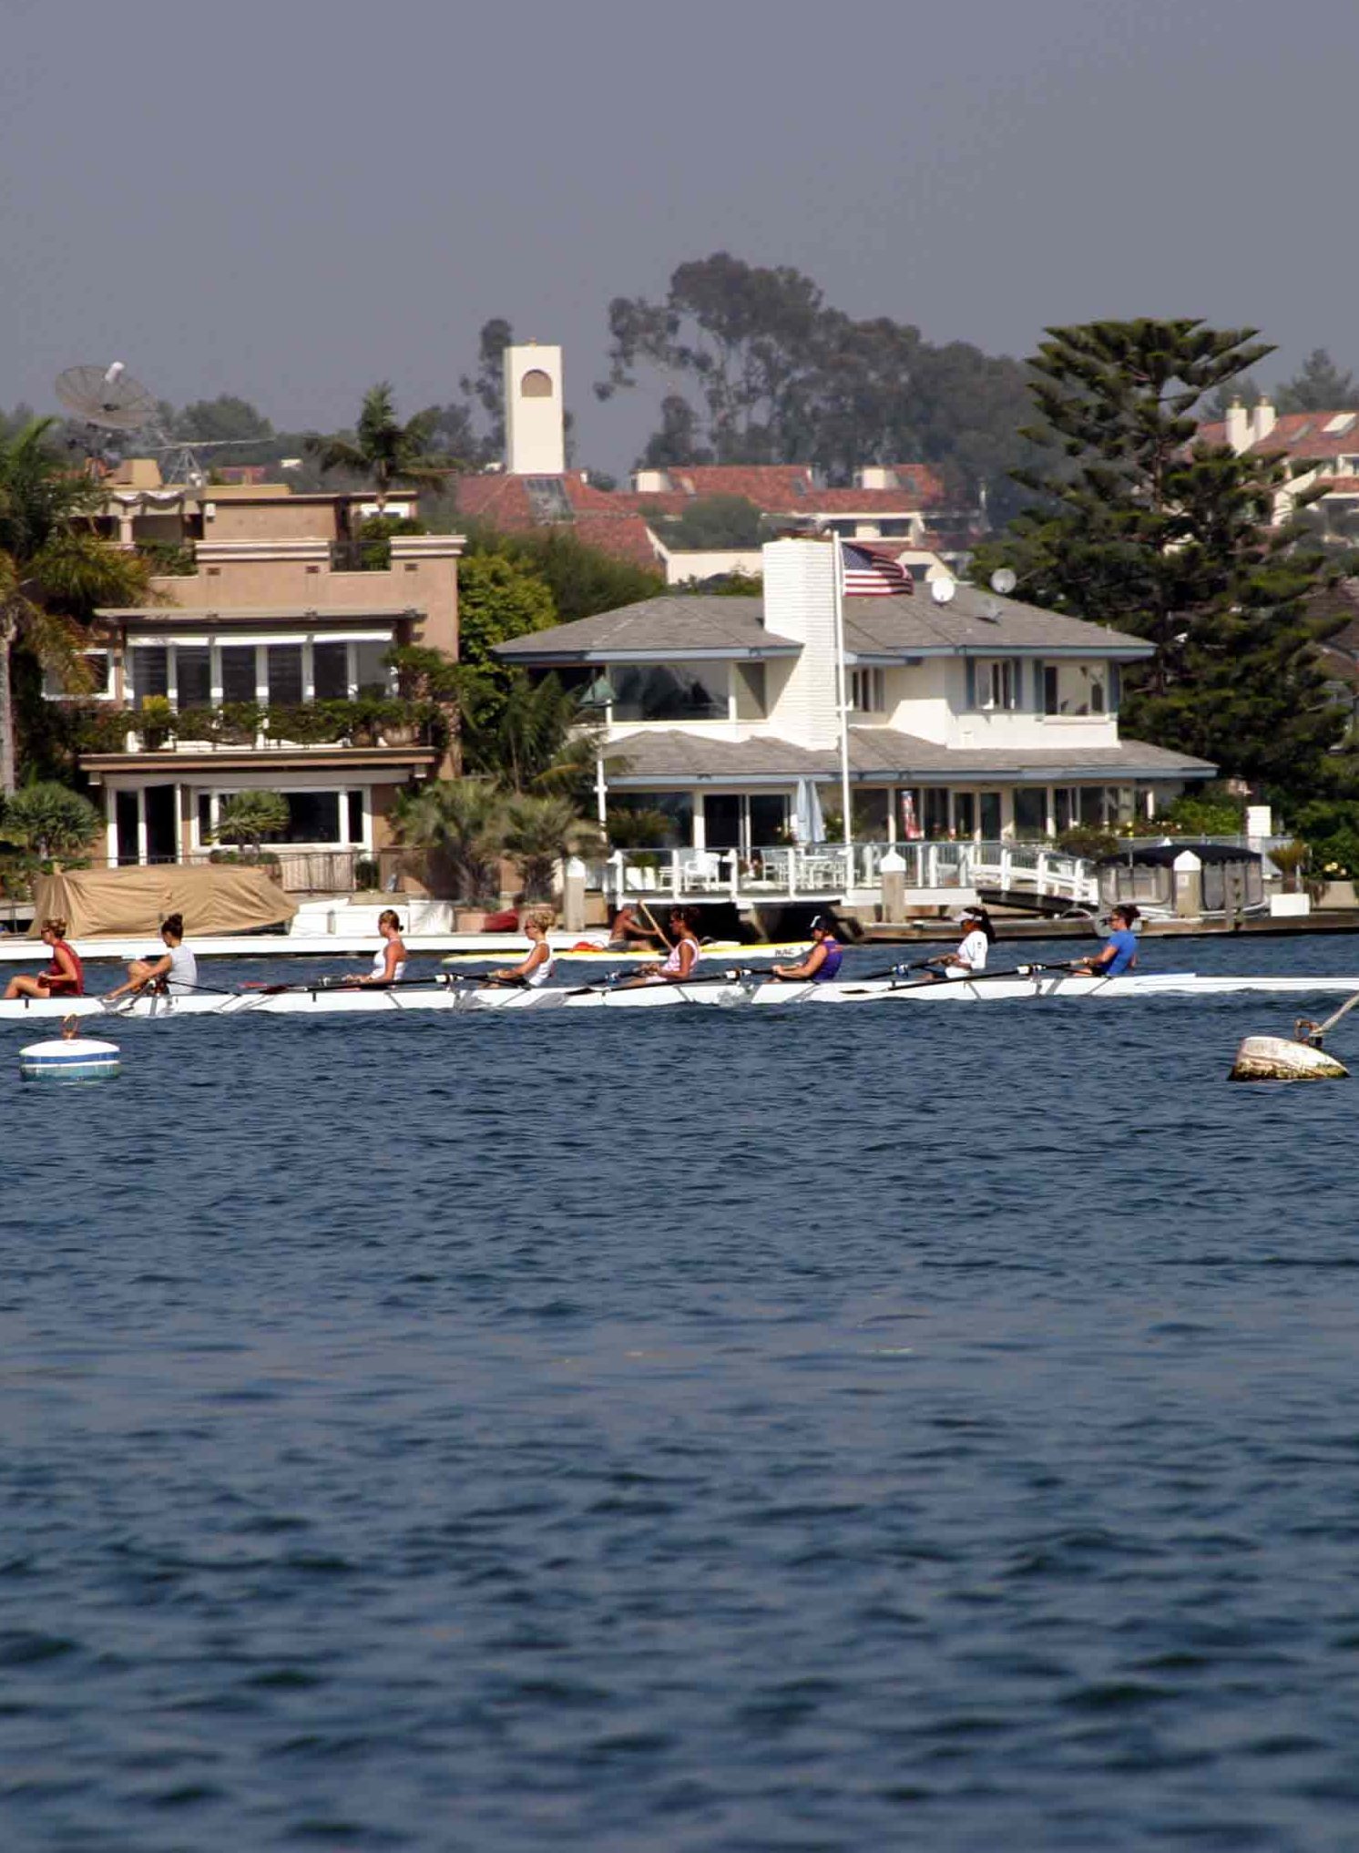
How can pesticides get into water?
Photo courtesy of gmeador
Notes:
Let’s discuss how pesticides can move away from the area where they are applied and how they could get into water.

Slide 7
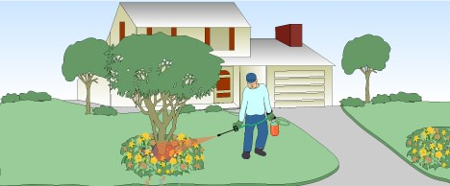
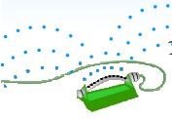
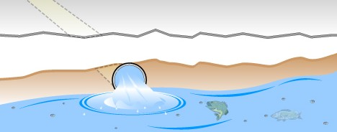
There are several ways that pesticides get into water.
Pesticide applied to landscape
Irrigation
Pesticides can run into gutters, storm drains, and eventually creeks, rivers, or oceans.
Graphics used with permission from UC IPM
Notes:
Because pesticides are applied to many areas of a landscape where they may come into contact with water from irrigation or rainfall, they have the potential to both leach into groundwater and flow into storm drains. Storm drains are often directly connected to creeks, rivers, lakes, or the ocean, so contaminants in this water have a high potential to impair water quality. In most cases, the water in storm drains is not treated. In addition, the high percentage of impervious surfaces (i.e., surfaces that shed water, such as pavement and roofs) that are typical of urban landscapes reduces infiltration and increases surface runoff, carrying pesticides farther from the site of application.

Slide 8
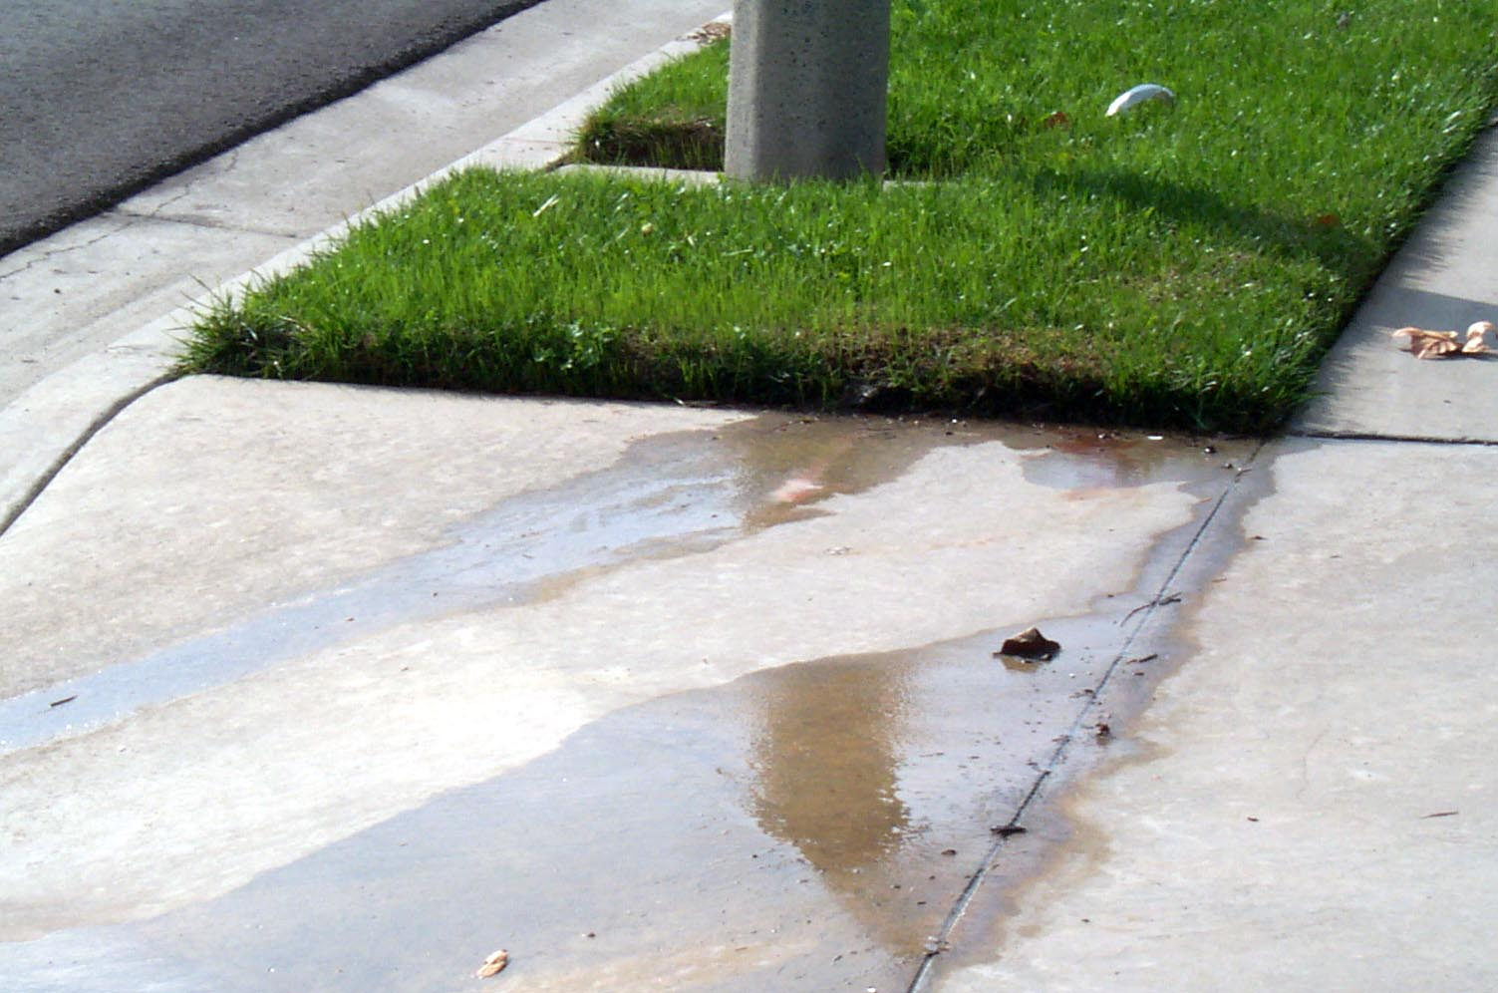
Runoff can move pesticides off site.
Notes:
Runoff is excess water that moves off the landscape. The factors that contribute to whether runoff occurs include the grade or slope of the area, soil texture, and the amount of vegetation. Soil that’s saturated can’t take in the water, so it runs off. The amount and timing of irrigation or rainfall is critical. The pesticide characteristics, especially water solubility, also play a role.
Irrigation overspray is a common cause of runoff that washes pollutants, including pesticides, off paved surfaces. It is difficult to irrigate up to the pavement edge without overspray that results in runoff. In arid areas, summer runoff is often primarily a result of over-irrigation or overspray.

Slide 9
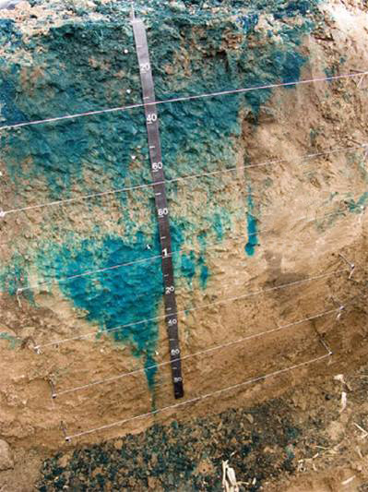
Pesticides can leach into the water table.
Photo courtesy of Kansas Geological Society
Notes:
This photo shows the concept of leaching, or movement of water downward through the soil. Colored dye applied to the soil surface has been carried down into the soil with the application of water. In this same way, pesticides that are dissolved in the water can migrate into groundwater. Pesticides in groundwater are a problem because groundwater may be a source of drinking water or irrigation water, or it may feed into streams, lakes, or other surface water. Pesticides can leach due to natural water movement from rain or snowmelt or with excess irrigation. Some soil types, such as coarse-textured or sandy soils, also increase the likelihood of pesticides moving down through the soil profile. Soluble pesticides (pesticides that dissolve readily in water) are more likely to leach.
Contaminated groundwater from pesticides leaching through the soil is nearly impossible to completely clean up, and it is extremely costly. It is much better to prevent groundwater contamination in the first place by using preventive practices.

Slide 10
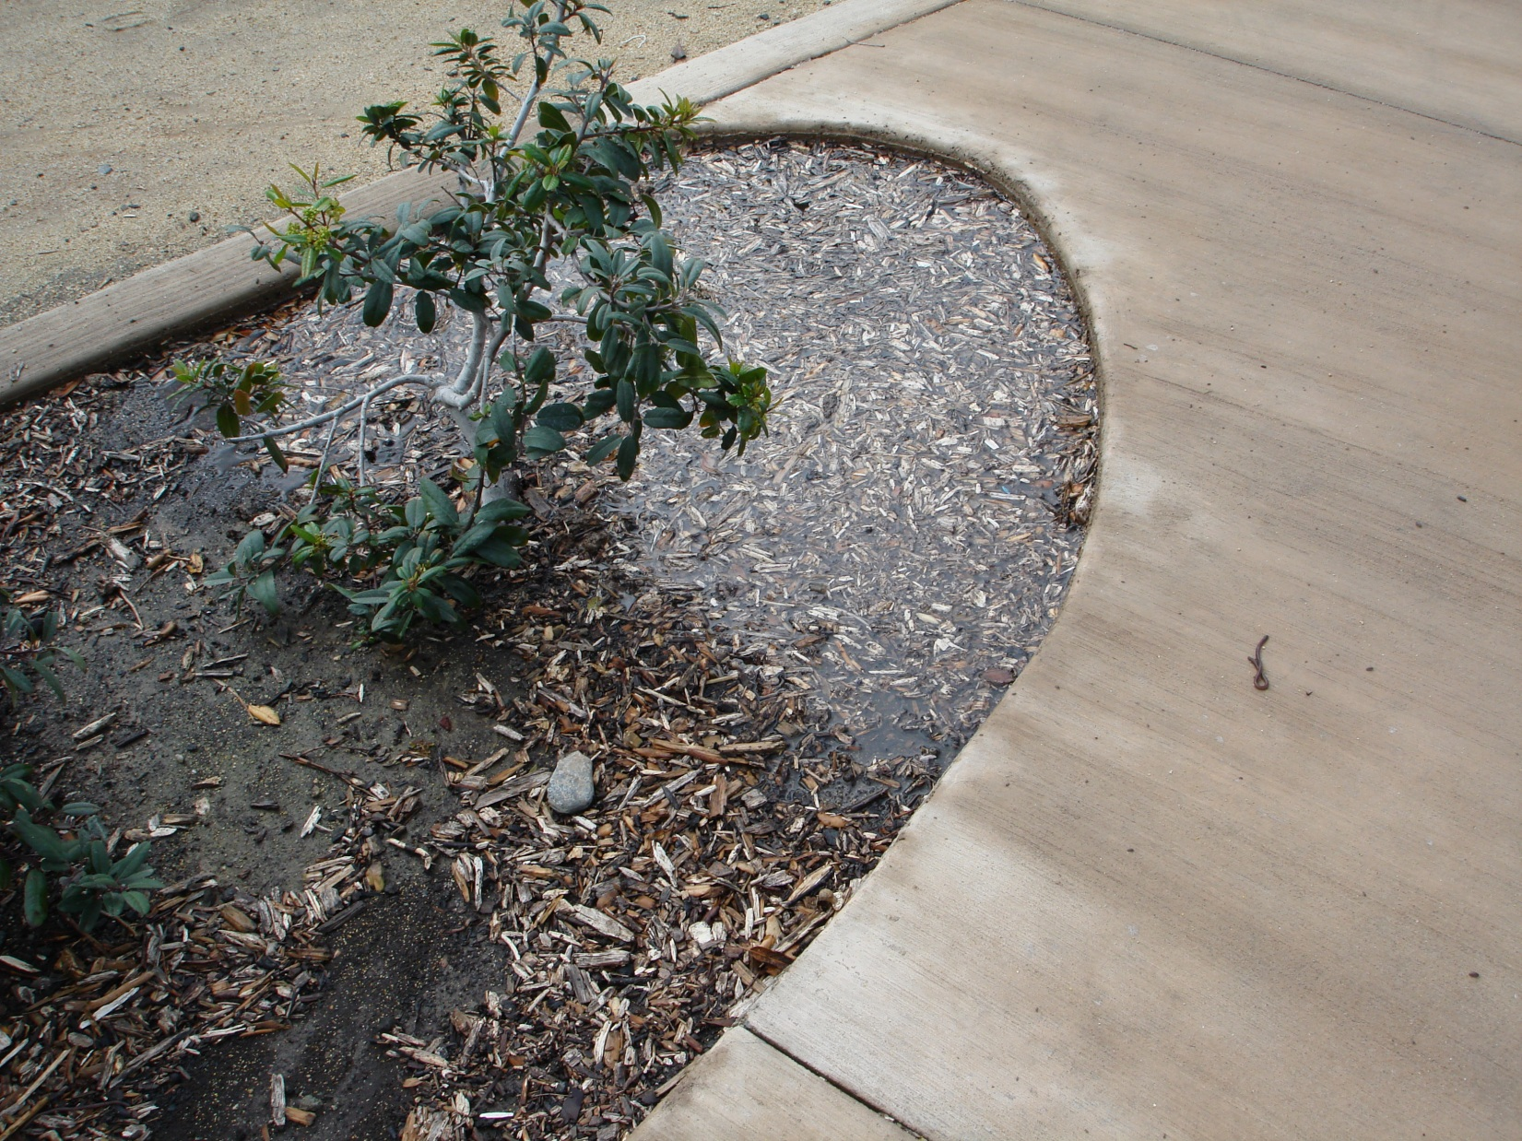
Rain or excessive irrigation after a pesticide application may leach soluble pesticides.
Notes:
In addition to increasing the potential for groundwater contamination, water can carry soluble pesticides farther into the soil where they are no longer effective at controlling the pest.

Slide 11
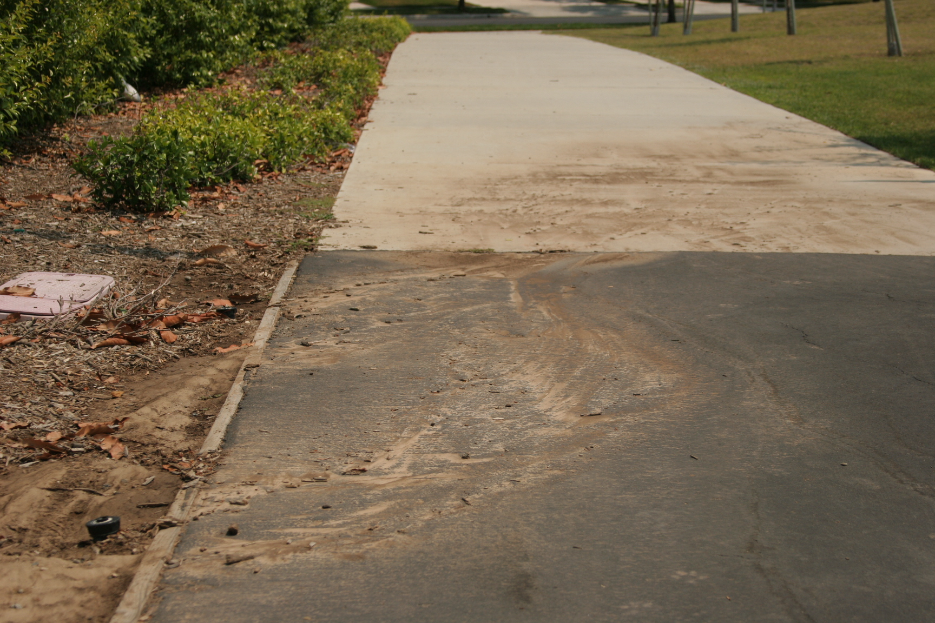
Pesticides can move with soil.
Notes:
Erosion is the process by which soil moves from the landscape due to flowing water. This can happen because of problems with irrigation equipment (such as line breaks) resulting in runoff; because of errors in irrigation management (over-irrigation); or because of weather (excessive rainfall or snow melt). The speed and amount of runoff determine the extent of erosion. When erosion occurs, pesticides adsorbed (attached) to soil particles will travel off site with the eroded soil.

Slide 12
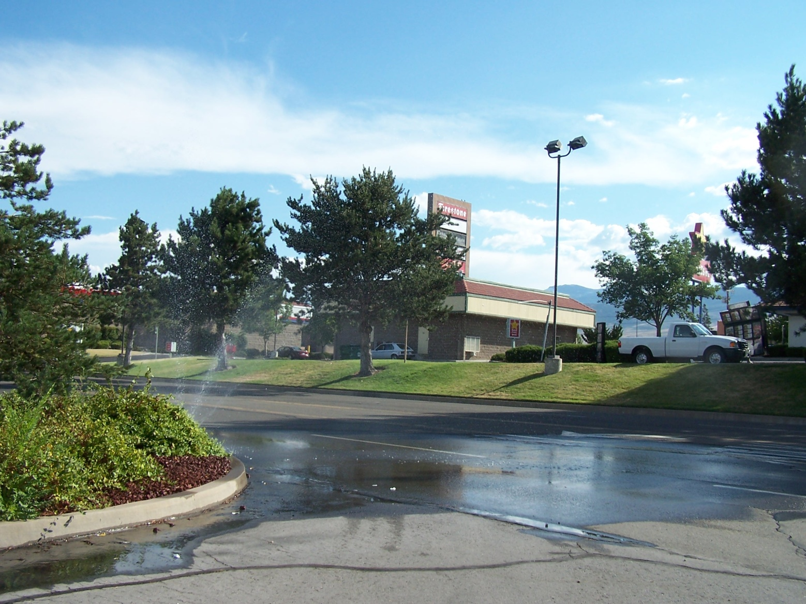
Paved surfaces and sidewalks can contribute to pesticide runoff.
Notes:
Pesticides applied directly to, or drifting onto, paved surfaces and sidewalks may be mobilized by irrigation or rain runoff, making their way into storm drains and ultimately into waterways, where they can cause water quality impairments. Pesticide movement is impacted by the type of hardscape (e.g., concrete, decomposed granite, stone, asphalt, etc.) the pesticide comes into contact with as well as the overall chemistry of the pesticide.

Slide 13

Spray applications can drift into water.
Photo courtesy of camknows
Notes:
When pesticides are applied as sprays, the smaller droplets can drift from where they are applied. If you are spraying next to lakes, streams, canals, or other bodies of water, some of the spray could drift onto the water and cause contamination. In this photo of Lake Washington, there are lawns directly adjacent to the lake. This lake, in western Washington, is a recreational area for many people. The best way to avoid spray drift entering the water here would be to avoid applying pesticides directly adjacent to the lake. Create a buffer, or no-spray zone, between the water’s edge and the pesticide application.

Slide 14

Pesticides can volatilize and move in air as vapor drift.
Wind
Drift
Vapor
Notes:
Pesticides can also move off site and enter water by volatilization or vapor drift. If a pesticide is applied to soil or plants as a granular product or spray, it may volatilize, becoming a gas or vapor, and enter the air stream. The vapor can be carried off site and deposited into nearby water. Conditions of high temperature, low humidity, and increasing wind speeds increase the potential for pesticide volatilization.

Slide 15
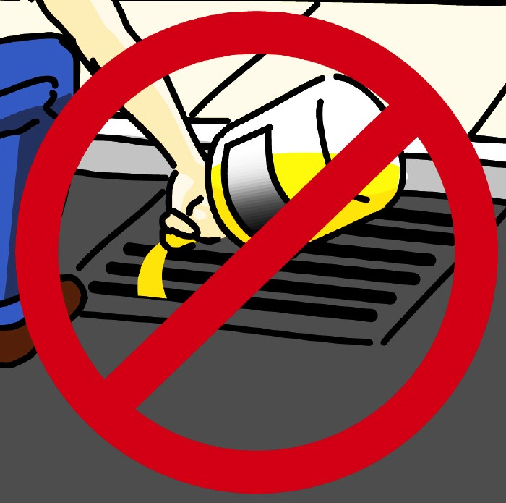
Improper pesticide handling can contaminate water.
Notes:
Misapplication, spills, and improper storage, mixing/loading, or disposal of unused or unwanted pesticides are the most likely pathways for pesticides to move from your home landscape into the storm drain system.

Slide 16
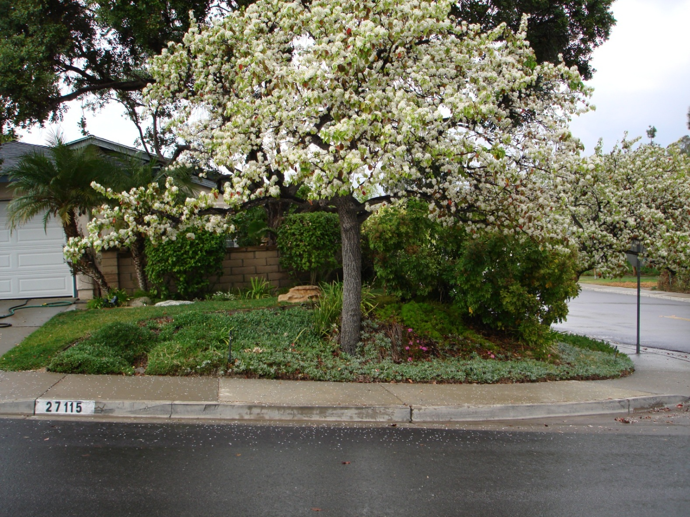
Weather conditions impact pesticide movement.
Notes:
The weather can have a significant effect on the movement of pesticides away from where they are applied. It is important to understand how weather affects pesticide movement and avoid conditions that could lead to off-target movement and water contamination.

Slide 17
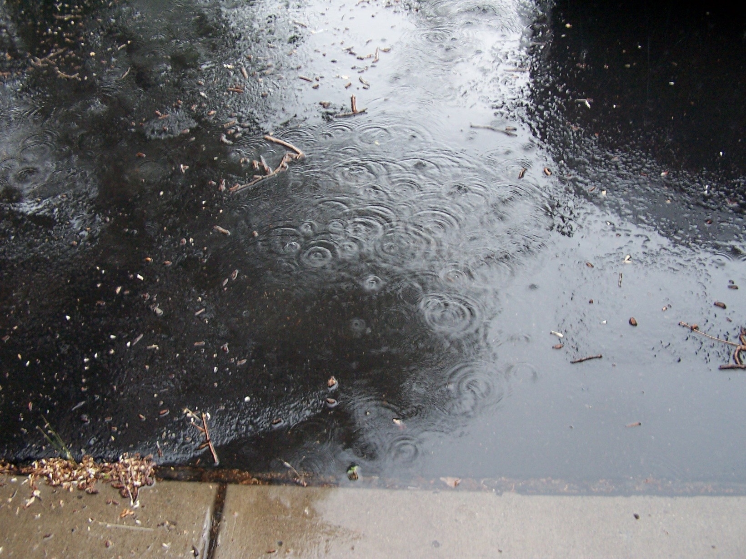
Excessive or untimely rainfall can carry pesticides away from the application site.
Notes:
Pesticide applications made to the home landscape prior to rainfall events may be washed from the point of application into landscape drains or directly into the gutter. Products that enter the storm drain system may then contaminate water. Do not apply pesticides when heavy rainfall is expected within 48 hours.

Slide 18
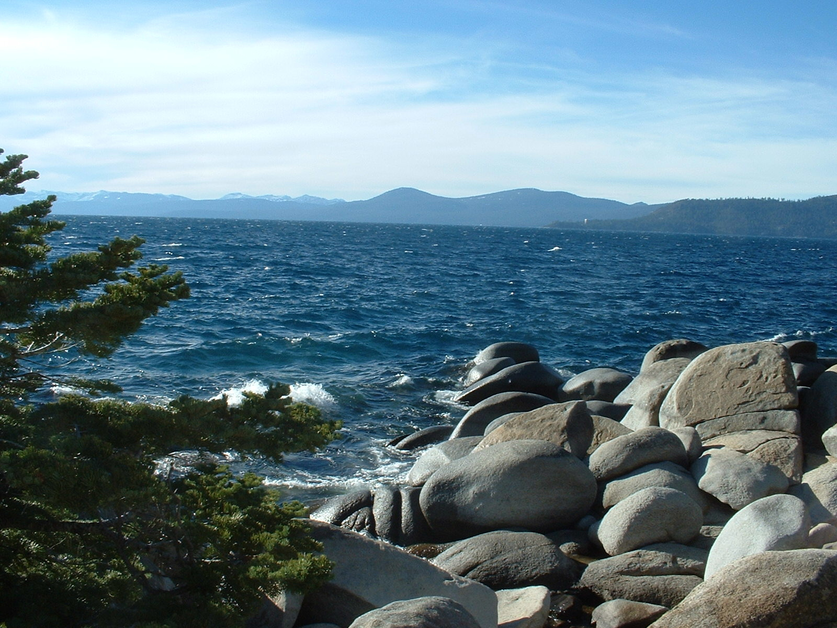
Wind can blow pesticides into nearby waterways.
Notes:
Wind can blow pesticide spray droplets into nearby waterways. Dust applications or pesticides attached to soil can also be blown about and end up in water.

Slide 19
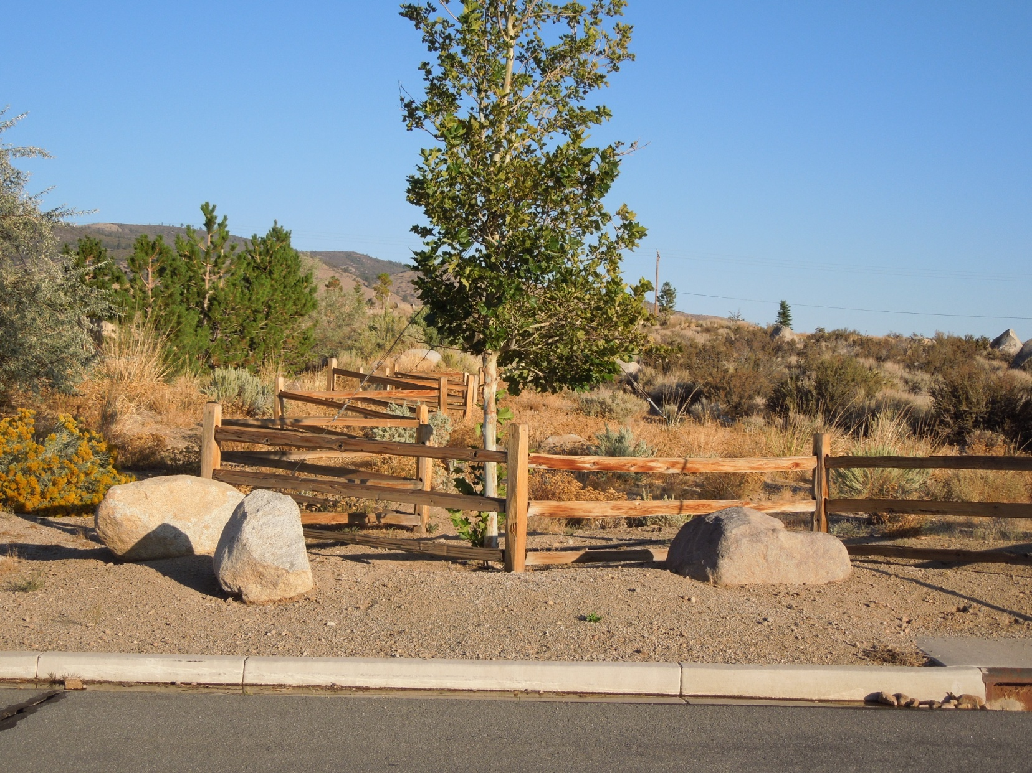
High temperature and low humidity increase volatility.
Photo courtesy of Monica Guy
Notes:
Vapor drift is more of a problem when the temperatures are high and the humidity is low. Some urban areas have these conditions during much of the year.

Slide 20
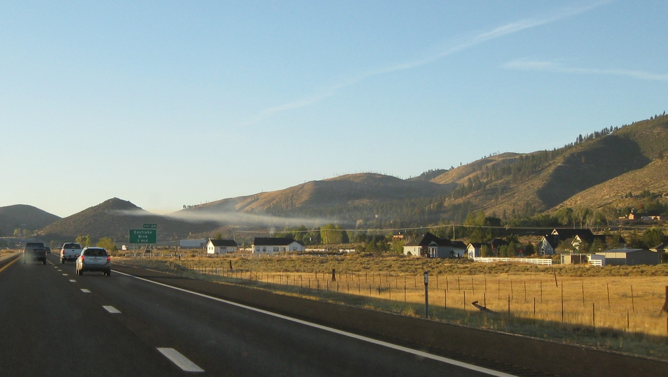
Long-distance drift can occur when there is an inversion.
Notes:
This photo shows an early-morning inversion layer in Washoe Valley, Nevada. Smoke from wood-burning is traveling horizontally along the inversion layer. If a pesticide is applied during an inversion, it can travel long distances horizontally along the inversion layer. Never apply pesticides during an inversion. Check your local weather forecast to determine whether an inversion is expected.

Slide 21
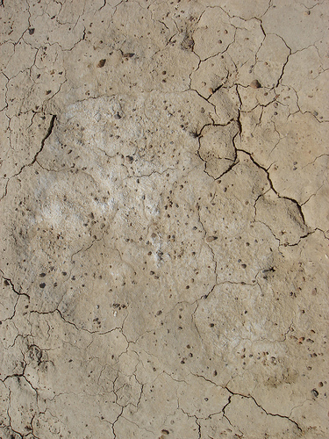
Soil characteristics and pesticide properties influence off-site movement of pesticides.
Notes:
We have looked at the ways that pesticides can move away from the place where they were applied and end up in water. Soil characteristics and pesticide properties also influence the potential for pesticide movement.

Slide 22
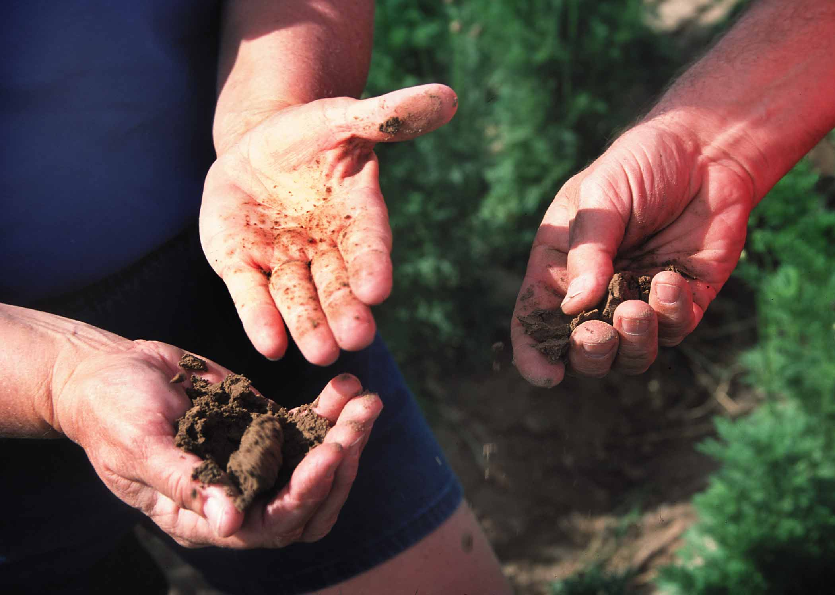
Soil texture and structure affect water-holding capacity and infiltration.
Photo courtesy of USDA-NRCS
Notes:
Soil texture and soil structure are important physical properties that determine the arrangement of soil particles and amount and type of soil pore space (spaces occupied by air and water). Soil texture is the amount of sand, silt, and clay in a soil. Structure is the grouping of soil particles into larger aggregates or clods. Soil texture and structure determine a soil’s water-holding capacity and the extent and speed with which water enters the soil (infiltrates) and moves through the soil (percolates).
Coarse-textured soils, with high sand content, have large pore spaces and low water-holding capacity, increasing water movement. Fine-textured soils, like clay, have very small pore spaces and bind water tightly to clay particles, reducing the potential for leaching. Silty soils are intermediate to sand and clay, with medium-sized pore spaces. Coarse soils tend to have a higher potential for deep percolation and leaching of pesticides.

Slide 23
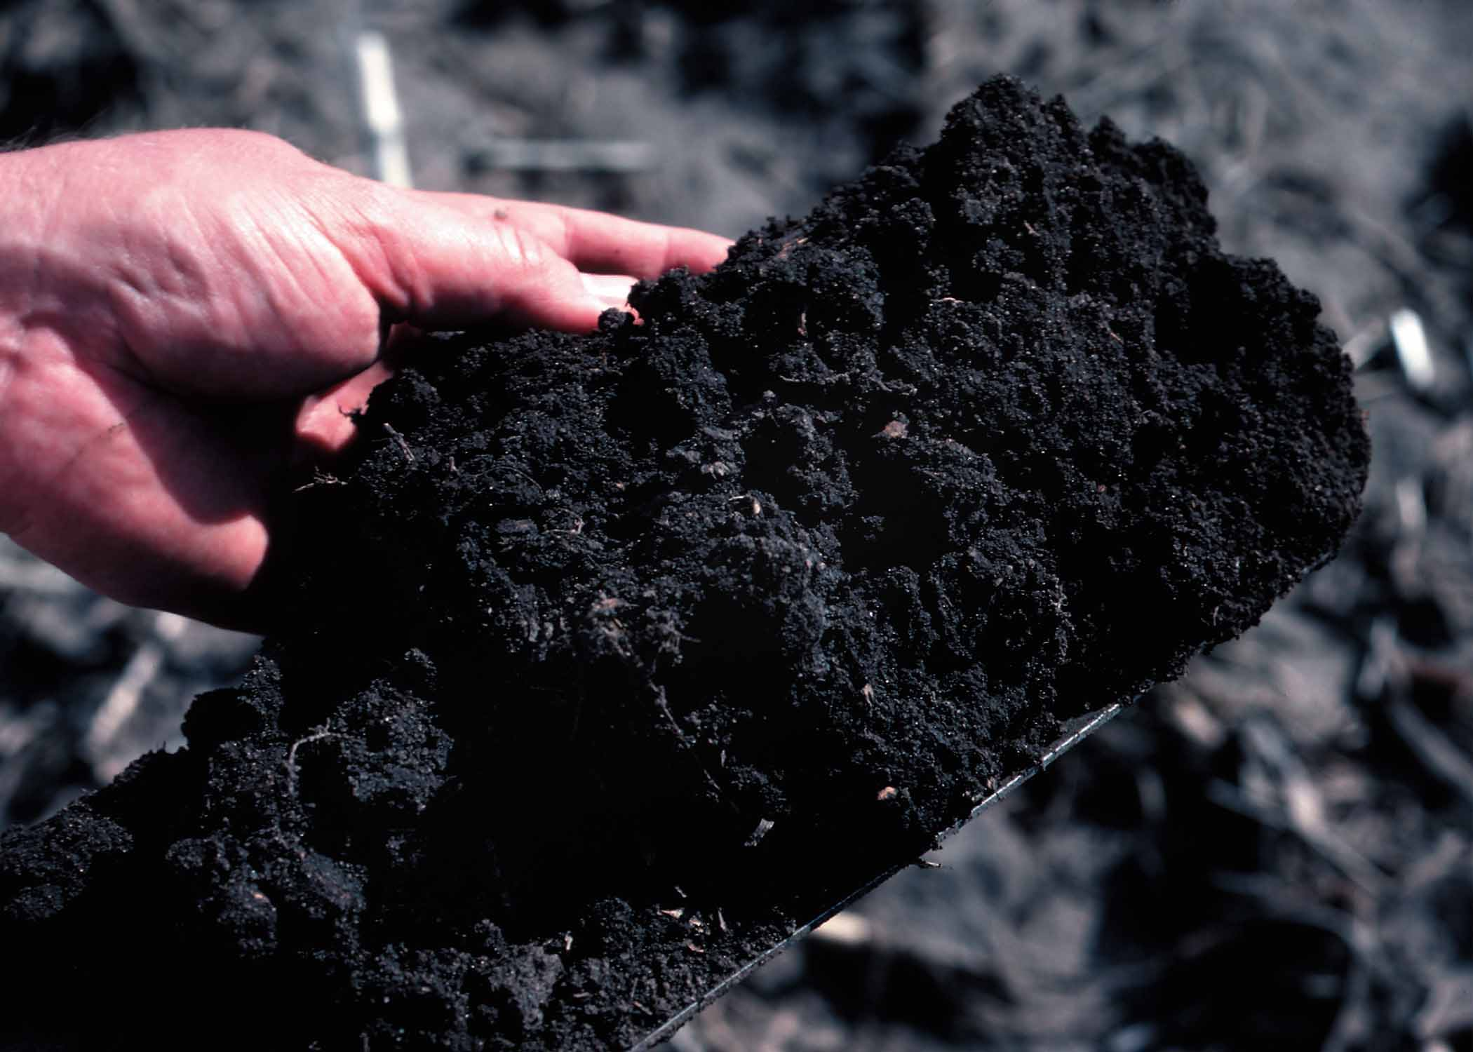
Soils that are high in clay or organic matter bind pesticides tightly.
Photo courtesy of USDA-NRCS
Notes:
Pesticide adsorption to soil is important to the fate of the pesticide. Adsorption, that is A-D-sorption, is the physical binding of the pesticide molecules to the outside of soil particles and organic matter. Clay and organic soils have many, many binding sites and adsorb a lot of pesticide. If a pesticide is adsorbed or bound to the soil, it doesn’t move freely with the soil water, and water contamination concerns are greatly reduced.
Soil organic matter influences soil structure and water-holding capacity, provides a source of energy for microorganisms, and can retain nutrients and adsorb other chemical constituents. All of these characteristics impact pesticide movement and persistence.
Soil pH typically ranges from 5 to 9. Most pesticides are labeled for specific soil conditions. If soils have a pH outside the label’s allowed range, pesticides may become ineffective, may be changed to an undesirable form, or may not degrade as expected. Soil pH also influences microbial activity, which can also impact pesticides.

Slide 24
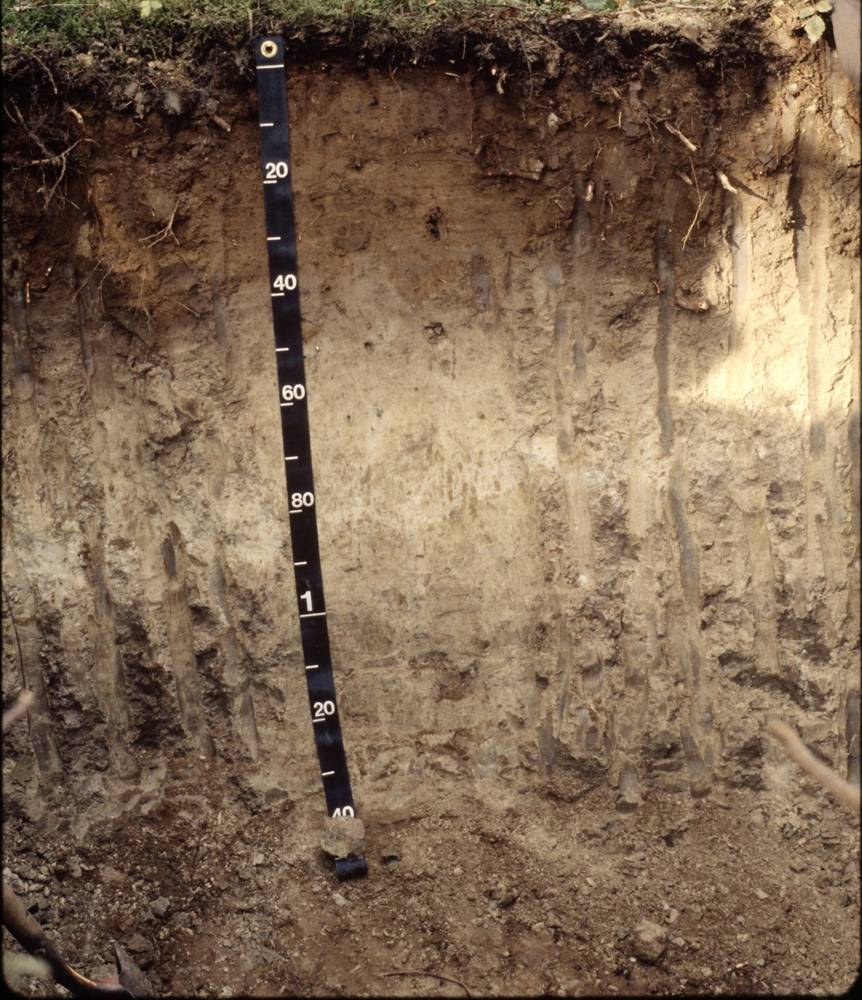
The deeper the soil, the more opportunity for pesticides to be retained and the less potential for leaching into groundwater.
Photo courtesy of USDA-NRCS
Notes:
The depth of the soil and the thickness of different soil horizons can influence the movement of water and soluble pesticides. The greater the distance to groundwater, the more opportunity there is for pesticides to be retained (adsorbed) and the lower the potential is for leaching. Likewise, the thicker the topsoil layer (where most of the organic material is located), the greater the opportunity for pesticide adsorption and retention within the rooting zone.
A soil is made up of individual layers with different soil properties, called soil horizons. The upper soil horizon generally contains considerable amounts of organic matter. As mentioned in the previous slide, organic matter increases pesticide adsorption and thus helps reduce leaching. Some soils contain restrictive soil horizons (e.g., thick clay layers) which can significantly reduce leaching and groundwater contamination. Soil depth, or the amount of soil overlaying bedrock, can also determine the potential for leaching. Soil temperature and soil moisture also vary with depth, and these properties also influence how well pesticides work and how long they remain in the active form.

Slide 25
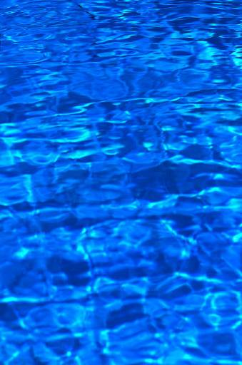
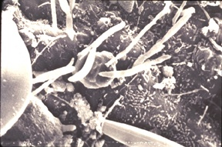

Pesticide Properties: Pesticides are degraded in the environment by microorganisms, sunlight, and chemical processes.
Hydrolysis
occurs
at
high pH.
Notes:
Understanding how readily a pesticide degrades and the mechanism of how it degrades is important. Generally, after a pesticide degrades it becomes inactive in the environment, having no impact on water quality. However, there are some degradation products of pesticides (e.g., atrazine) that may still be active and contaminate water resources. Microbial degradation is the process in which soil microorganisms feed on pesticides and break them down. Soil conditions that favor microorganism reproduction increase the degradation process. These soil conditions include warm soil temperatures, aeration, adequate soil moisture, fertility, favorable pH, and adsorption. Simple chemical reactions that occur in the soil can also lead to pesticide degradation. Pesticides break down in water (hydrolysis). In natural field settings, hydrolysis occurs most often in soils with higher pH (alkaline soils). The mixing of water and the pesticide can result in hydrolysis, which causes pesticides to break down. Sunlight can cause another type of pesticide breakdown called photodegradation.

Slide 26
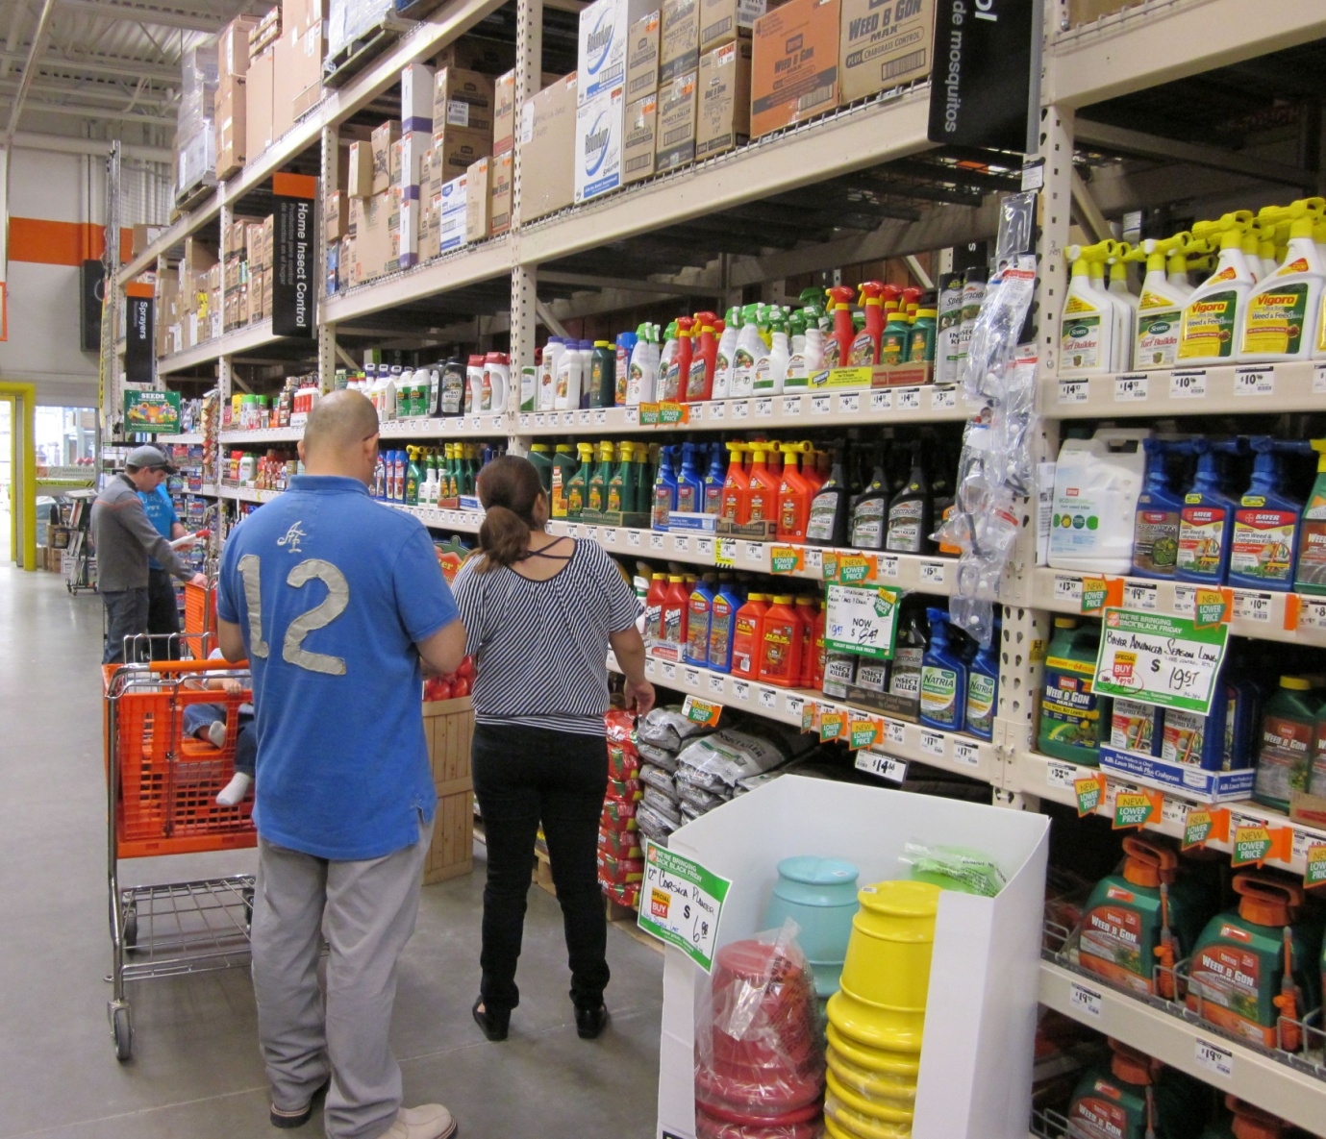
Certain pesticide properties are more conducive to off-site movement.
Notes:
Pesticide active ingredients and formulations also have properties that you need to consider. When you purchase a pesticide, the active ingredient in the pesticide is the chemical that kills the pest. The formulation is the mixture of ingredients that comes in the container. It may contain water, stabilizers, and other ingredients to aid in application or safety.

Slide 27
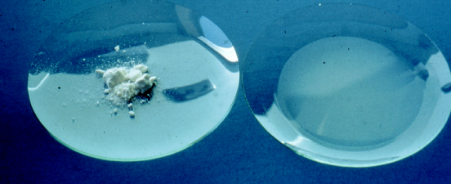
Water-soluble pesticides are more likely to move with water.
Notes:
Solubility is a pesticide’s ability to dissolve in water or some other solvent. In this picture, the dry pesticide product on the left was mixed with water and completely dissolved as shown on the right. This pesticide is water-soluble and more likely to move off site with runoff water or down through the soil into the groundwater. Once in the water, the pesticide can move and spread quickly.

Slide 28
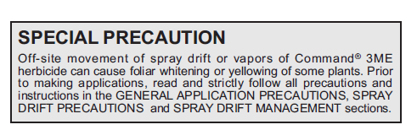
Volatile pesticides can move long distances off site.
Notes:
Some pesticide products are more prone to volatilize and move off site as vapor drift. Once airborne, volatile pesticides can move long distances off site with air movement.

Slide 29
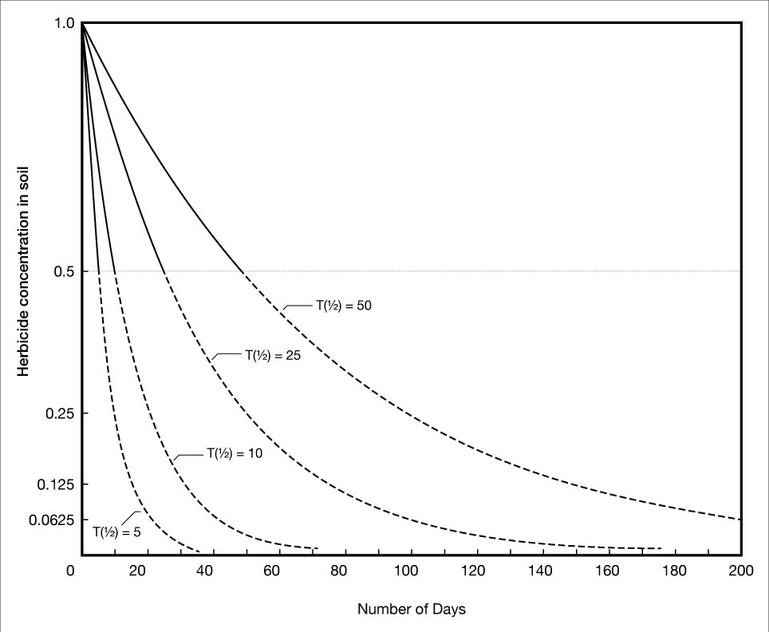
Persistence is how long a pesticide remains active before it breaks down.
Notes:
Persistence is another important pesticide characteristic to consider when assessing impacts on the environment. Persistence is the measure of how long a pesticide remains active before it breaks down, or degrades. Persistent pesticides don’t break down for some time, which makes them more prone to move off site through dust, runoff, or leaching. Persistent pesticides have a greater potential to harm sensitive plants or animals. Factors that affect persistence of a pesticide include its volatility, solubility, and formulation, as well as soil moisture, soil and air temperature, and air movement.
Because persistent pesticides don’t degrade for longer periods of time -- often months to years -- they are more prone to move off site through blowing soil and/or runoff and leaching. This graph shows the number of days it takes for different compounds to break down. T(1/2) refers to the half-life of a compound, in other words, how long it takes the compound to break down to half its original amount. The curves on this graph show half lives of 5, 10, 25, and 50 days. In Oklahoma soils, 2,4-D has a half-life of 5 days and dicamba is much more persistent, with a half-life of 25 days.

Slide 30
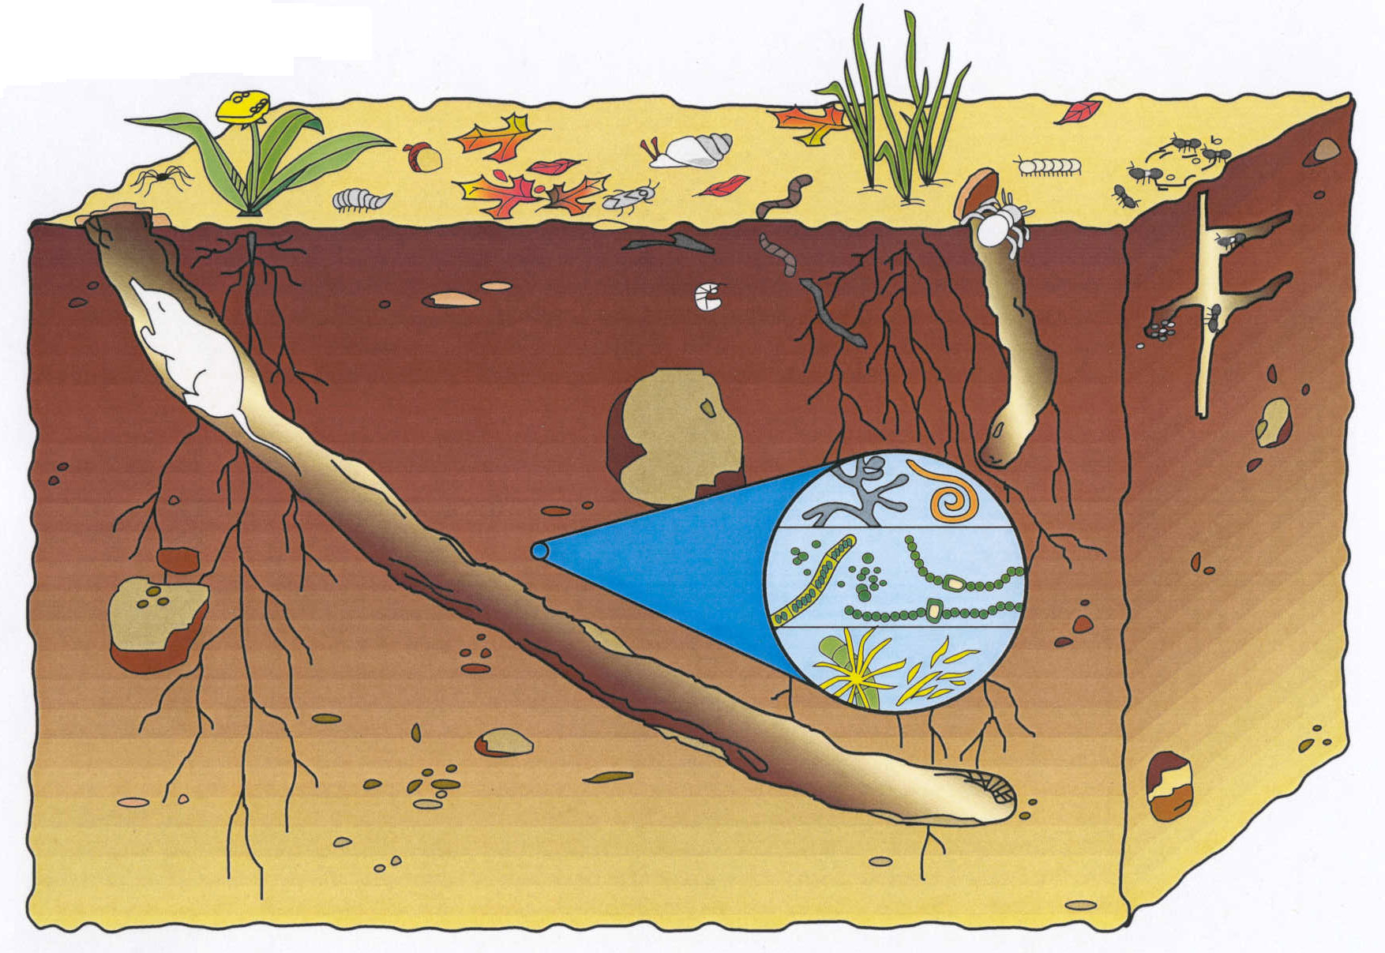
Pesticides are degraded in the environment by microorganisms, sunlight, and chemical processes.
Notes:
Pesticides are broken down in the environment by microorganisms, sunlight, and chemical processes. Microbial degradation is the most common cause of pesticide breakdown. Some soil microorganisms feed on pesticides and change them into other products. Soil conditions that favor microorganism reproduction increase the degradation process. Favorable conditions include warm soil temperatures, adequate aeration and soil moisture, soil fertility, favorable pH, and adsorption. The sun can cause pesticide degradation, called photodegradation. Nonliving processes also cause degradation. Simple chemical reactions occur in the soil. The mixing of water and the pesticide in the soil can result in hydrolysis, causing pesticides to break down.

Slide 31

Use science-based information to protect water.
Notes:
Pesticide use and excellent water quality can be compatible, but you must use science-based information and make thoughtful choices before you proceed.

Slide 32
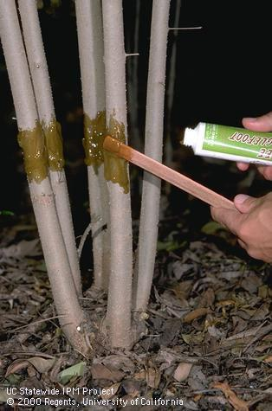
Manage pests responsibly by following an integrated pest management program.
by combust
Notes:
Integrated Pest Management (IPM) is a common-sense process for managing pests that focuses on evaluating the causes of a landscape problem and tailoring a solution that is safe and effective. IPM is not complicated, but you will need to know your pests and what IPM tools are available. For example, this picture shows someone applying a sticky barrier to stems to control certain insect pests.

Slide 33
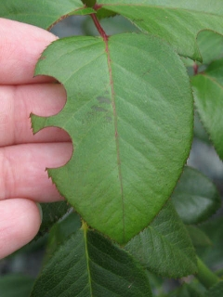
Identify the “perceived pest” and monitor pest populations.
Notes:
Start by determining what’s wrong with the plant or landscape. Sometimes it is perceived that there is a pest problem, when there is actually no pest involved. For example, the image shows leaf notches that were caused by leafcutter bees, a beneficial pollinator, that will not harm the plant otherwise. Many plant problems have abiotic (non-living) causes, including over- or under-watering, nutrient deficiencies, salts, mechanical injuries, too much sun or shade, temperature extremes, or wind damage. Master Gardener volunteers at your local Cooperative Extension office can help diagnose plant problems, determine whether a pest problem exists, and offer Integrated Pest Management solutions.

Slide 34
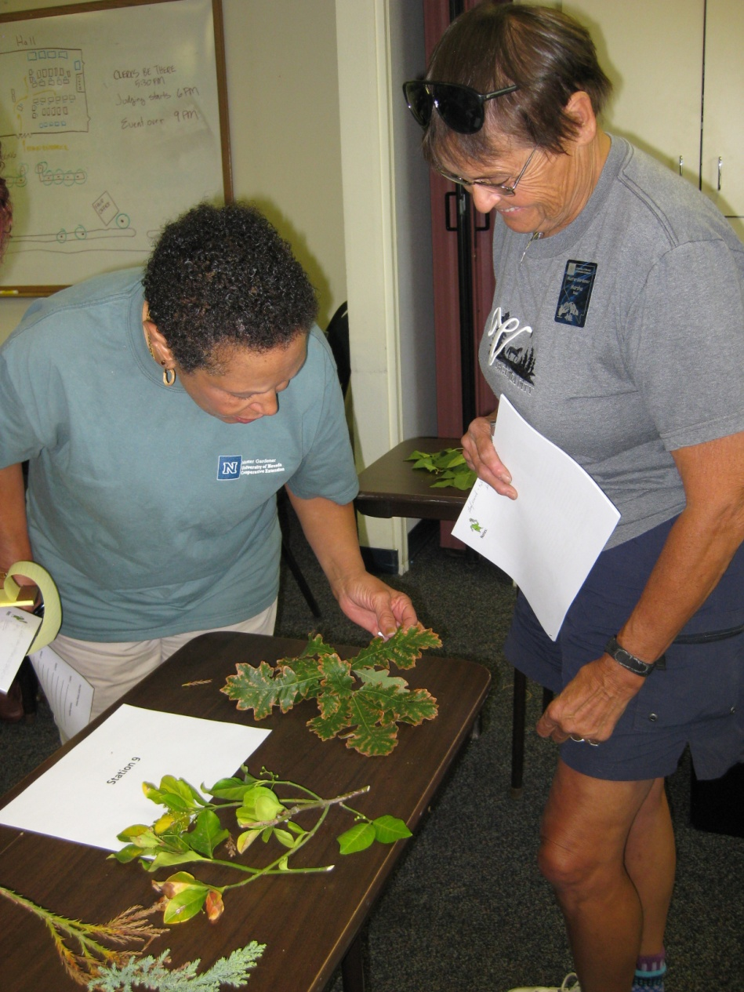
Determine if you need to take action and what management options are effective.
Notes:
If you find a pest, look more closely at the plants in the landscape to determine how extensive the problem is. How many plants are involved? Is the amount of damage more than you can tolerate? What methods are available for treating this pest? It may be possible to use mechanical or cultural methods to manage the pest at an acceptable level.

Slide 35
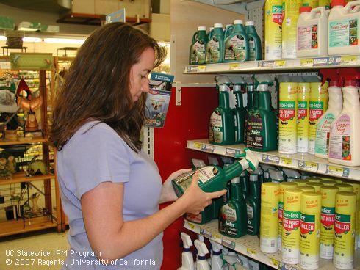
Consider whether use of a pesticide is warranted.
Notes:
In some cases, you may need to use a pesticide to avoid unacceptable levels of damage. If you choose to use a pesticide, make certain that the product is effective against the pest and appropriate for the site where it will be applied. Follow all application and safety guidelines carefully to minimize the potential for contaminating water.

Slide 36
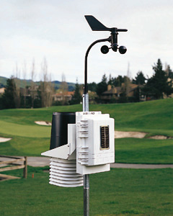
Always consider the weather before making an application.
Notes:
If data from a local weather station are not available, consult the National Weather Service Forecast Office in your area for weather information. Local forecasts are available at www.wrh.noaa.gov.

Slide 37
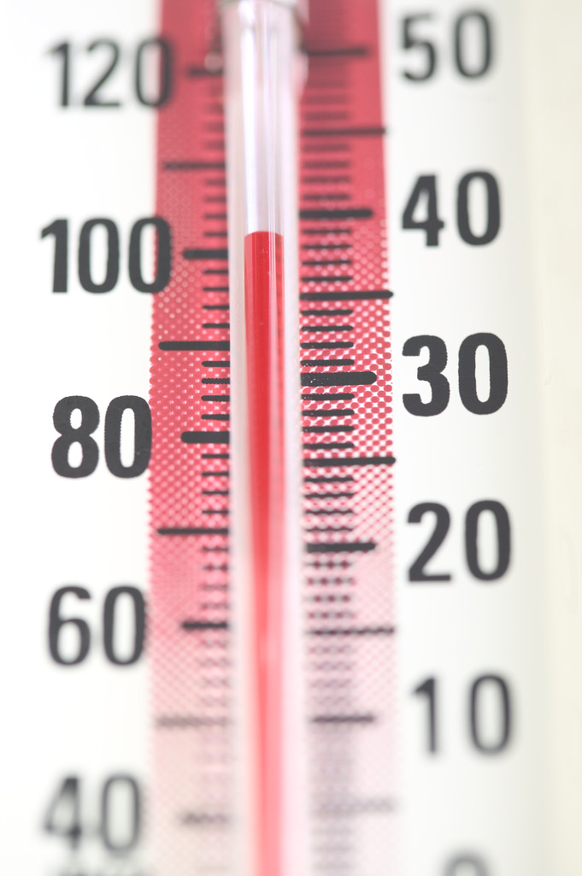
Avoid using pesticides when temperatures are high and humidity is low.
Notes:
To reduce the chance of vapor drift, avoid spraying when temperatures are high or when the air is very dry. Check the label for information on temperature and humidity ranges when you can make an application.

Slide 38
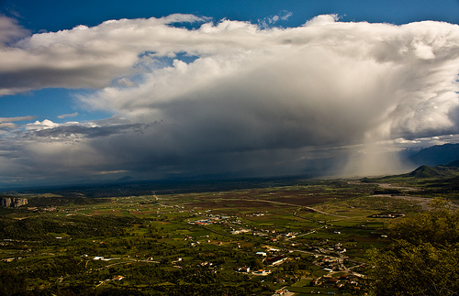
Check to see if rain is in the forecast.
Photo courtesy of eliaslar
Notes:
If rain is expected, delay the application. If the product washes off, it will not do a good job of controlling the pest, and the chances of runoff and water contamination are much higher. During dry months, monitor the forecast for the possibility of rainstorms before making applications.

Slide 39
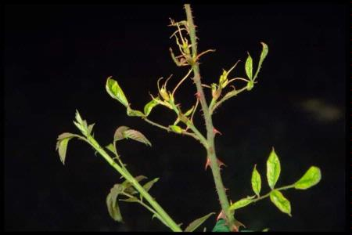
Don’t spray on windy days when drift might occur.
Notes:
Wind can cause pesticides to drift from the intended site onto desirable landscape plants. Also consider whether occasional gusts could cause drift to occur. Herbicide drifted onto this rose plant, causing damage. Never apply pesticides when wind is blowing more than 10 miles per hour.

Slide 40

Never spray when there is an inversion.
Photo courtesy of john.d.mcdonald
Notes:
Check weather forecasts to see if inversions are predicted, and avoid applying pesticides during inversions. The air will be very still in an inversion. Inversions are more likely in the late afternoon and early morning.

Slide 41
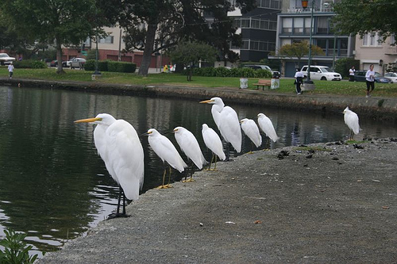
Survey your application site for slope and locations of water table, surface water, and storm drains.
Photo courtesy of bgreenlee
Notes:
What are some other measures that you can take to limit or mitigate the off-site movement of pesticides? One way is to take into account the layout of the property, such as slopes and impervious surfaces, water drains, and irrigation patterns. Always be aware of the site conditions. When it rains, where does water flow on the property? This will give you a good idea of where there is an increased chance that pesticides might move. Always think about the distance to surface water bodies and presence of storm drains before you make an application.

Slide 42
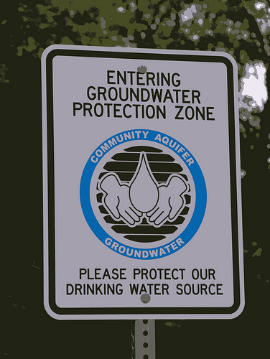
Find out the depth of the water table.
Photo courtesy of urbanworkbench
Notes:
Use soil data to help determine depth to water. See http://websoilsurvey.nrcs.usda.gov/ for a free online tool. If wells are present on the property, flag their locations and avoid mixing, storing, or applying pesticides within 100 feet of the wellhead. Never apply pesticides directly over the wellhead. Wells that are old or not constructed to current standards are at greater risk of contamination. Never store pesticides in a well shed.

Slide 43
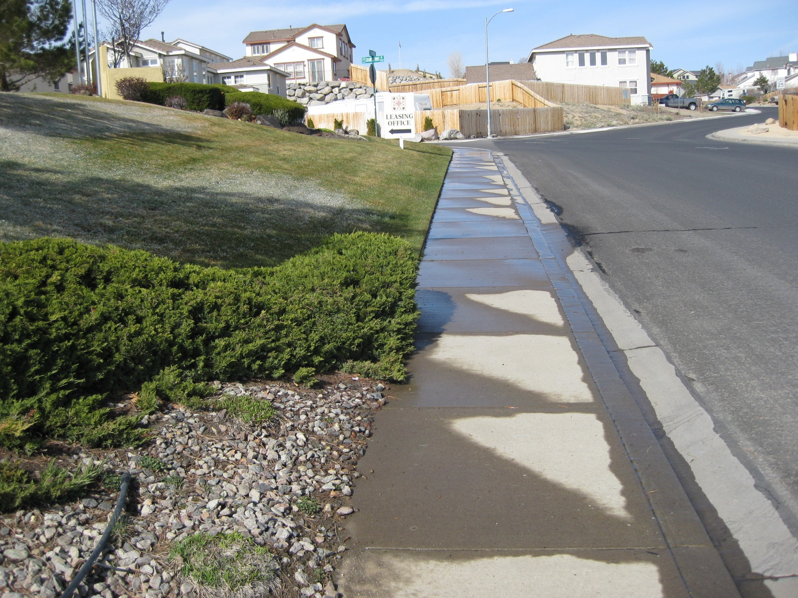
Do not apply pesticides on steep slopes with compacted soil.
Notes:
These conditions increase the potential for runoff to occur. If applications must be made to sloped areas, get help from an expert to select the least hazardous pesticide and most appropriate application method. Ensure that runoff does not occur when irrigating.

Slide 44
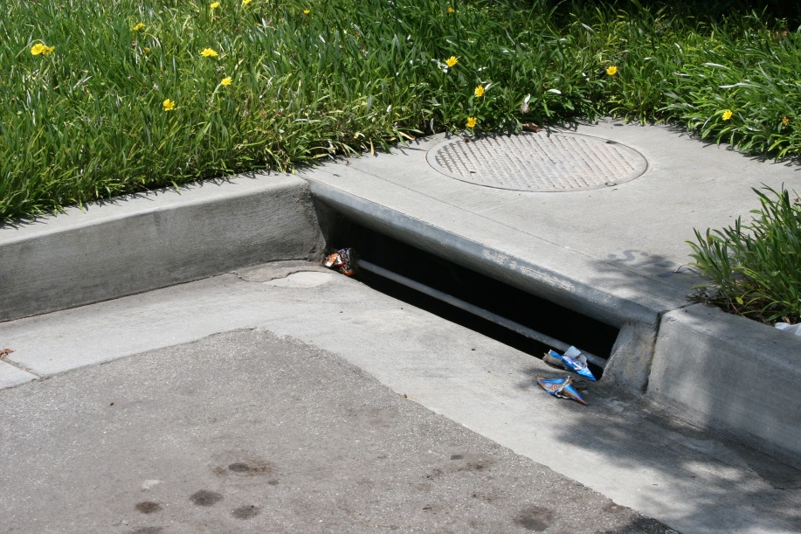
Avoid spraying pesticides on and around hard surfaces.
Notes:
Don’t let pesticides fall or drift onto hard surfaces. When you are using a granular formulation, sweep up any material that lands on a hard surface. Do not wash away with a hose, because that will move the material into the storm drain system. If you sweep up pesticide, it can be applied to an appropriate area in your landscape or lawn. When mixing pesticides or rinsing out the containers or sprayer, do it on the ground, not on the pavement.

Slide 45
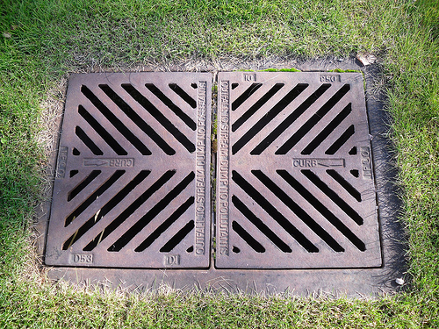
Do not apply over storm drains.
Photo courtesy of Crowbeak.Sasquatch
Notes:
Storm drains convey untreated runoff into adjacent water bodies. Applications made over storm drains greatly increase the risk of water contamination.

Slide 46
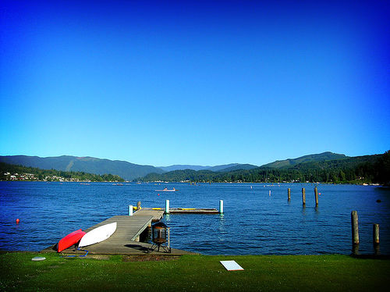
Establish buffers next to lakes, streams, and other water bodies.
Photo courtesy of esteban
Notes:
Buffers are untreated areas adjacent to water bodies. These areas provide protection from pesticide drift or runoff. Wider buffers should be established for pesticides that are very soluble or those that don’t adsorb strongly. Persistent pesticides may also need wider buffers. This photo is of a lawn next to Lake Whatcom in western Washington. This large lake is the primary source of drinking water for residents in the area. The best way to avoid water contamination here is with a no-spray buffer adjacent to the lake.

Slide 47

Choose the least hazardous, most effective product and application technique.
Notes:
Always use the principles of IPM when selecting an application method and pesticide. When choosing a pesticide, try to avoid broad-spectrum pesticides as well as products that are classified as “high runoff risk.” Try to choose another product that has a low-risk rating or statement that will also be effective on the pest you’re trying to control.
Pay close attention to the method of application. For example, a pesticide might be wiped onto a weedy pest at a sensitive site. Or a pinpoint stream application might be used on ant trails. There is less chance of drift, and the pesticide is less likely to be washed away by rain or sprinklers.

Slide 48
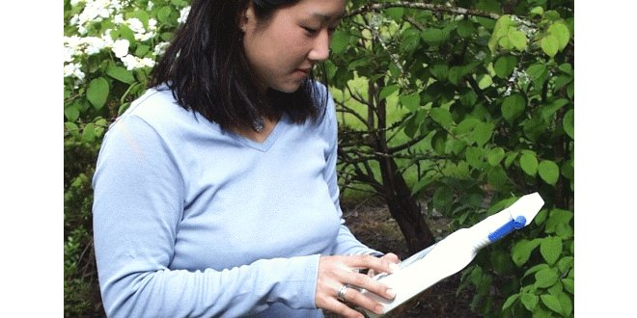
Read the label, paying particular attention to environmental precautions.
Notes:
Read the product label before you purchase a pesticide. Pesticide labels contain a great deal of useful information on the safe and legal use of these products. It is your responsibility to read and follow all directions. A variety of environmental precautions may be listed on the label. For example, the label may include a groundwater advisory stating that the product may leach and enter groundwater. Specific mixing and loading requirements may also be included on the label.

Slide 49

Follow label rates and application intervals.
Photo courtesy of John Trenholm
Notes:
Carefully follow label rates and timing of application to maximize success and minimize chances of environmental contamination. You can find information about application timing at your local Extension office. Rates and timing of application are determined after many research trials. Using excessive amounts of a pesticide or applying a pesticide more frequently than specified on the label does not result in better control and is against the law.

Slide 50
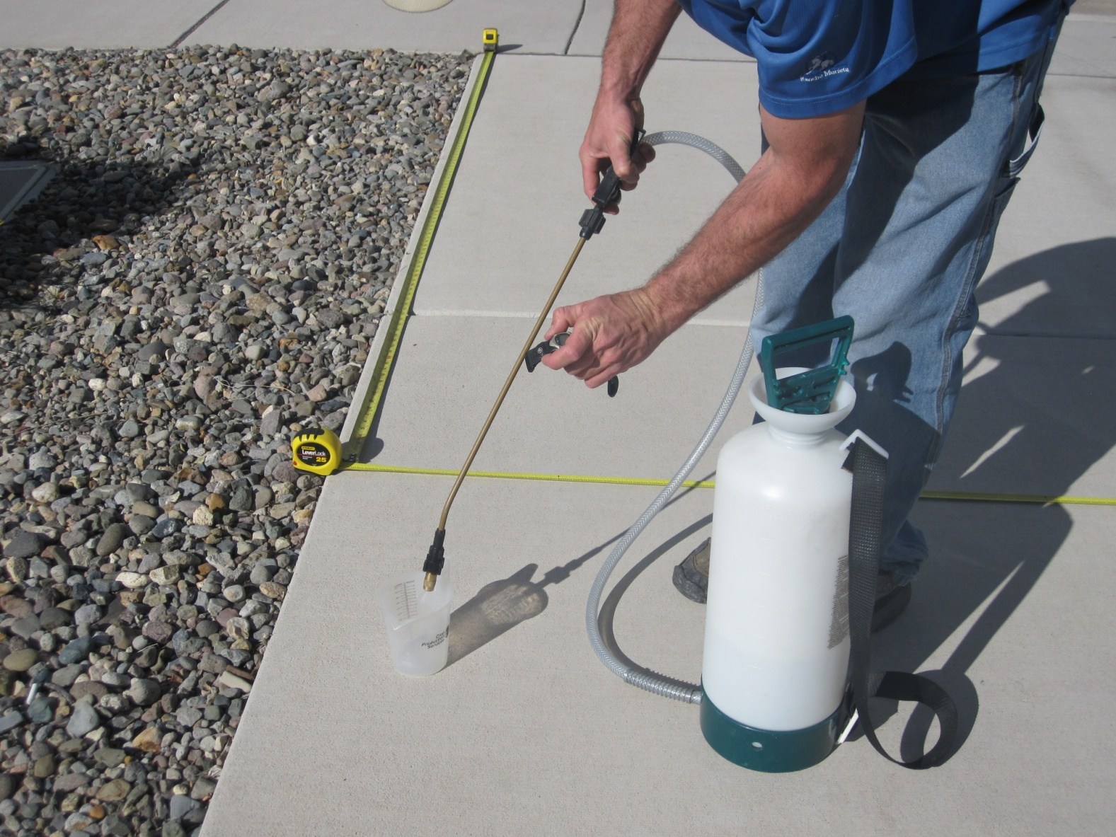
Always calibrate and maintain your equipment.
by UNL PSEP
Notes:
This person is using water to calibrate their equipment on a flat surface. You need to calibrate your equipment frequently to apply the correct amount of a pesticide. Properly-maintained equipment is essential to ensure even applications at the correct rate, and to avoid leaks. Worn nozzles should be replaced at the beginning of each season or more frequently if needed. To avoid drift, ensure droplet size is appropriate for the weather conditions.

Slide 51
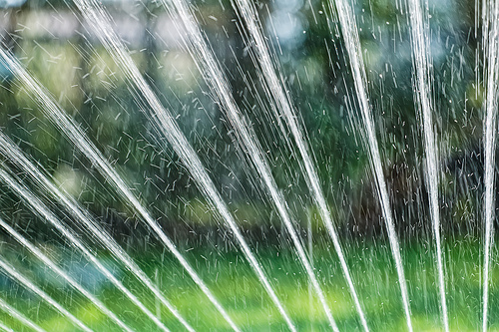
Manage irrigation to reduce the chance of pesticides moving into water.
Photo courtesy of dibytes
Notes:
Never apply pesticides just before an irrigation cycle unless the label calls for watering the product into the soil. Time applications for a day or two following irrigation to give the product sufficient time to control the pest prior to the next irrigation cycle. Sprinkle irrigate in cycles to enhance infiltration and reduce runoff. Weed-and-feed type products contain pesticides, and excess irrigation can wash them off the lawn.

Slide 52
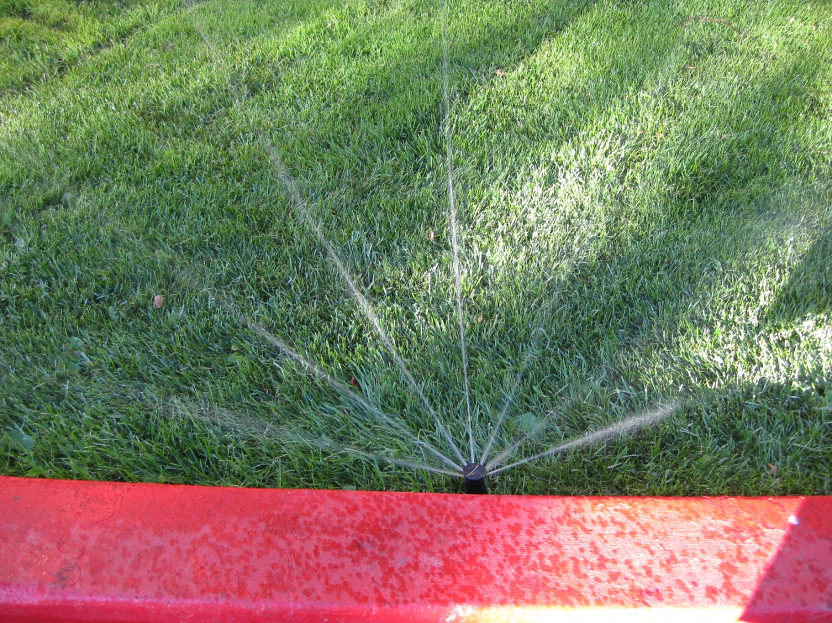
Adjust sprinkler heads so that water is applied only on vegetation.
Notes:
Irrigation audits or checks should be conducted on a regular basis to make adjustments to sprinklers to ensure irrigation falls only on vegetation. Irrigation falling on hard surfaces can move pesticides that are on these surfaces. Fix leaking heads or emitters promptly.

Slide 53

Establish a buffer between your lawn and the sidewalk or street.
Notes:
Establish drip-irrigated landscaped buffers between sprinkle-irrigated lawns and paved surfaces to capture irrigation oversprays. Set lawn irrigation so any oversprays fall only on the buffer, and not on the pavement.

Slide 54
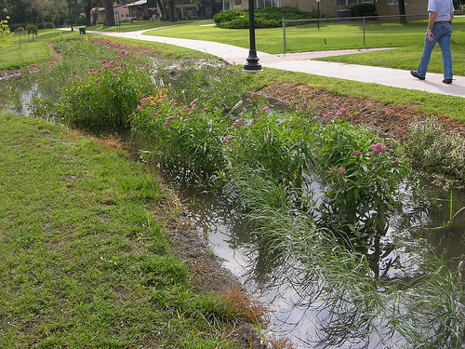
Install rain gardens to allow runoff to soak into the ground.
Photo courtesy of UNL PSEP
Notes:
Rain gardens can provide additional storage space and increase infiltration, reducing runoff. Pesticides can stick or adsorb onto soil particles and be broken down by microbes or chemical processes.

Slide 55

Local and regional resources are available.
Notes:
Seek out local and regional resources on IPM and water quality protection.
Your local county Cooperative Extension office and eXtension’s Pesticide Environmental Stewardship Web site (http://pesticidestewardship.org) provide specific resources to ensure that homeowners use pesticides safely. Refer to the publication “Pesticides: Safe And Effective Use in the Home Landscape,” UC ANR Publication 74126, available online at http://anrcatalog.ucdavis.edu.
Also consult the WaterTox database found on the UC IPM Web site (http://www.ipm.ucdavis.edu/TOX/simplewatertox.html) or the PesticideWise Web site (www.pw.ucr.edu), both of which provide information on the potential impacts of pesticides on water quality.

Slide 56
The Western IPM Center would like to thank the following people for their assistance reviewing this training module:
Troy Bauder, Colorado State University
Eric Bernsten, California State Water Resources Control Board
Herb Bolton, National Institute of Food and Agriculture
Wayne Buhler, North Carolina State University
Aimee Code, Northwest Center for Alternatives to Pesticides
Pamela Geisel, University of California
Kevin Masterson, Oregon Department of Agriculture
Kelly McLain, Washington State Department of Agriculture
Bob Simmons, Washington State University
Andrew Sutherland, University of California
Sherman Takatori, Idaho State Department of Agriculture

