Slide 1
Water Quality Protection Measures for
Landscape Professionals
Authors:
Sue Donaldson, University of Nevada
Carrie Foss, Washington State University
Darren Haver, University of California
This slide set was funded by USDA NIFA through
the Western Integrated Pest Management Center
January, 2013
Photo courtesy of mtsvancouver
Notes:
This module is designed for use by educators to teach landscape professionals about the ways in which pesticides can move into water after they are applied, about the soil and pesticide properties that influence the movement of pesticides, and about how you can use best management practices to protect water resources. The slide set was funded by the USDA NIFA through the Western Integrated Pest Management Center. We would appreciate input from you on your use of these slides. Please send input to Carla Thomas, Associate Director, Western IPM Center, cthomas@ucdavis.edu or wripmc.org

Slide 2
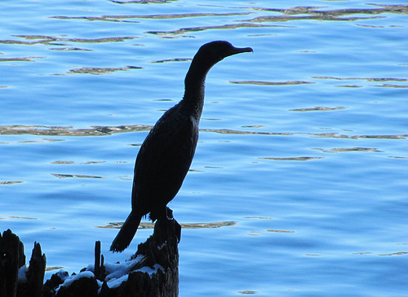
How can you protect water when using pesticides?
Photo courtesy of mtsvancouver
Notes:
How Can Pesticide Users Protect Water?
This module is designed for use by educators to teach pesticide applicators about the ways in which pesticides can move into water after they are applied, about the soil and pesticide properties that influence the movement of pesticides, and about how pesticide applicators can use best management practices to protect water resources. The slide set was funded by the USDA NIFA through the Western Integrated Pest Management Center. We would appreciate input from you on your use of these slides. Please send input to Carla Thomas, Associate Director, Western IPM Center, cthomas@ucdavis.edu or wripmc.org

Slide 3
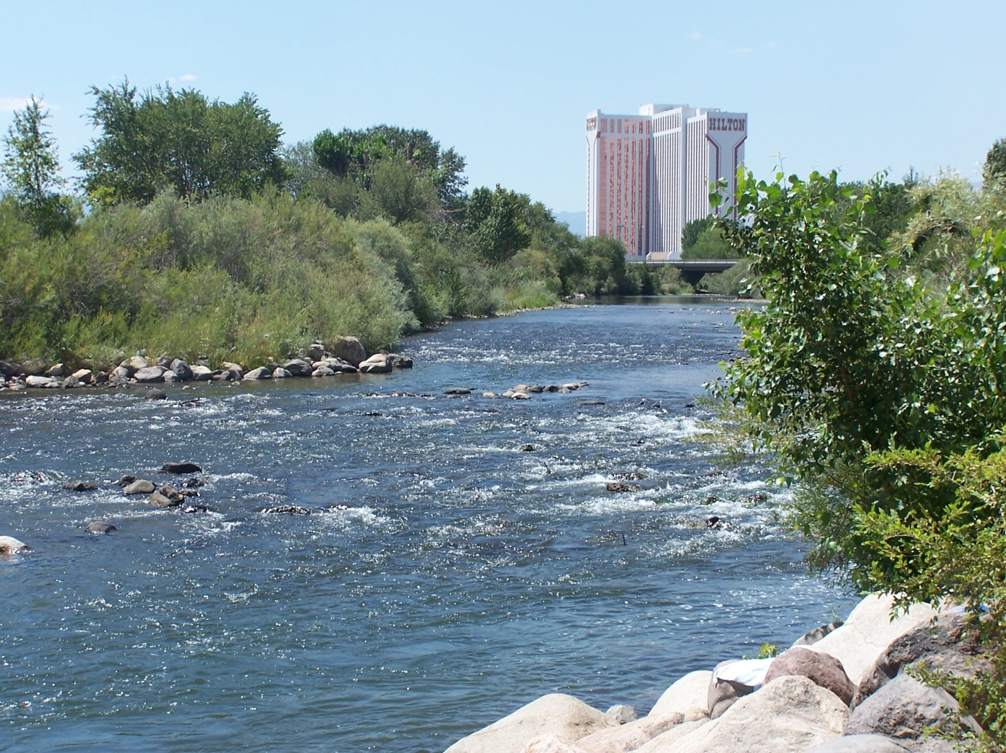
Pesticides have been found in water in many places.
Notes:
Water quality monitoring programs conducted in many western states, as well as in other parts of the country, have identified pesticides as the main or a contributing factor affecting water quality. Contamination of urban waters by pesticides may result when people have little understanding about what happens to pesticides once they are applied in an urban environment.

Slide 4
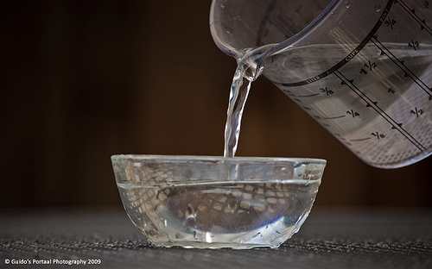
Pesticide use and good water quality are compatible.
Notes:
The goal of this presentation is to provide you with a better understanding of how pesticides can end up contaminating urban waters -- but more importantly, what you can do to ensure pesticides have little or no impact on water quality and aquatic ecosystems.

Slide 5
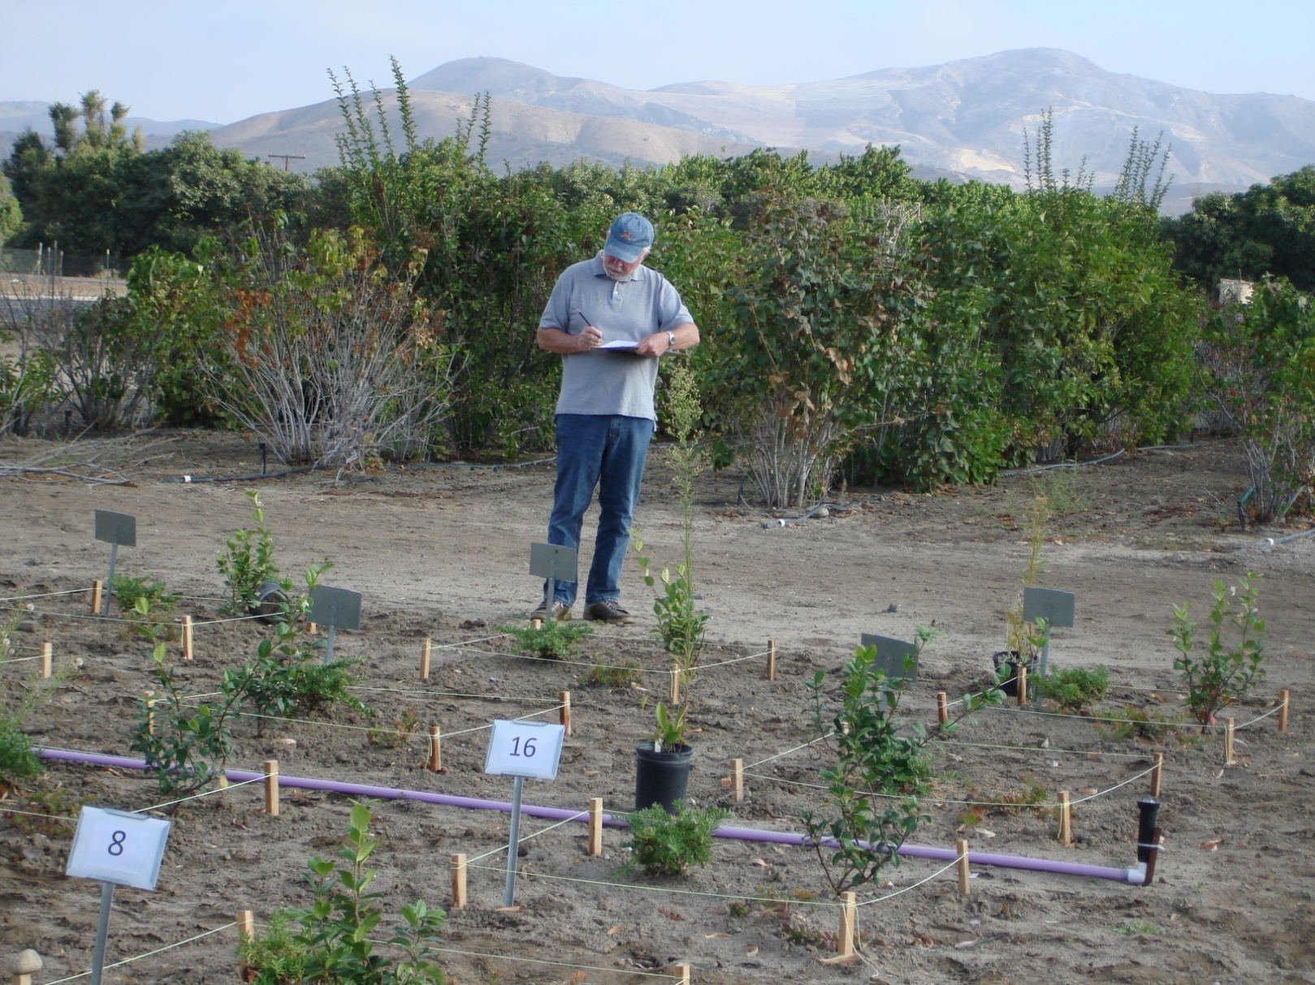
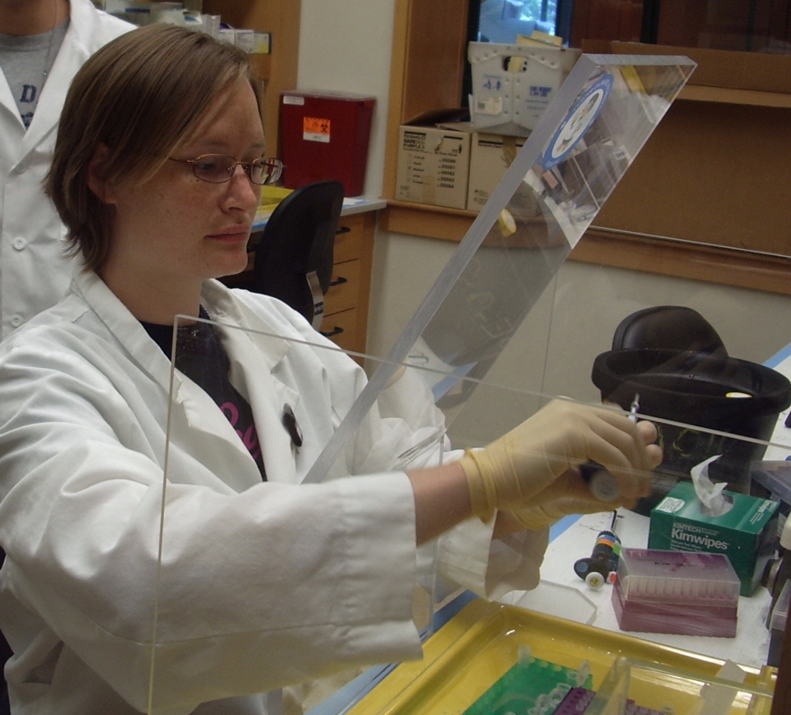
Use IPM and best management practices to protect water.
Notes:
There are several tools available to you to effectively manage pests while still protecting water quality. Integrated Pest Management (IPM), an example of a best management practice, helps you to effectively manage pests while still protecting water quality. This presentation includes 1) a basic explanation of the different ways pesticides can easily enter waterways, 2) information on how soil and pesticide properties and weather impact pesticide movement, and 3) the simple management practices you can implement to lessen the likelihood that the use of a pesticide will impact water quality.

Slide 6
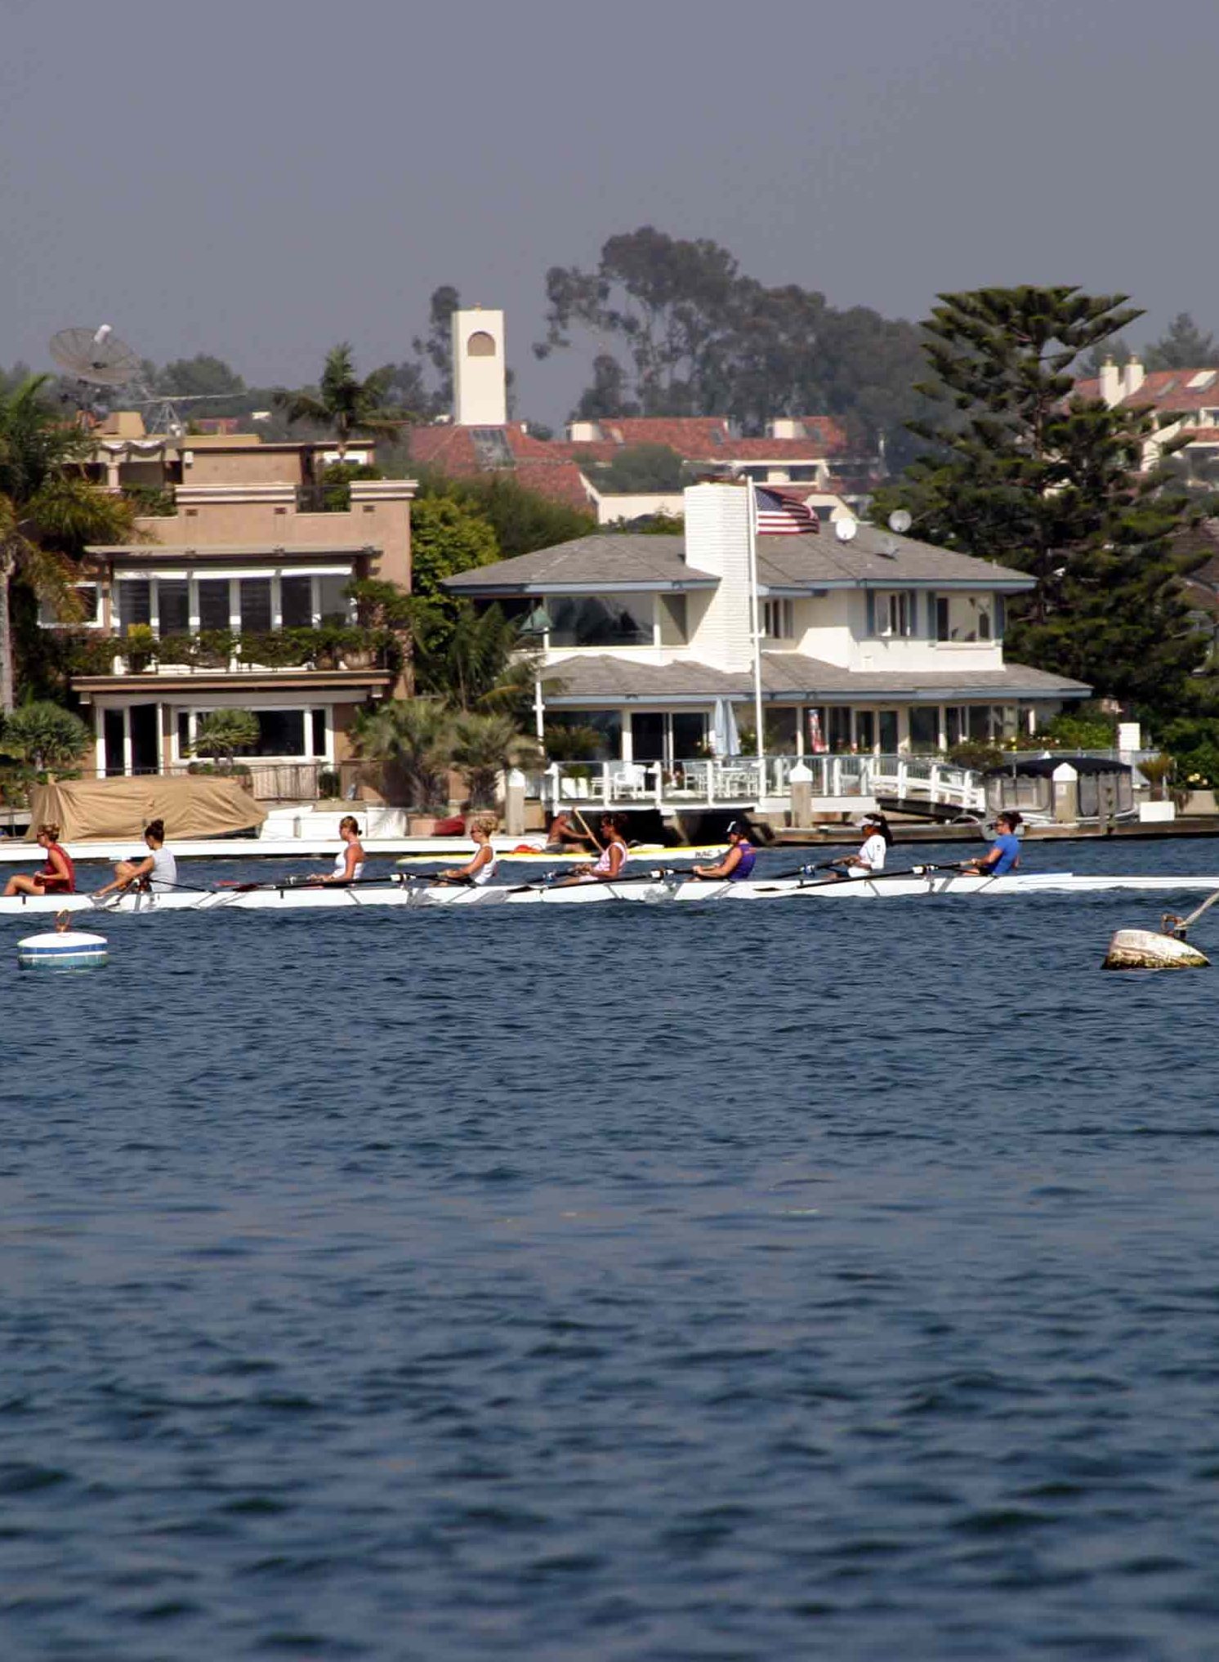
How can pesticides get into water?
Photo courtesy of gmeador
Notes:
Let’s discuss how pesticides can move away from the area where they are applied and how they could get into water.

Slide 7
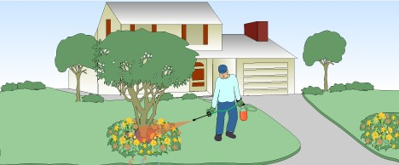
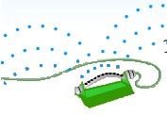
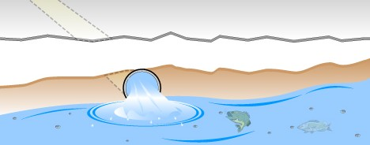
There are several ways that pesticides get into water.
Pesticide applied to landscape
Irrigation
Pesticides can run into gutters, storm drains, and eventually creeks, rivers, or oceans.
Graphics used by permission from UC IPM
Notes:
Because pesticides are applied to many areas of a landscape where they may come into contact with water from irrigation or rainfall, they have the potential to both leach into groundwater and flow into storm drains. Storm drains are often directly connected to creeks, rivers, lakes, or the ocean, so contaminants in runoff water have a high potential to impair water quality. In most cases, the water in storm drains is not treated. In addition, the high percentage of impervious surfaces (i.e., surfaces that shed water, such as pavement and roofs) that are typical of urban landscapes reduces infiltration and increases surface runoff, carrying pesticides farther from the site of application.

Slide 8
Runoff can move pesticides off site.
Notes:
Runoff is excess water that moves off the landscape. The factors that contribute to whether a runoff event occurs include the grade or slope of the area, soil texture, and the amount of vegetation. Soil that’s saturated can’t take in the water, so it runs off. The amount and timing of irrigation or rainfall is critical. The pesticide characteristics, especially water solubility, also play a role.
Irrigation overspray is a common cause of runoff that washes pollutants, including pesticides, off paved surfaces. It is difficult to irrigate up to the pavement edge without overspray that results in runoff. In arid areas, dry weather flows are often primarily a result of over-irrigation or overspray.

Slide 9
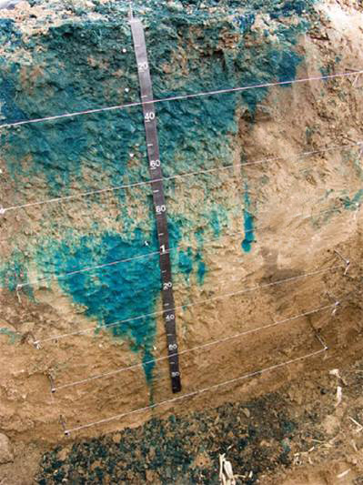
Pesticides can leach into the water table.
Photo courtesy of Kansas Geological Society
Notes:
This photo shows the concept of leaching, or movement of water downward through the soil. Colored dye applied to the soil surface has been carried down into the soil with the application of water. In this same way, pesticides that are dissolved in the water can migrate into groundwater. Pesticides in groundwater are a problem because groundwater may be a source of drinking water or irrigation water, or it may feed into streams, lakes, or other surface water. Pesticides can leach due to natural water movement from rain or snowmelt or with excess irrigation. Some soil types, such as coarse-textured or sandy soils, also increase the likelihood of pesticides moving down through the soil profile. Soluble pesticides (pesticides that dissolve readily in water) are more likely to leach.
Contaminated groundwater from pesticides leaching through the soil is nearly impossible to completely clean up (remediate), and it is extremely costly. It is much better to prevent groundwater contamination in the first place by applying preventive practices.

Slide 10
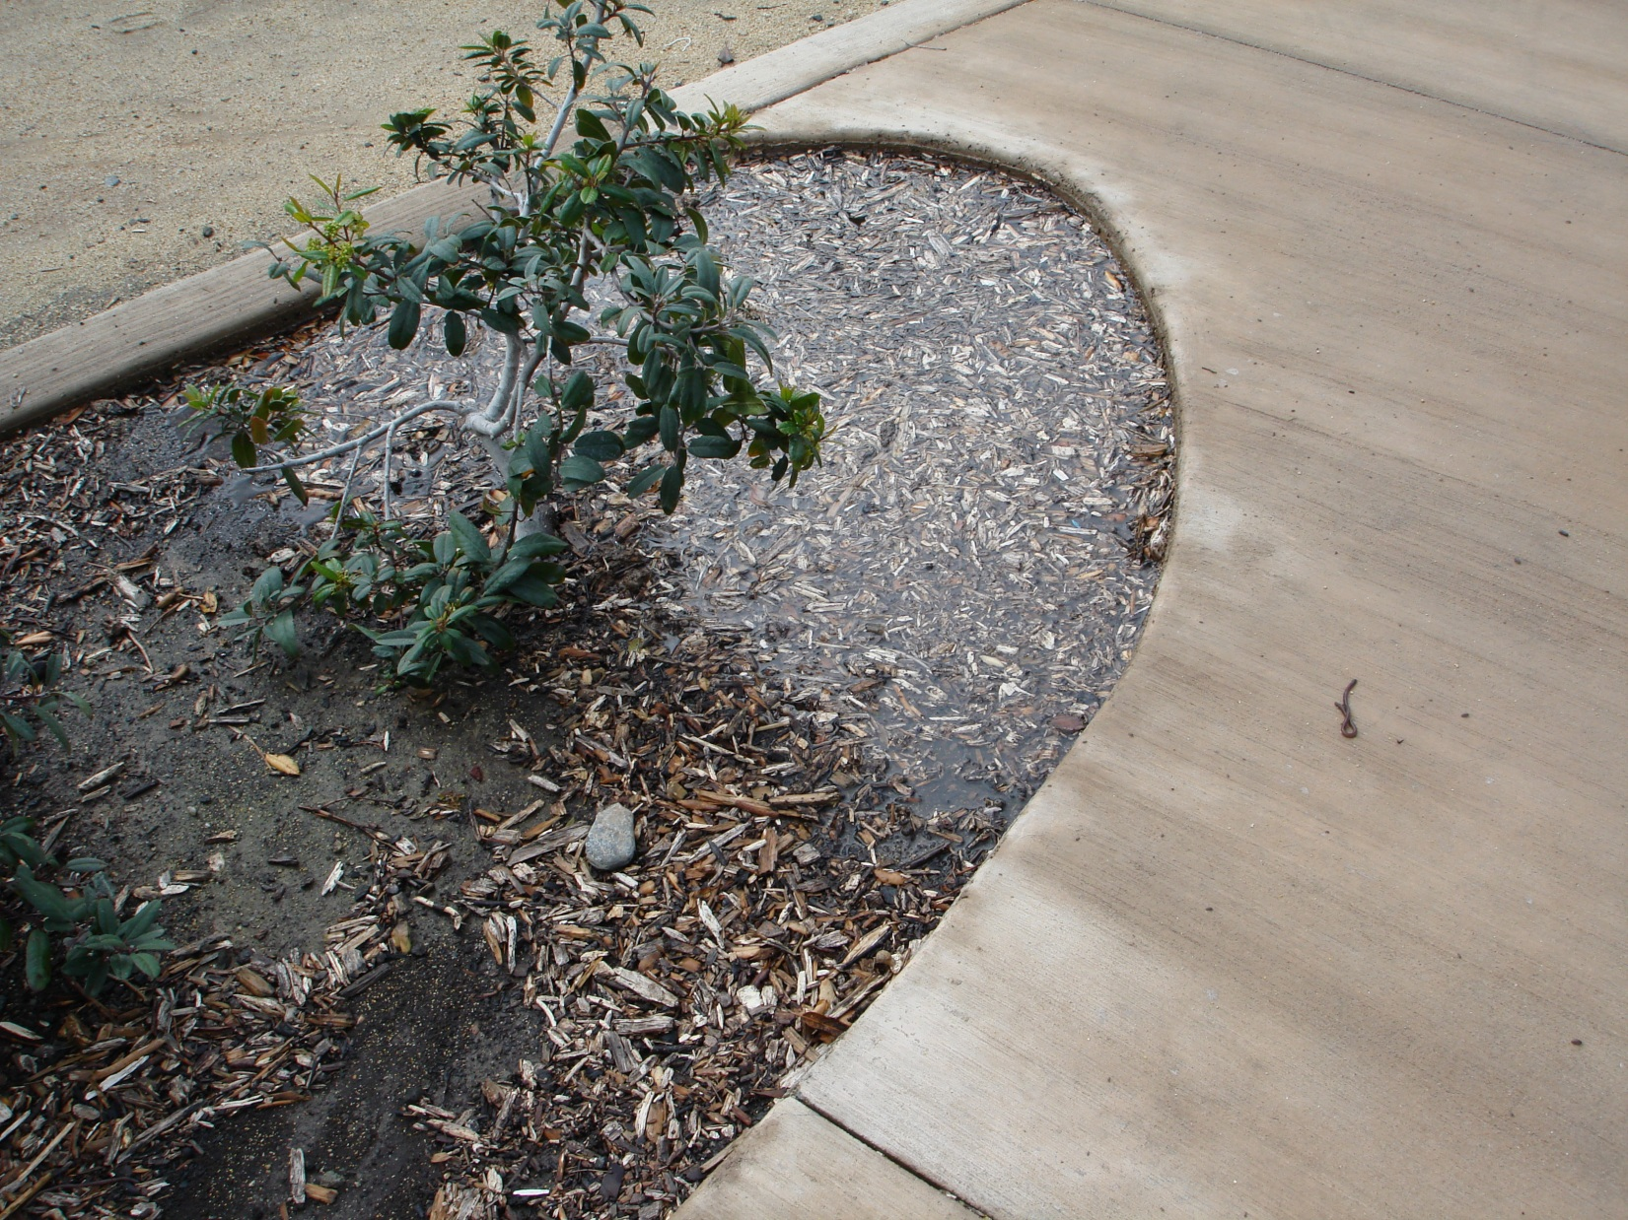
Rain or excessive irrigation after a pesticide application may leach soluble pesticides.
Notes:
In addition to increasing the potential for groundwater contamination, water can carry soluble pesticides farther into the soil where they are no longer effective at controlling the pest.

Slide 11
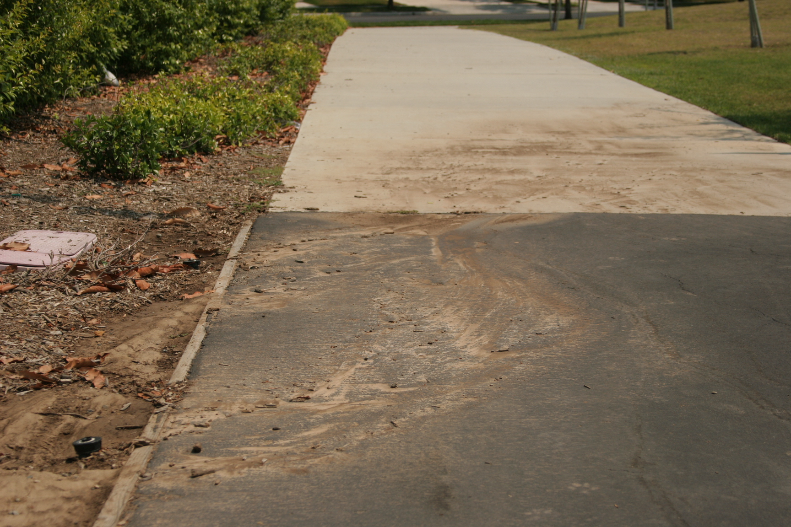
Pesticides can move with soil.
Notes:
Erosion is the process by which soil is moved from the landscape due to flowing water. This can happen because of problems with irrigation equipment (such as line breaks) resulting in runoff; because of errors in irrigation management (over-irrigation); or because of weather (excessive rainfall or snow melt). The quantity and velocity of runoff determine the extent of erosion. When erosion occurs, pesticides adsorbed (attached) to soil particles will travel off site with the eroded soil.

Slide 12
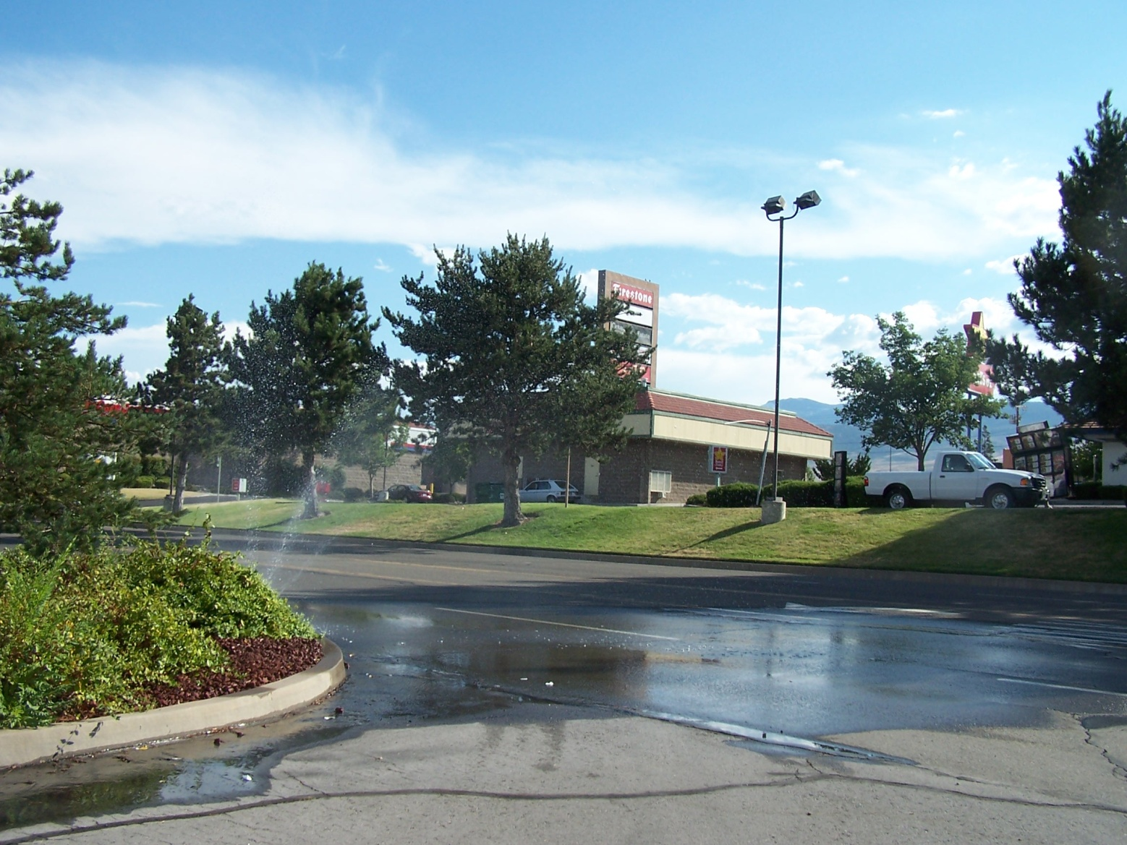
Paved surfaces and sidewalks can contribute to pesticide runoff.
Notes:
Pesticides applied directly to, or drifting onto, paved or compacted surfaces and sidewalks may be mobilized by irrigation or rain runoff, making their way into storm drains and ultimately into waterways, where they can cause water quality impairments. Pesticide movement is impacted by the type of hardscape (e.g., concrete, decomposed granite, stone, asphalt, etc.) the pesticide comes into contact with as well as the overall chemistry of the pesticide.

Slide 13

Spray applications can drift into water.
Photo courtesy of camknows
Notes:
When pesticides are applied as sprays, the smaller droplets can drift from where they are applied. If you are spraying next to lakes, streams, canals, or other bodies of water, some of the spray could drift onto the water and cause contamination. In this photo of Lake Washington, there are lawns directly adjacent to the lake. This lake, in western Washington, is a recreational area for many people. The best way to avoid spray drift entering the water here would be to avoid applying pesticides directly adjacent to the lake. Create a buffer, or no-spray zone, between the water’s edge and the pesticide application.

Slide 14

Pesticides can volatilize and move in air as vapor drift.
Wind
Drift
Photo courtesy of LeonArts.at
Notes:
Pesticides can also move off site and enter water by volatilization or vapor drift. If a pesticide is applied to soil or plants as a granular product or spray, it may volatilize, becoming a gas or vapor, and enter the air stream. The vapor can be carried off site and deposited into nearby water. Conditions of high temperature, low humidity, and increasing wind speeds increase the potential for pesticide volatilization.

Slide 15
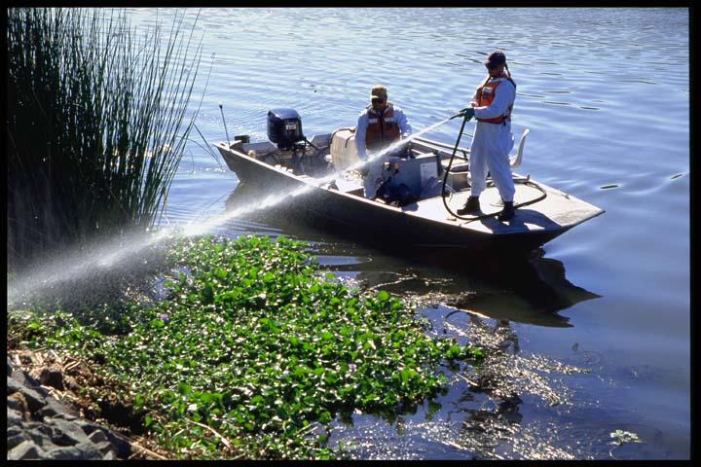
Pesticides are sometimes applied directly to water.
Photo courtesy of UCIPM
Notes:
Pesticides are sometimes intentionally applied to water to manage invasive weeds, public health pests, or pestiferous fish. Only pesticides labeled for aquatic uses can be applied in this manner. These products have been tested and labeled for this purpose. There are federal and state permitting and licensing requirements that must be followed when making aquatic pesticide applications.
The National Pollutant Discharge Elimination System (NPDES) allows permittees to apply pollutants (pesticides) to water bodies for certain uses (e.g., mosquito and other flying insect pest control, weed and algae control, animal pest control, and forest canopy pest control). The permit requires that pesticide discharges be minimized through the use of pest management measures, and that permittees monitor for and report any adverse incidents. Be aware that some states have additional aquatic use requirements.
Aquatic use MUST be listed on the label as an allowable application site.

Slide 16
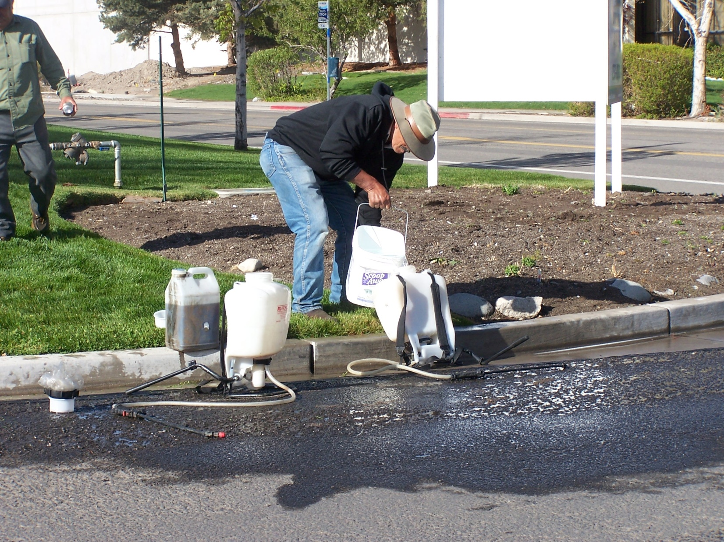
Improper pesticide handling can contaminate water.
Notes:
The landscape maintenance personnel shown in this photo are diluting pesticides in the gutter. The storm drain is just to the left of the edge of the photo. In this case, spills will flow directly to the Truckee River, which is the source of drinking water for a large municipal area in northern Nevada. Pesticides should never be mixed or applied in the gutter.

Slide 17
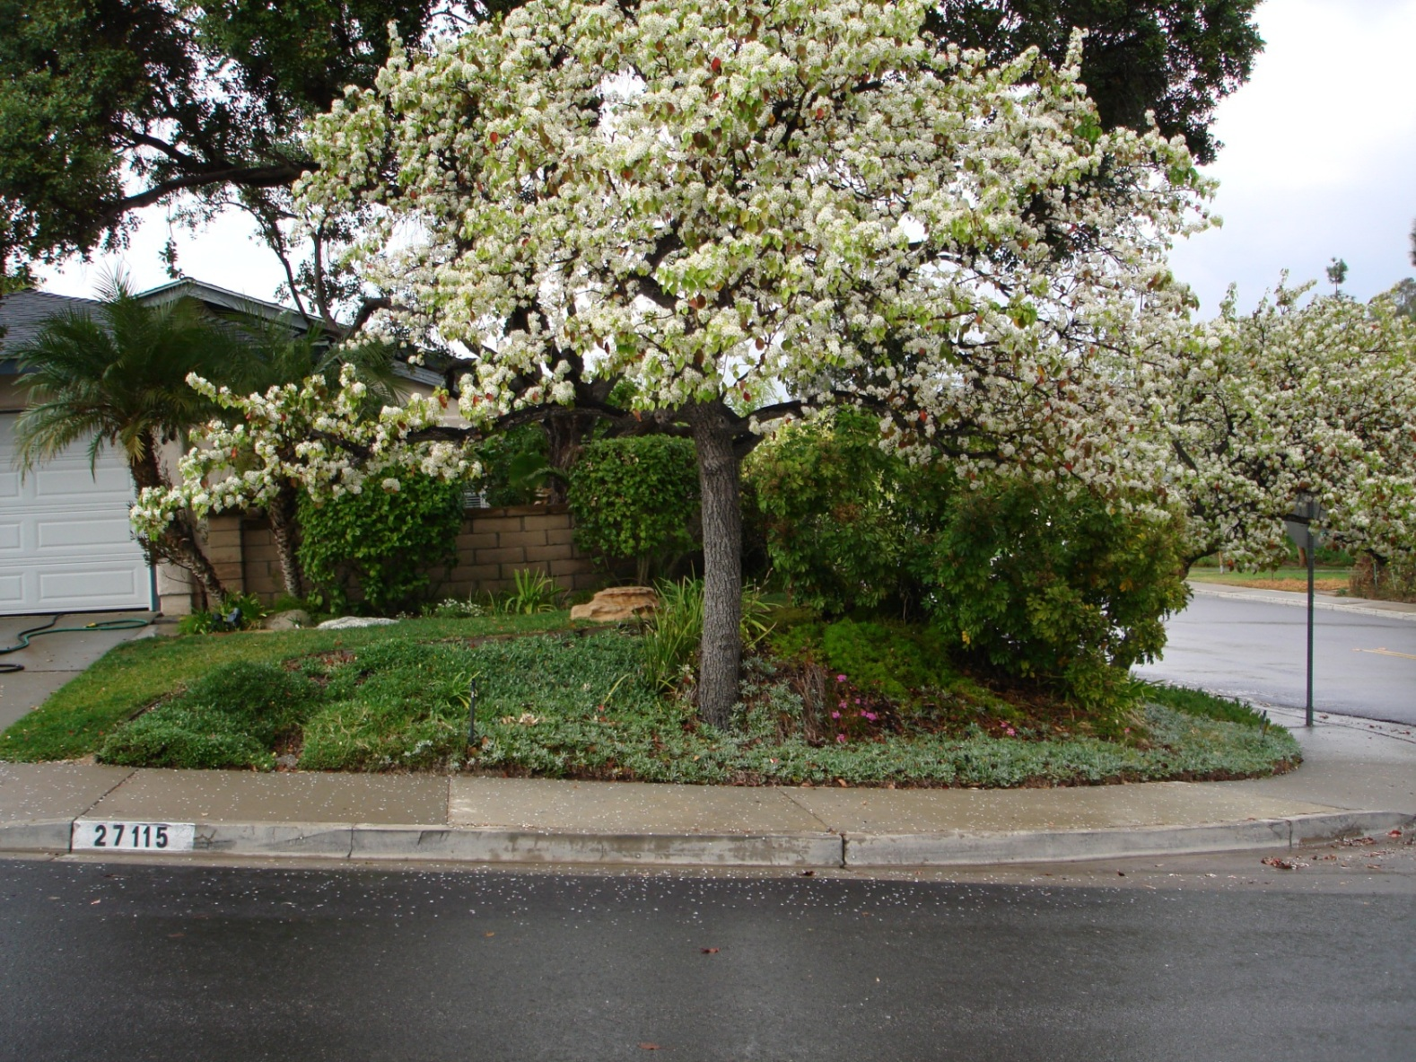
Weather conditions affect pesticide movement.
Notes:
The weather can have a significant effect on the movement of pesticides away from where they are applied. It is important to understand how weather affects pesticide movement and avoid conditions that could lead to off-target movement and water contamination.

Slide 18

Excessive or untimely rainfall can carry pesticides away from the application site.
Photo courtesy of zodski
Notes:
Rain can wash pesticides off plants if the application has not had adequate time to dry. Heavy rain can also run off the application site, carrying pesticides in the water. Pesticides may also be leached down through the soil profile during rainstorm events. Do not apply pesticides when heavy rainfall is expected within 48 hours.

Slide 19

Wind can blow pesticides into nearby waterways.
Notes:
Wind can blow pesticide spray droplets into nearby waterways. Dust applications or pesticides attached to soil can also be blown about and end up in water.

Slide 20
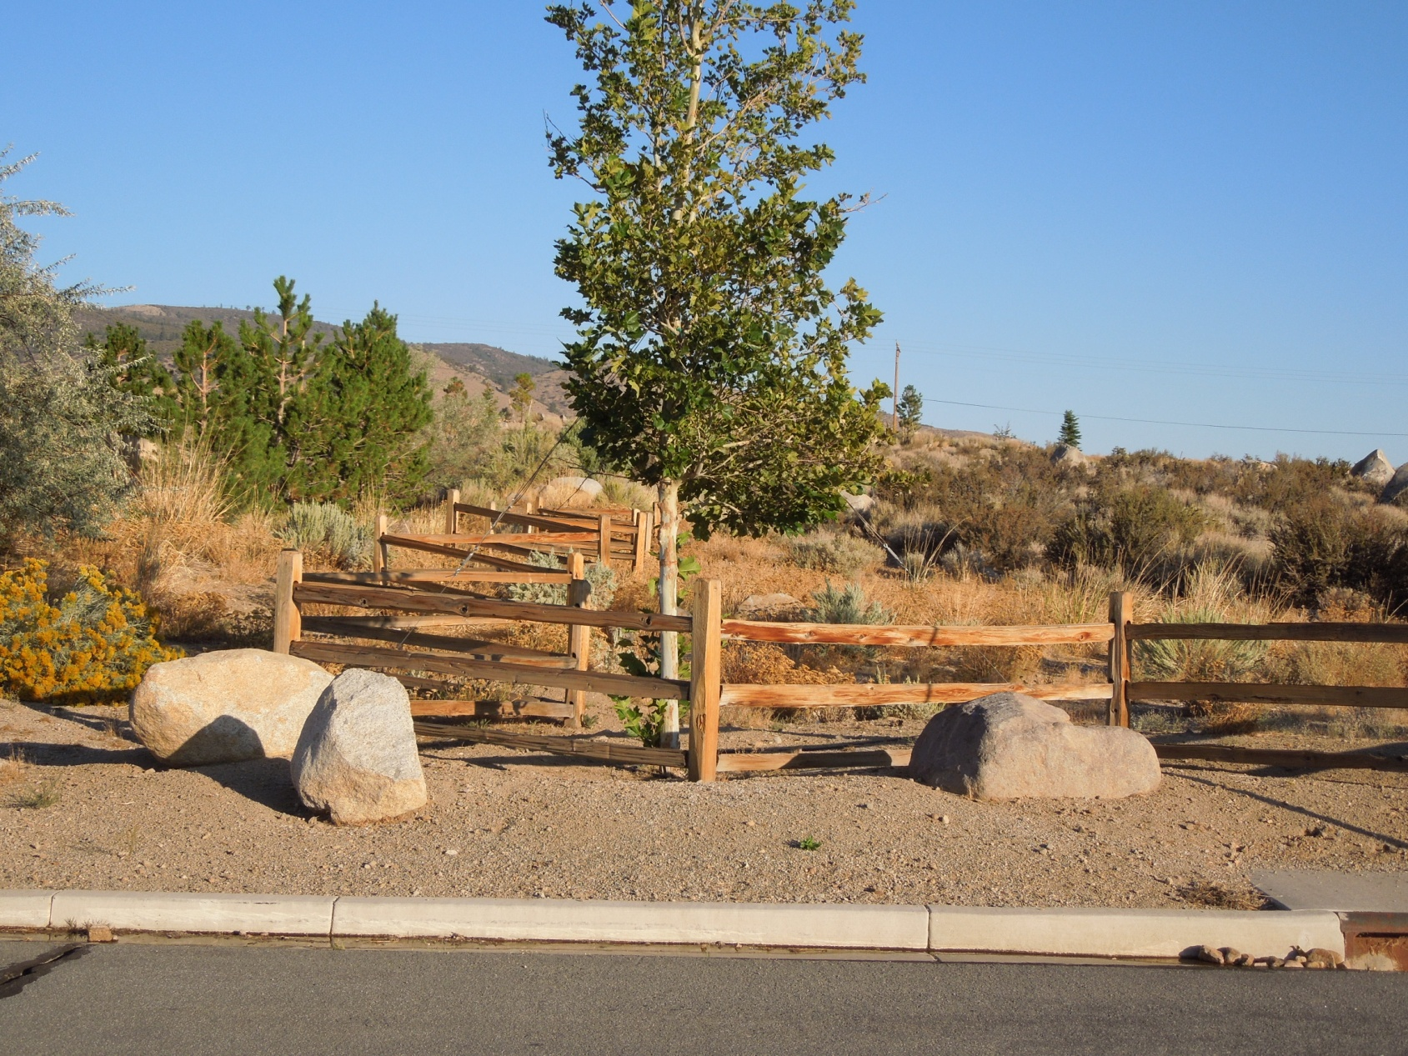
High temperature and low humidity increase volatility.
Photo courtesy of Monica Guy
Notes:
Vapor drift is more of a problem when the temperatures are high and the humidity is low. Some urban areas have these conditions during much of the year. To avoid vapor drift, select products that are less volatile.
Landscape and turf professionals must consider appropriate pesticide formulations for applications under these conditions, avoiding highly-volatile formulations.

Slide 21
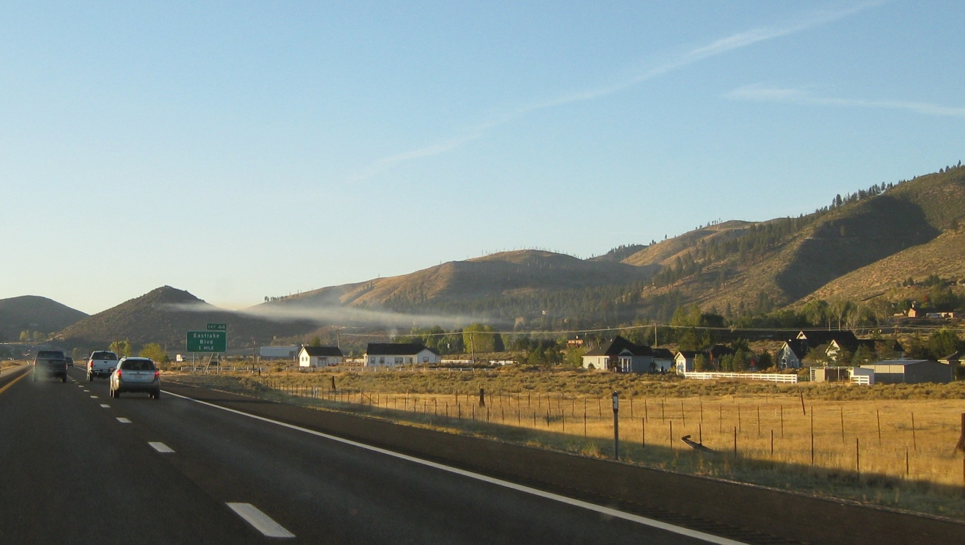
Long-distance drift can occur when there is an inversion.
Notes:
This photo shows an early-morning inversion layer in Washoe Valley, Nevada. Smoke from wood-burning is traveling horizontally along the inversion layer. If a pesticide is applied during an inversion, it can travel long distances horizontally along the inversion layer. Never apply pesticides during an inversion. Check your local weather forecast to determine whether an inversion is expected.

Slide 22
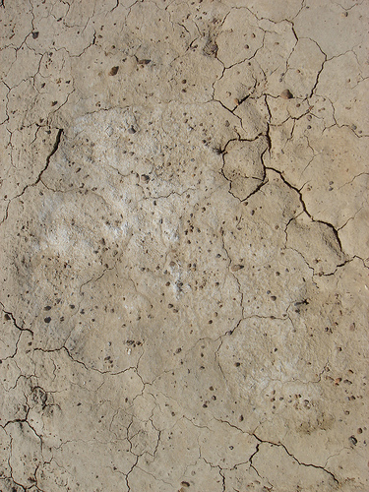
Soil characteristics and pesticide properties influence off-site movement of pesticides.
by Flat6
Notes:
We have looked at the ways that pesticides can move away from the place where they were applied and end up in water. Soil and pesticide properties also influence the potential for pesticide movement.

Slide 23
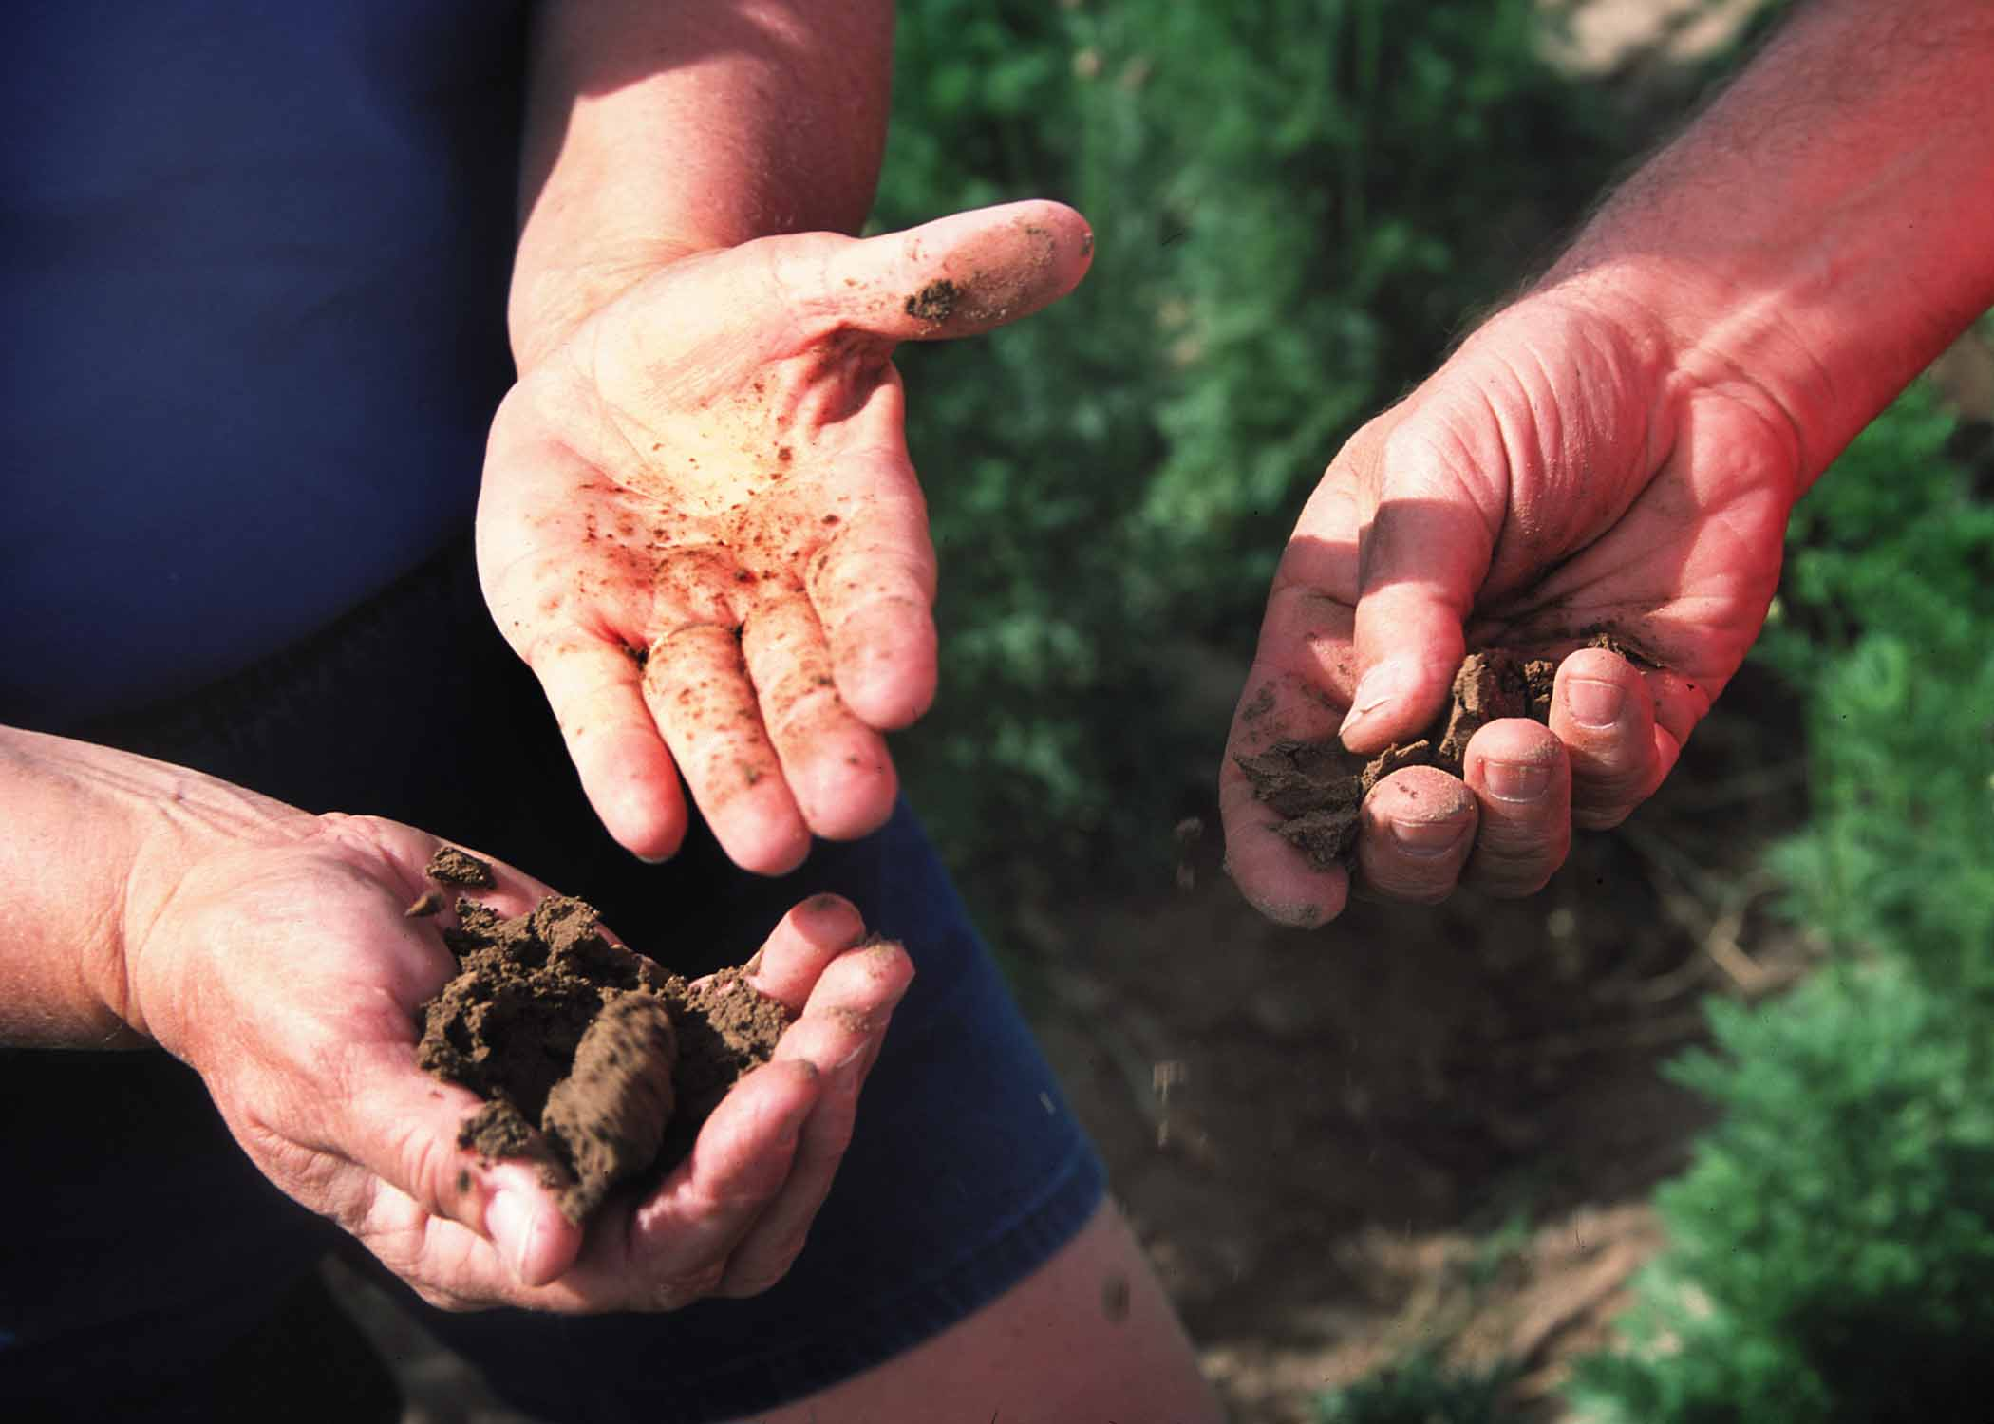
Soil texture and structure affect water-holding capacity and infiltration.
Photo courtesy of USDA-NRCS
Notes:
Soil texture and soil structure are important physical properties that determine the arrangement of soil particles and amount and type of soil pore space (spaces occupied by air and water). Soil texture refers to the amount of sand, silt, and clay in a soil. Structure refers to the grouping of soil particles into larger aggregates or clods. Soil texture and structure impact a soil’s water-holding capacity and the extent and speed with which water enters the soil (infiltrates) and moves through the soil (percolates).
Coarse-textured soils, with high sand content, have large pore spaces and low water-holding capacity, increasing water movement. Fine-textured soils, like clay, have very small pore spaces and bind water tightly to clay particles, reducing the potential for leaching. Silty soils are intermediate to sand and clay, with medium-sized pore spaces. Coarse soils tend to have a higher potential for deep percolation and leaching of pesticides.

Slide 24
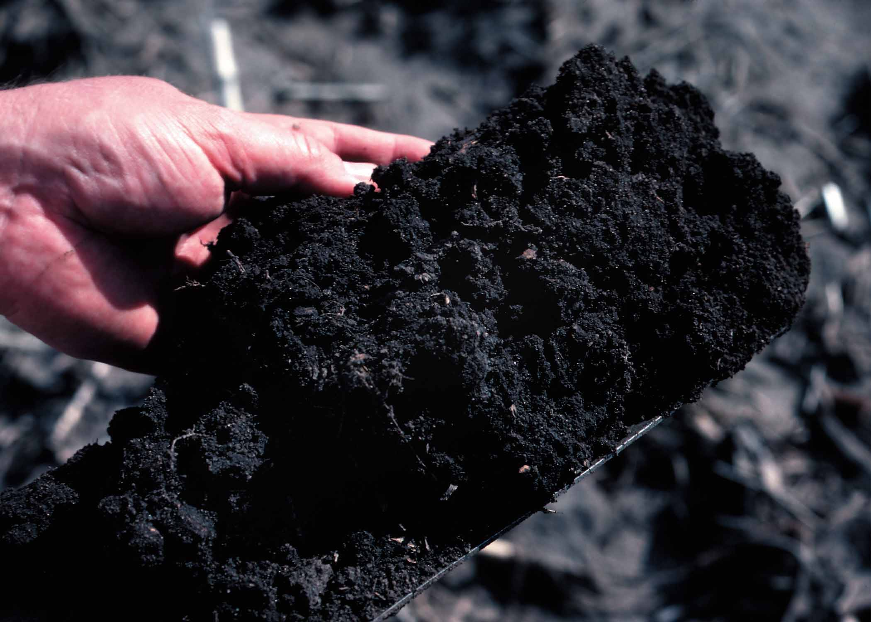
Soils that are high in clay or organic matter bind pesticides tightly.
Photo courtesy of USDA-NRCS
Notes:
The degree to which a pesticide adsorbs to soil is important to the fate of the pesticide. Adsorption, that is A-D-sorption, is the physical binding of the pesticide molecules to the outside of soil particles and organic matter. Pesticides that are oil-soluble or oil-loving tend to adsorb or bind to soil particles. Soil type is a key factor in determining the amount of the pesticide that is held by the soil particles. Clay and organic soils have many, many binding sites and adsorb a lot of pesticide. If a pesticide is adsorbed or bound to the soil, it doesn’t move freely with the soil water, and water contamination concerns are greatly reduced.
Soil organic matter influences soil structure and water-holding capacity, provides a source of energy for microorganisms, and can retain nutrients and adsorb other chemical constituents. All of these characteristics impact pesticide movement and persistence.
Soil pH typically ranges from 5 to 9. Most pesticides are labeled for specific soil conditions. If soils have a pH outside the label’s allowed range, pesticides may become ineffective, may be changed to an undesirable form, or may not degrade as expected. Soil pH also influences microbial activity, which can also impact pesticides.

Slide 25
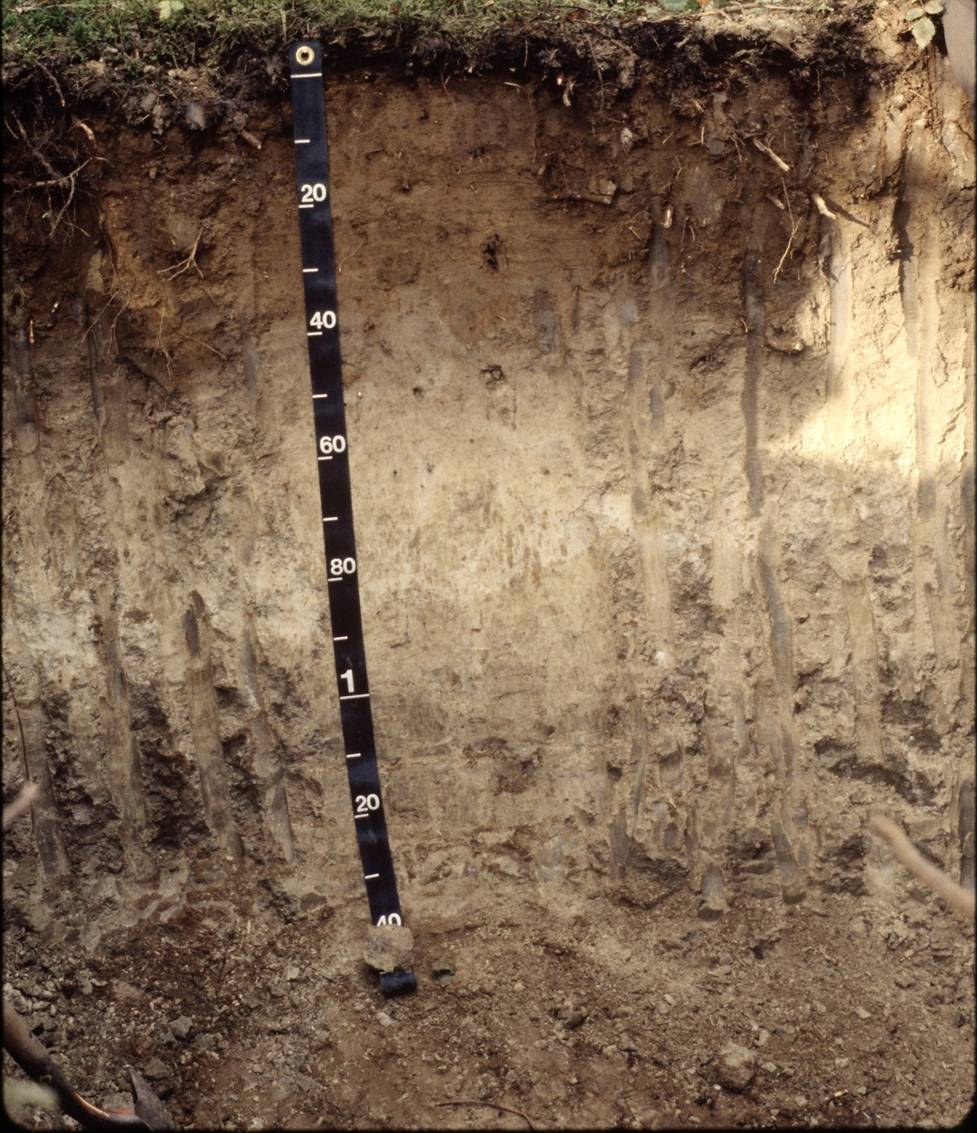
The deeper the soil, the more opportunity for pesticides to be retained and the less potential for leaching into groundwater.
Photo courtesy of USDA-NRCS
Notes:
The depth of the soil and the thickness of different soil horizons can influence the movement of water and soluble pesticides. The greater the distance to groundwater, the more opportunity there is for pesticides to be retained (adsorbed) and the lower the potential is for leaching. Likewise, the thicker the topsoil layer (where most of the organic material is located), the greater the opportunity for pesticide adsorption and retention within the rooting zone.
A soil is made up of individual layers with different soil properties, called soil horizons. The upper soil horizon generally contains considerable amounts of organic matter. As mentioned in the previous slide, organic matter increases pesticide adsorption and thus helps reduce leaching. Some soils contain restrictive soil horizons (e.g., thick clay layers) which can significantly reduce leaching and groundwater contamination. Soil depth, or the amount of soil overlaying bedrock, can also determine the potential for leaching. Soil temperature and soil moisture also vary with depth, and these properties also influence how well pesticides work and how long they remain in the active form.

Slide 26
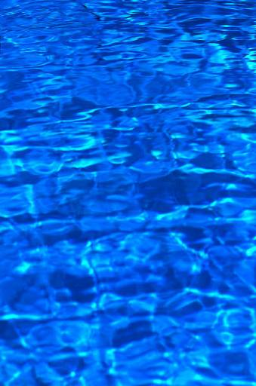
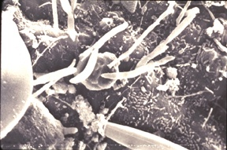

Pesticide Properties: Pesticides are degraded in the environment by microorganisms, sunlight, and
chemical processes.
Hydrolysis
occurs
at
high pH.
Notes:
Understanding how readily a pesticide degrades and the mechanism of how it degrades is important. Generally, after a pesticide degrades it becomes inactive in the environment, having no impact on water quality. However, there are some degradation products of pesticides (e.g., atrazine) that may still be active and contaminate water resources. Microbial degradation is the process in which soil microorganisms feed on pesticides and break them down. Soil conditions that favor microorganism reproduction increase the degradation process. These soil conditions include warm soil temperatures, aeration, adequate soil moisture, fertility, favorable pH, and adsorption. Simple chemical reactions that occur in the soil can also lead to pesticide degradation. Pesticides break down in water (hydrolysis). In natural field settings, hydrolysis occurs most often in soils with higher pH (alkaline soils). The mixing of water and the pesticide can result in hydrolysis, which causes pesticides to break down. Sunlight can cause another type of pesticide breakdown called photodegradation.

Slide 27

Pesticide properties can influence off-site movement.
Notes:
Pesticide active ingredients and formulations also have properties that you need to consider. When you purchase a pesticide, the active ingredient in the pesticide is the chemical that kills the pest. The formulation is the mixture of ingredients that comes in the container. It may contain water, stabilizers, and other ingredients to aid in application or safety.

Slide 28
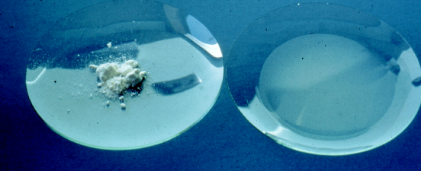
Water-soluble pesticides are more likely to move with water.
Notes:
Solubility is a pesticide’s ability to dissolve in water or some other solvent. In this picture, the dry pesticide product on the left was mixed with water and completely dissolved as shown on the right. This pesticide is water-soluble and more likely to move off site with runoff water or down through the soil into the groundwater. Once in the water, the pesticide can move and spread quickly.

Slide 29
Some pesticide products are more volatile than others.
Notes:
Some pesticide products are more prone to volatilize and move off site as vapor drift. The volatility of a pesticide in part depends on the formulation. For example, 2,4-D is available in both ester and amine forms. The amine form is more soluble in water and less volatile. Once airborne, volatile pesticides can move long distances off site with air movement.

Slide 30
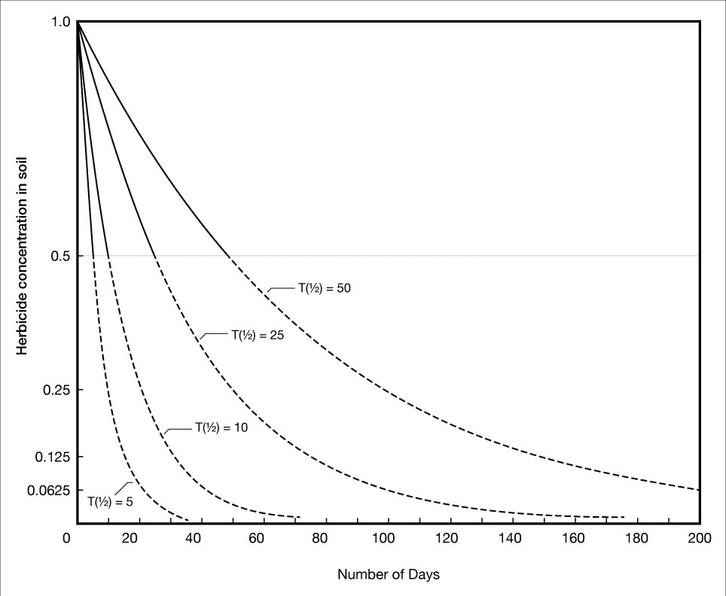
Persistence is the measure of how long a pesticide remains active before it degrades.
Notes:
Persistence is another important pesticide characteristic to consider when assessing impacts on the environment. Persistence is the measure of how long a pesticide remains active before it breaks down, or degrades. Persistent pesticides don’t break down for some time, which makes them more prone to move off site through dust, runoff, or leaching. Persistent pesticides have a greater potential to harm sensitive plants or animals. Factors that affect persistence of a pesticide include its volatility, solubility, and formulation, as well as soil moisture, soil and air temperature, and air movement.
Because persistent pesticides don’t degrade for longer periods of time -- often months to years -- they are more prone to move off site through blowing soil and/or runoff and leaching. This graph shows the number of days it takes for different compounds to break down. T(1/2) refers to the half-life of a compound, in other words, how long it takes the compound to break down to half its original amount. The curves on this graph show half lives of 5, 10, 25, and 50 days. In Oklahoma soils, 2,4-D has a half-life of 5 days and dicamba is much more persistent, with a half-life of 25 days.

Slide 31
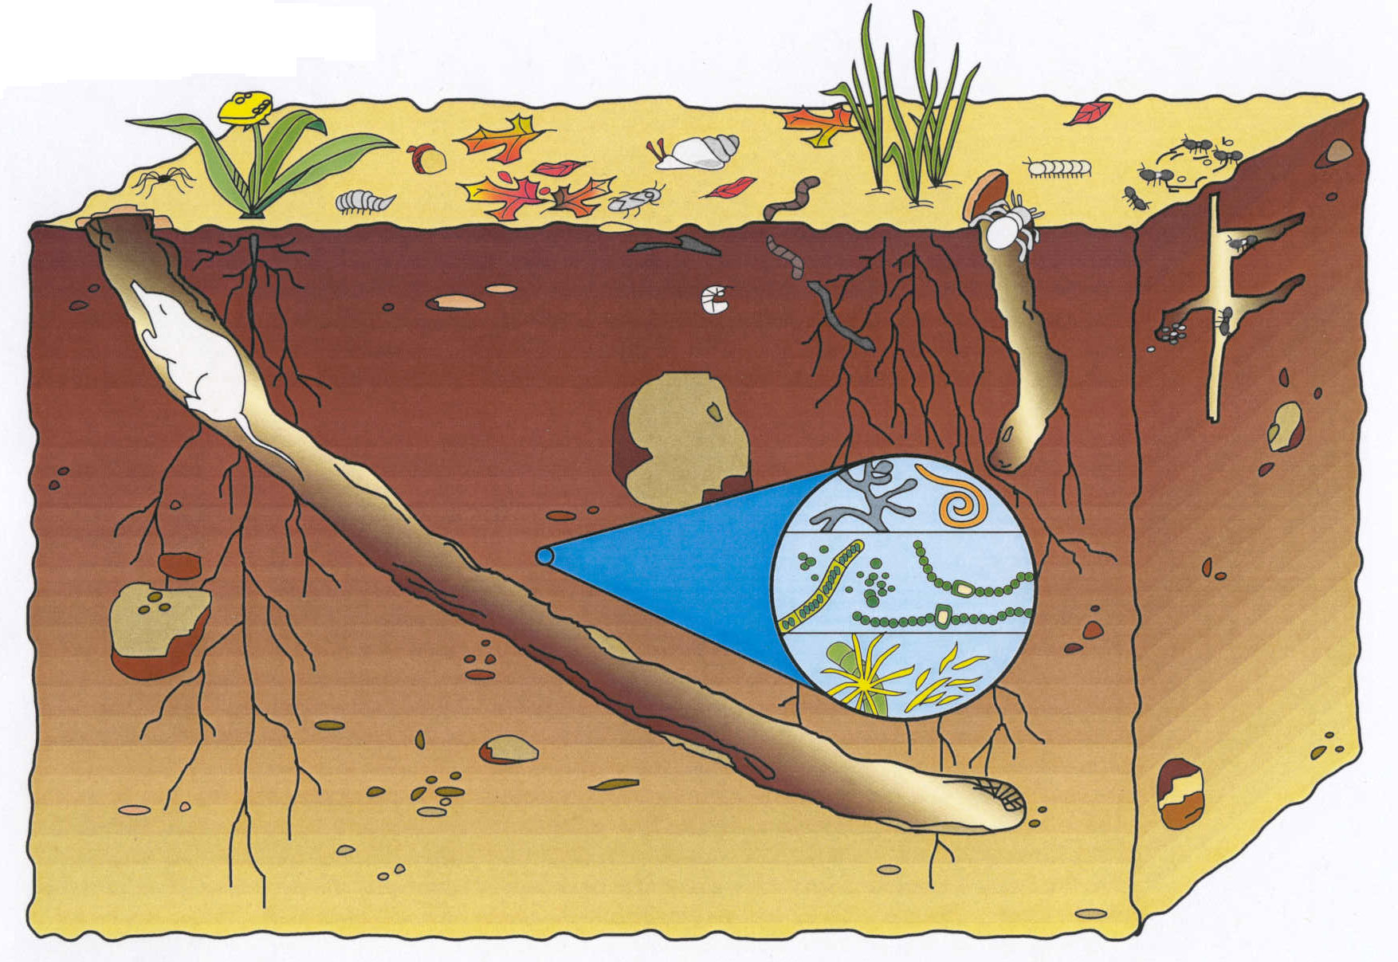
Pesticides are degraded in the environment by microorganisms, sunlight, and chemical processes.
Notes:
Pesticides are broken down in the environment by microorganisms, sunlight, and chemical processes. Microbial degradation is the most common cause of pesticide breakdown. Some soil microorganisms feed on pesticides and change them into other products. Soil conditions that favor microorganism reproduction increase the degradation process. Favorable conditions include warm soil temperatures, adequate aeration and soil moisture, soil fertility, favorable pH, and adsorption. The sun can cause pesticide degradation, called photodegradation. Nonliving processes also cause degradation. Simple chemical reactions occur in the soil. The mixing of water and the pesticide in the soil can result in hydrolysis, causing pesticides to break down.

Slide 32
Pesticide Movement: Leaching Potential
Notes:
Pesticide characteristics can affect a pesticide’s ability to move through the environment. You need to evaluate pesticide properties to determine whether there is a potential for the pesticide to leach. This table highlights two pesticides with very different leaching potential. While glyphosate is very soluble, it sticks strongly to soil particles (Koc) and this guards against movement. Picloram (shown in blue) is not as soluble as glyphosate, but does not stick strongly to soil particles and lasts longer in the environment.
Note to the presenter: this table can be changed to be locally and audience-appropriate. You might also consider screen shots from the PesticideWise web site (www.pw.ucr.edu) or demonstrating the use of this tool online.

Slide 33

Use science-based information to protect water.
Notes:
Pesticide use and excellent water quality can be compatible, but you must use science-based information and make thoughtful choices before you make any pesticide application.

Slide 34
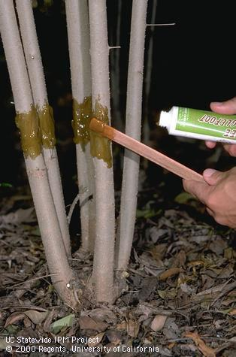
Manage pests responsibly by following an integrated pest management program.
by combust
Notes:
Integrated Pest Management (IPM) is a common-sense process for managing pests that focuses on evaluating the causes of a landscape problem and tailoring a solution that is safe and effective. IPM is not complicated, but you will need to know your pests and what IPM tools are available. For example, this picture shows someone applying a sticky barrier to stems to control certain insect pests.

Slide 35
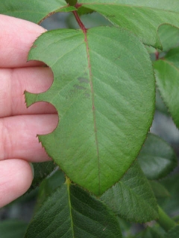
Identify the “perceived pest” and monitor pest populations.
Notes:
Start by determining what’s wrong with the plant or landscape. Sometimes it is perceived that there is a pest problem, when there is actually no pest involved. For example, the image shows leaf notches that were caused by leafcutter bees, a beneficial pollinator, that will not harm the plant otherwise. Many plant problems have abiotic (non-living) causes, including over- or under-watering, nutrient deficiencies, salts, mechanical injuries, too much sun or shade, temperature extremes, or wind damage. Master Gardener volunteers at your local Cooperative Extension office can help diagnose plant problems, determine whether a pest problem exists, and offer Integrated Pest Management solutions.

Slide 36
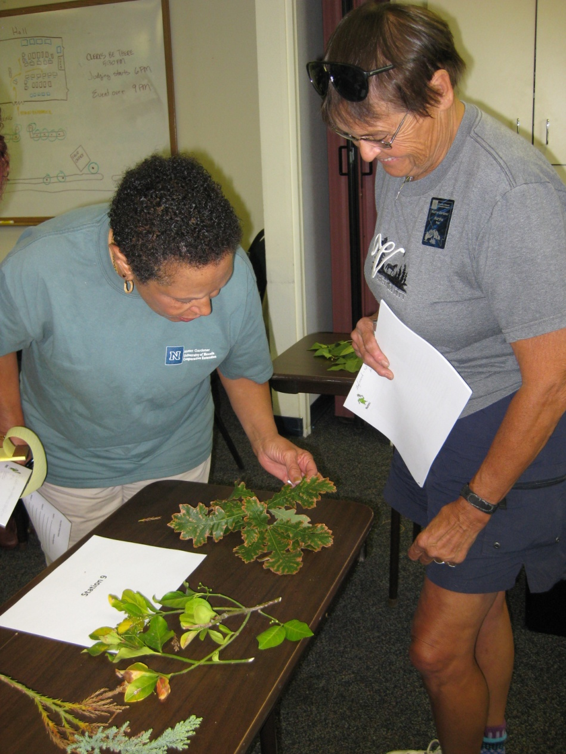
Determine if you need to take action and what management options are effective.
Notes:
If a pest is found, scout the site to determine how extensive the problem is. How many plants are involved? Is the amount of damage more than your client will tolerate? What methods are available for treating this pest? Many excellent management resources are available on the Web. It may be possible to use mechanical or cultural methods to manage the pest at an acceptable level.

Slide 37
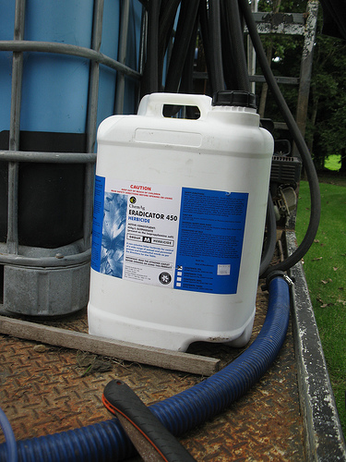
Consider whether use of a pesticide is warranted.
Notes:
In some cases, you may need to use a pesticide to avoid unacceptable levels of damage. If you choose to use a pesticide, make certain that the product is effective against the pest and appropriate for the site where it will be applied. Follow all application and safety guidelines carefully to minimize the potential for contaminating water.

Slide 38
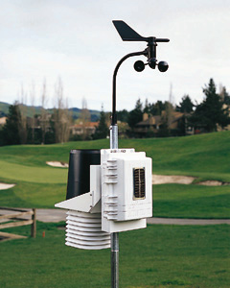
Always consider the weather before making an application.
Notes:
If data from a local weather station are not available, consult the National Weather Service Forecast Office in your area for weather information. Local forecasts are available at www.wrh.noaa.gov.

Slide 39
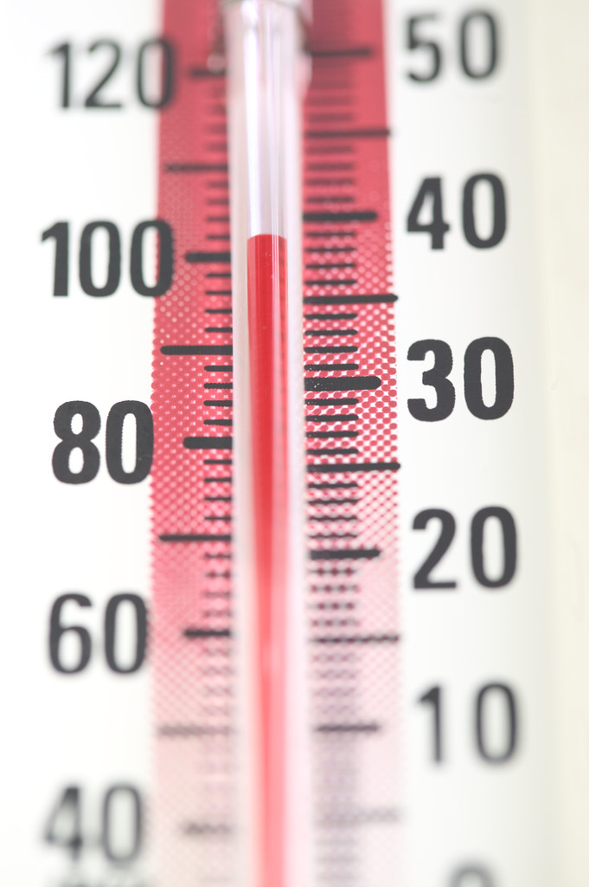
Avoid using pesticides when temperatures are high and humidity is low..
Notes:
To reduce the chance of vapor drift, avoid spraying when temperatures are high or when the air is very dry. Check the label for information on temperature and humidity ranges when you can make an application.

Slide 40
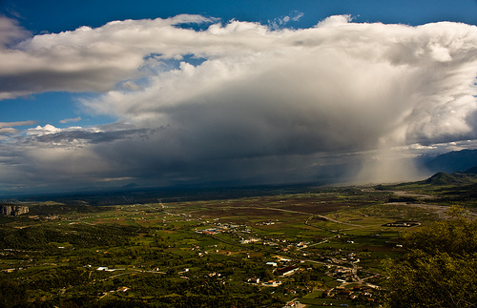
Check to see if rain is in the forecast.
Photo courtesy of eliaslar
Notes:
If rain is expected, delay the application. If the product washes off, it will not do a good job of controlling the pest, and the chances of runoff and water contamination are much higher. During dry months, monitor the forecast for the possibility of thunderstorms before making applications.

Slide 41
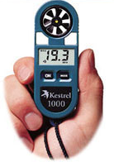
Use a wind meter to find out the actual wind speed.
Notes:
Don’t guess about wind speeds. Use a wind meter to determine the actual wind speed and direction before applying pesticides. Also consider whether occasional gusts could cause drift to occur. Continue to record wind speeds periodically during the application.

Slide 42

Never spray when there is an inversion.
Photo courtesy of john.d.mcdonald
Notes:
Check weather forecasts to see if inversions are predicted, and avoid applying pesticides during inversions. The air will be very still in an inversion. Inversions are more likely in the late afternoon and early morning.

Slide 43
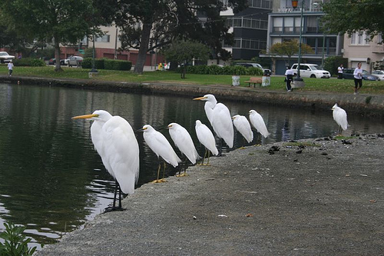
Survey your site before making a pesticide application.
Photo courtesy of bgreenlee
Notes:
What are some other measures that you can take to limit or mitigate the off-site movement of pesticides? One way is to take into account the layout of the property, such as slopes and impervious surfaces, water drains, and irrigation patterns. Always be aware of the site conditions. When it rains, where does water flow on the property? This will give you a good idea of where there is an increased chance that pesticides might move. Always assess the distance to surface water bodies and presence of storm drains prior to making a pesticide application.

Slide 44
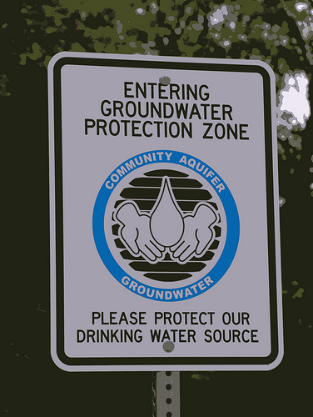
Find out the depth of the water table.
Photo courtesy of urbanworkbench
Notes:
Use soil data to help determine depth to water. See http://websoilsurvey.nrcs.usda.gov/ for an online tool. If wells are present on the property, flag their locations and avoid mixing, storing, or applying pesticides within 100 feet of the wellhead. Never apply pesticides directly over the wellhead. Wells that are old or not constructed to current standards are at greater risk of contamination.

Slide 45
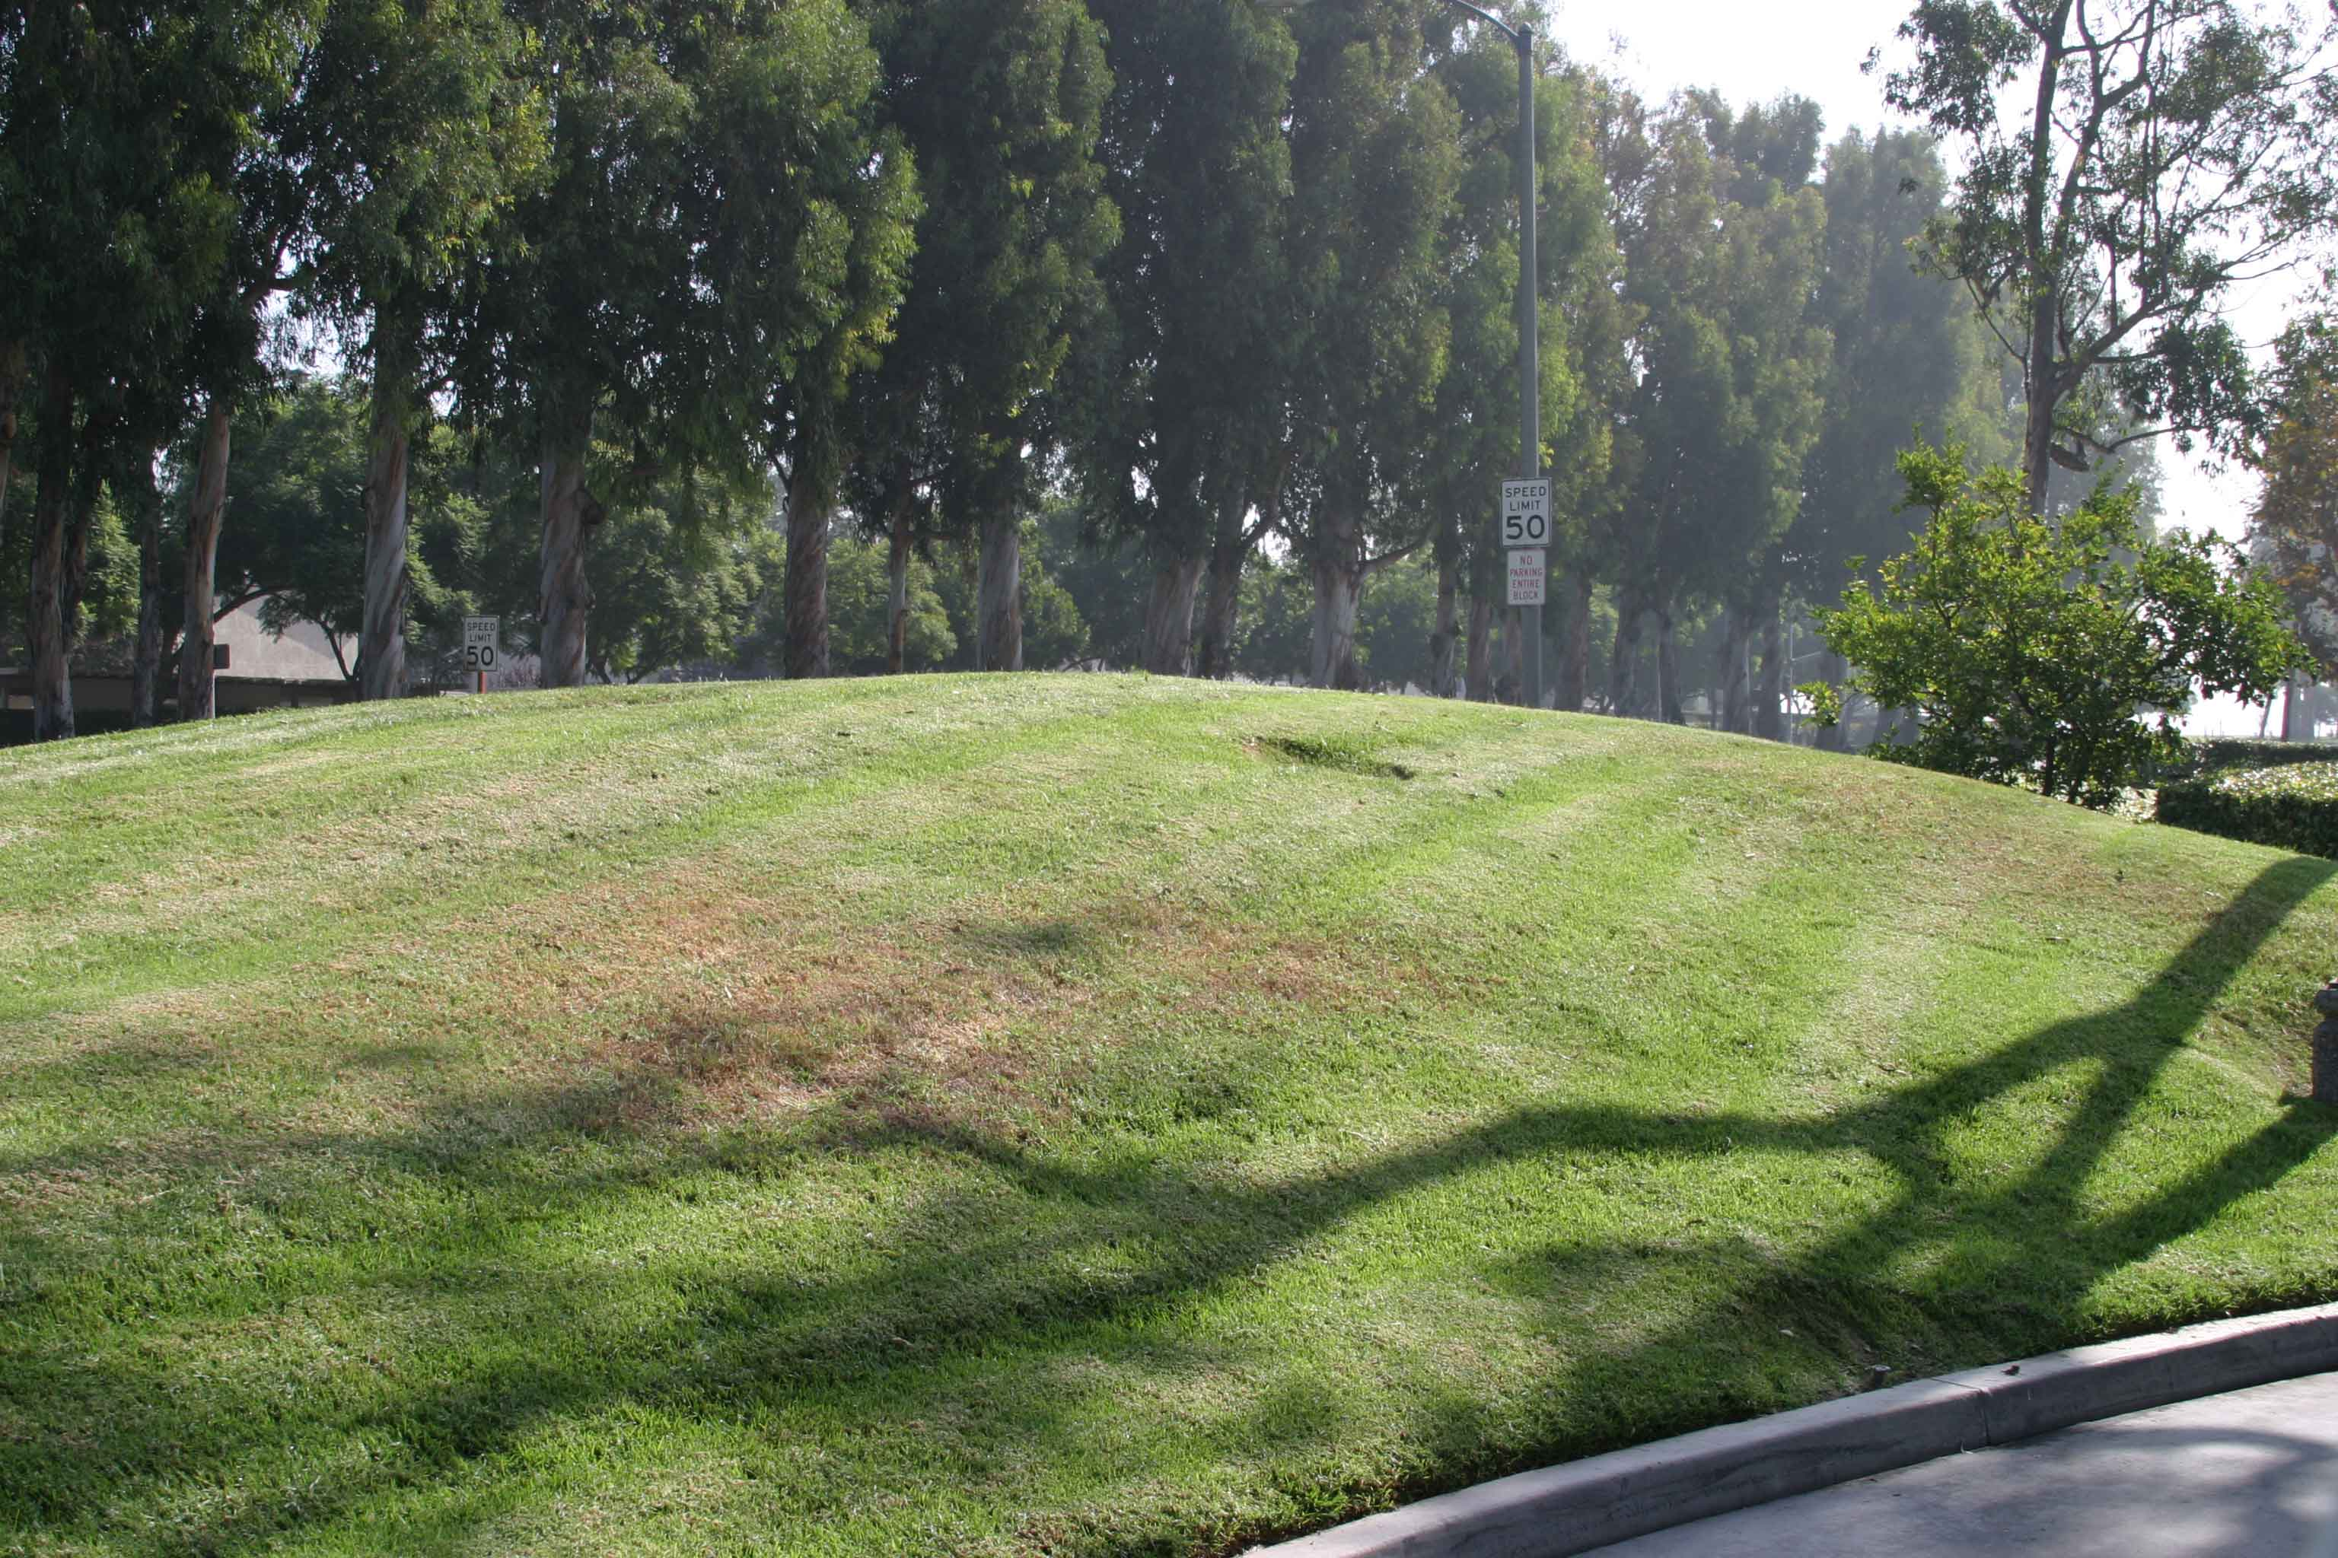
Do not apply pesticides on steep slopes with compacted soil.
Photo courtesy of udpslp
Notes:
These conditions increase the potential for runoff to occur. If applications must be made, seek assistance from an expert to select the least hazardous pesticide and most appropriate application method. Ensure that runoff does not occur when irrigating.

Slide 46
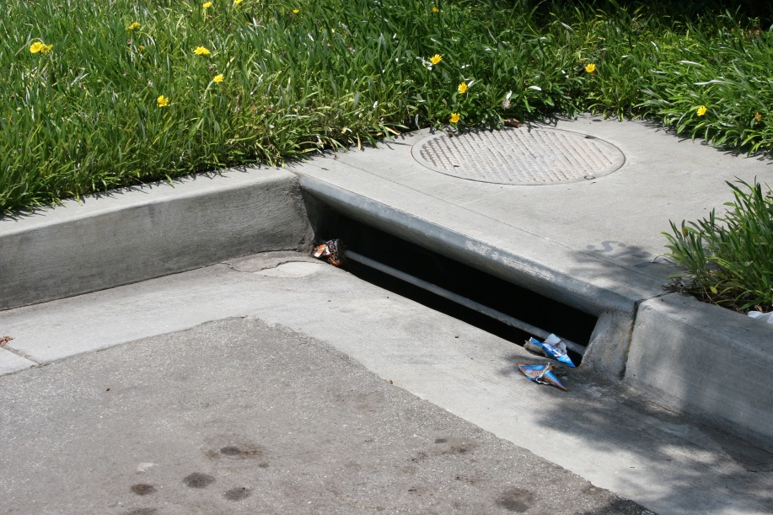
Avoid spraying pesticides on and around hard surfaces.
Notes:
Pesticides applied directly to, or drifting onto, landscape hard surfaces may move with irrigation or rain runoff, making their way into storm drains and ultimately into waterways where they may result in water quality impairments. Adsorption, absorption, and degradation of pesticides are impacted by the type of hardscape (e.g., concrete, decomposed granite, stone, asphalt) the pesticide comes into contact with as well as the overall chemistry of the pesticide.
Don’t let pesticides fall or drift onto hard surfaces. When you are using a granular formulation, sweep up any material that lands on a hard surface. Do not wash it away with a hose, because that will move the material into the storm drain system. Do not mix pesticides or clean equipment on hard surfaces (impervious), as this could also allow material to be carried into the storm drain system.

Slide 47
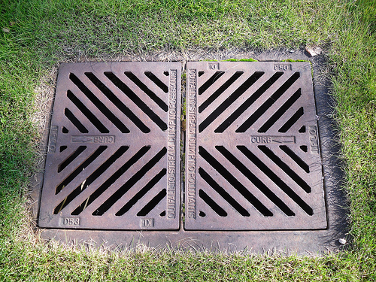
Do not apply over storm drains.
Photo courtesy of Crowbeak.Sasquatch
Notes:
Storm drains convey untreated runoff into adjacent water bodies. Applications made over storm drains greatly increase the risk of water contamination.

Slide 48
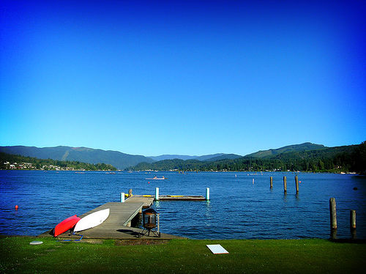
Establish buffers next to lakes, streams, and other water bodies.
Photo courtesy of esteban
Notes:
Buffers are untreated areas adjacent to water bodies. These areas provide protection from pesticide drift or runoff. Wider buffers should be established for pesticides that are very soluble or those that don’t adsorb strongly. Persistent pesticides may also need wider buffers. This photo is of a lawn next to Lake Whatcom in western Washington. This large lake is the primary source of drinking water for residents in the area. The best way to avoid water contamination here is with a no-spray buffer adjacent to the lake.

Slide 49
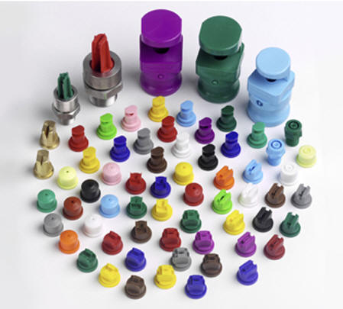
Choose the least hazardous, most effective product and application technique.
Notes:
Always use the principles of IPM when selecting an application method and pesticide. When choosing a pesticide, try to avoid broad-spectrum pesticides as well as products that are classified as “high runoff risk.” Try to choose another product that has a low-risk rating or statement that will also be effective on the pest you’re trying to control.
Pay close attention to the method of application. For example, a pesticide might be wiped onto a weedy pest at a sensitive site. Or a pinpoint stream application might be used on ant trails. Spray applications should be done with the coarsest droplet size that is appropriate for the application. There is less chance of drift, and the spray is less likely to be washed away by rain or sprinklers.
Remember, as a licensed professional applicator you are responsible for ensuring the correct pesticide and application method are chosen for the location.

Slide 50
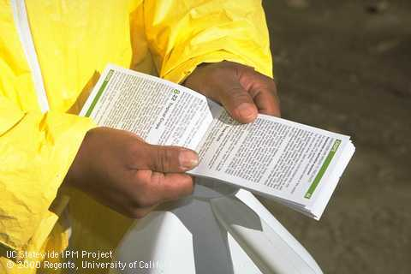
Read the label, paying particular attention to environmental precautions.
Notes:
Pesticide labels contain a great deal of useful information on the safe and legal use of these products, and it is your responsibility to read and follow all directions. A variety of environmental precautions may be listed on the label. For example, the label may include a groundwater advisory stating that the product may leach and enter groundwater. Specific mixing and loading requirements may also be included on the label.

Slide 51

Follow label rates and application intervals.
Photo courtesy of John Trenholm
Notes:
Carefully follow label rates and application intervals to maximize success and minimize chances of environmental contamination. You can find information about application timing at your local Extension office. Rates are determined after many research trials. Using excessive amounts of a pesticide or applying a pesticide more frequently than specified on the label does not result in better control and it is against the law.

Slide 52
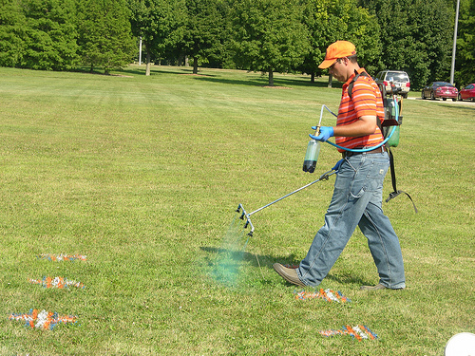
Always calibrate and maintain your equipment.
Photo courtesy of UNL PSEP
Notes:
Properly-maintained equipment is essential to ensure even applications at the correct rate, and to avoid leaks. Worn nozzles should be replaced at the beginning of each season or more frequently if needed. To avoid drift, ensure droplet size is appropriate for the weather conditions. Calibrate your equipment frequently to ensure you apply the correct amount of a pesticide.

Slide 53
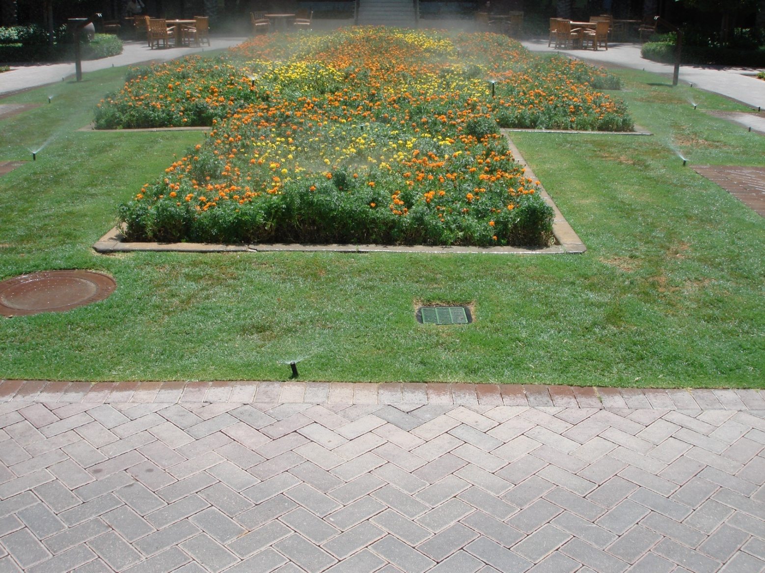
Manage irrigation to reduce the chance of pesticides moving into water.
Notes:
Never apply pesticides just before an irrigation cycle unless the label calls for watering the product into the soil. Time applications for a day or two following irrigation to give the product sufficient time to control the pest prior to the next irrigation cycle. Sprinkle irrigate in cycles to enhance infiltration and reduce runoff. As the applicator it is up to you to communicate clearly with the irrigator to ensure proper irrigation both prior to and following a pesticide application.

Slide 54
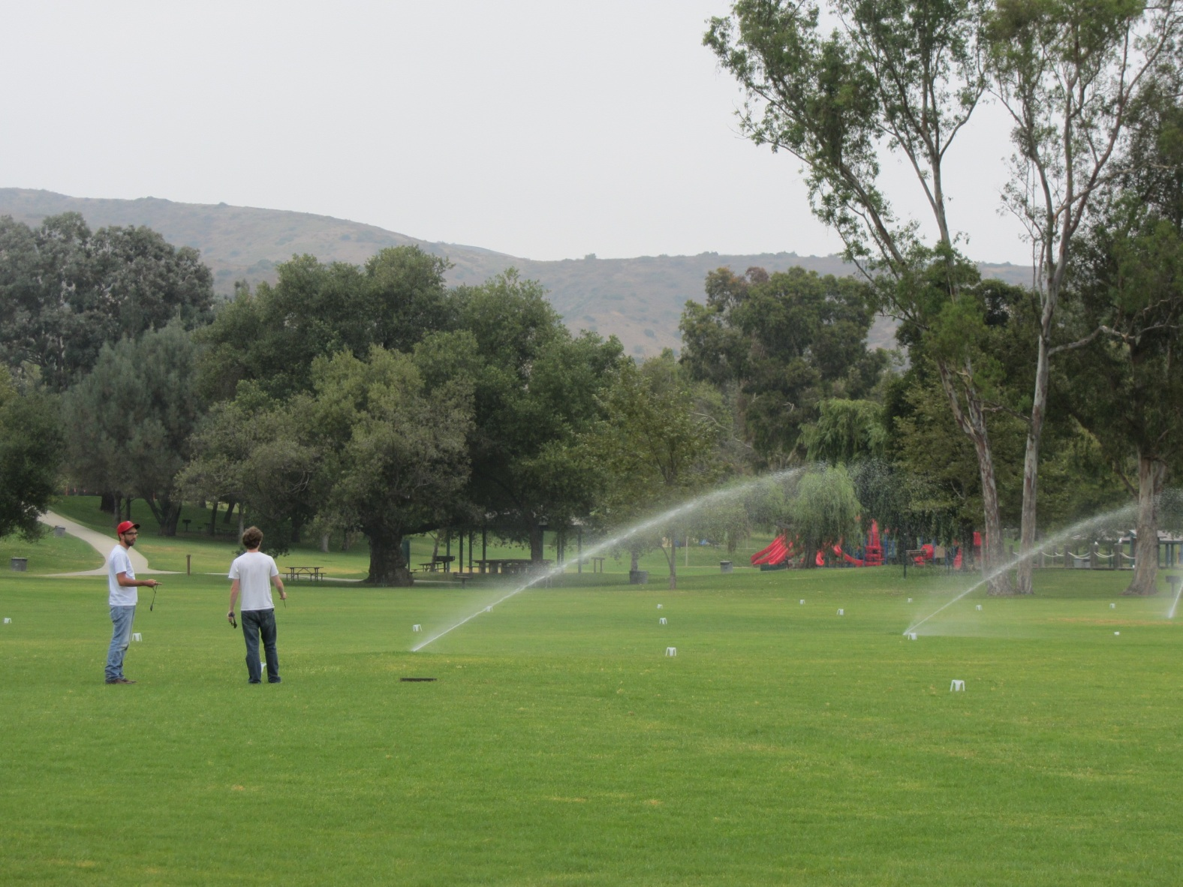
Adjust sprinkler heads so that water is applied only on vegetation.
Notes:
Irrigation audits or checks should be conducted on a regular basis to make adjustments to sprinklers to ensure irrigation falls only on vegetation. Irrigation falling on hardscape surfaces easily mobilizes pesticides on these surfaces. Fix leaking heads or emitters promptly. As a licensed professional applicator you should have a conversation with your clients on the importance of irrigation maintenance and its impact on pesticide movement.

Slide 55

Establish a buffer between the lawn and the sidewalk or street.
Notes:
When designing and installing landscapes, establish drip-irrigated landscaped buffers between sprinkle-irrigated lawns and paved surfaces to capture irrigation oversprays. Set lawn irrigation so any oversprays fall only on the buffer, and not on the pavement. Buffers can also be installed as part of a turf retrofit. Your clients may not be aware that lawn buffers are valuable in guarding against pesticide pollution. There may be an opportunity for you to educate your customers on the benefit of these landscape features in protecting water quality.

Slide 56
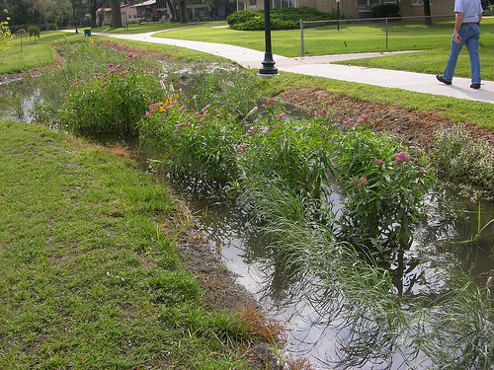
Install rain gardens to allow runoff to soak into the ground.
Photo courtesy of UNL PSEP
Notes:
Another landscape feature that you might suggest to your clients is a rain garden. Rain gardens can provide additional storage space and increase infiltration, reducing runoff. Pesticides can adsorb onto soil particles and be broken down by microbes or chemical processes. Rain gardens are easily added to existing landscapes.

Slide 57
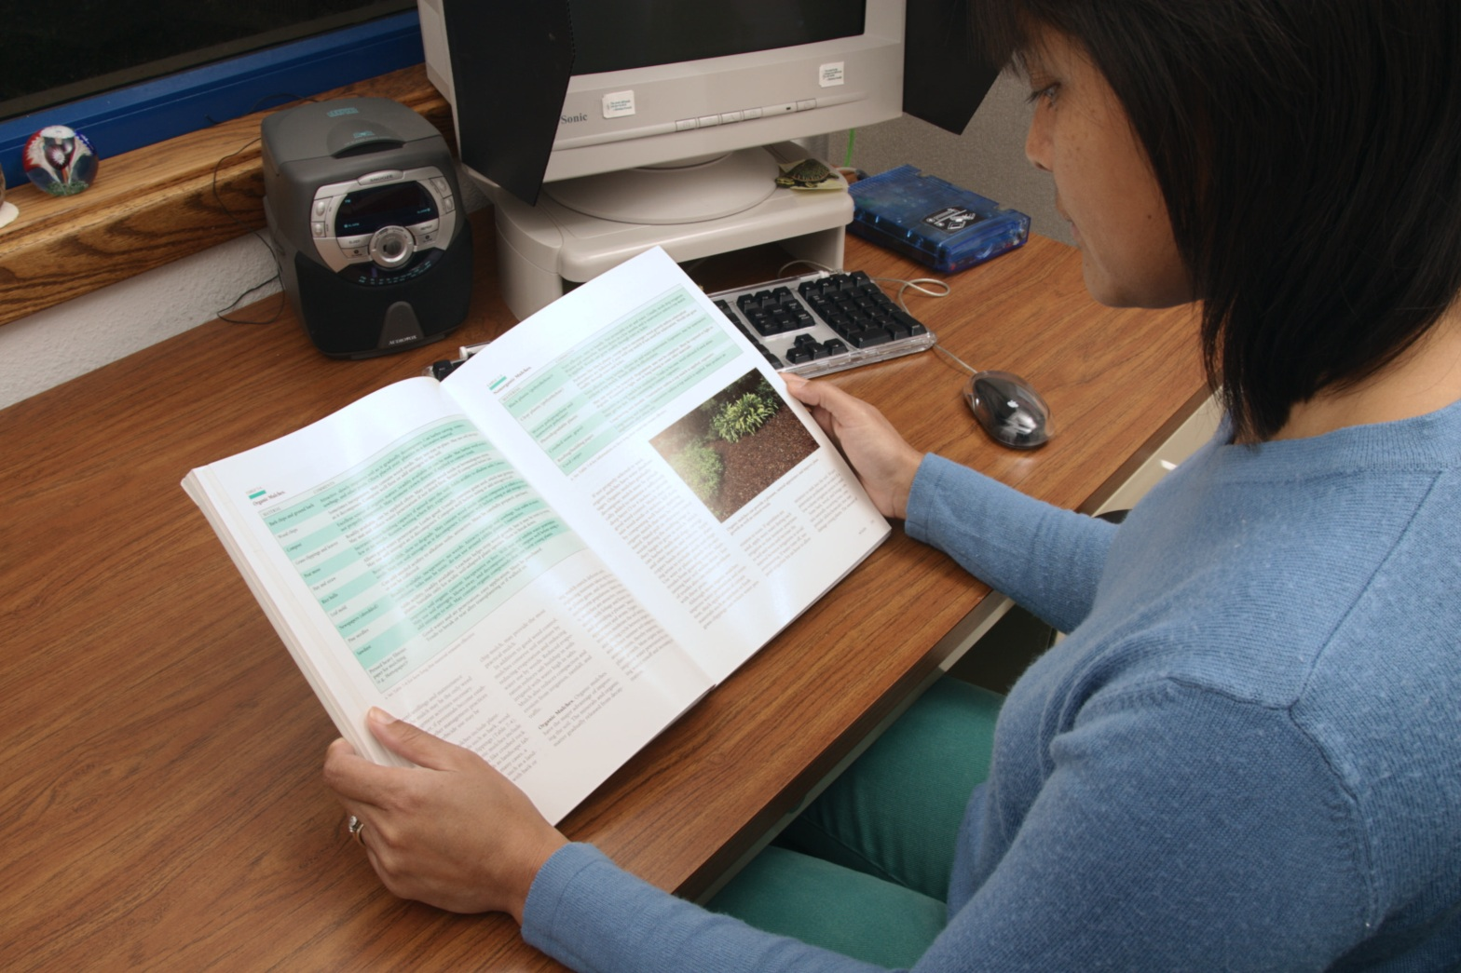
Local and regional resources are available.
Photo courtesy of UC ANR
Notes:
Seek out local and regional resources on IPM and water quality protection. Refer to the publications “Pesticide Choice: Best Management Practice (BMP) for Protecting Surface Water Quality in Agriculture,” UC ANR Publication 8161, and “Pesticide Selection to Reduce Impacts on Water Quality,” UC ANR Publication 8119. Both publications are available online at http://anrcatalog.ucdavis.edu.
Also consult the WaterTox database found on the UC IPM Web site (http://www.ipm.ucdavis.edu/TOX/simplewatertox.html) or the PesticideWise Web site (www.pw.ucr.edu) that provides information on aquatic toxicity ratings of pesticides. In addition, eXtension’s Pesticide Environmental Stewardship Web site (http://pesticidestewardship.org) is an excellent resource for the safe use of pesticides.
Your local county Cooperative Extension office is also a good resource for information.

Slide 58
The Western IPM Center would like to thank the following people for their assistance reviewing this training module:
Eric Bernsten, California State Water Resources Control Board
Herb Bolton, National Institute of Food and Agriculture
Wayne Buhler, North Carolina State University
Aimee Code, Northwest Center for Alternatives to Pesticides
Kevin Masterson, Oregon Department of Agriculture
Kelly McLain, Washington State Department of Agriculture
Bob Simmons, Washington State University
Andrew Sutherland, University of California
Sherman Takatori, Idaho State Department of Agriculture

